Slide 1
Kinsman Redeemer, Redeemer of Blood and the Cities of Refuge
Go’el haDam

Slide 2
What is a Kinsman Redeemer?
Notes:
The Bible introduces the concept of the kinsman redeemer in the book of Leviticus, chapter 25, verses 25-55. Here it is stated that the kinsman redeemer is one who is the nearest kinsman to a relative to buy back that which was lost or sold. This redemption also applies to a person if they sold themselves into slavery. The kinsman redeemer can purchase back that person's life into freedom.
According to the 1906 Jewish Encyclopedia (Jastrow, Prince, Kohler and Ginzberg), the concept of an avenger of blood was not unique to Israel. Under the subject of the Avenger of Blood the text reads, "Among primitive peoples of low political development—such as the ancient Greeks, Germans, and Slavs, some North American tribes, the modern Sicilians, Corsicans, and Arabs—the clan or family had to assume the right to protect itself."
It was considered one of the most important clan duties. It is still a custom among the desert Bedouins. Furthermore, one could not simply "pay off" a blood avenger as this would make the land "polluted by blood" (numbers 35:31). Several examples of unavenged blood exist throughout the biblical text, including Genesis 4:10, Isaiah 26:21, Ezekiel 24:7 and Job 16:18. As this was a role long ordained by God, the avenger of blood, then is regarded as not just a representative of the slain family member, but of YHWH Himself (Jewish Ecyclopedia, Avenger of Blood, Jastrow, Prince, Kohler and Ginzberg).

Slide 3
What is a Kinsman Redeemer?
Notes:
It is important to remember that though the Kinsman Redeemer purchases back the land or slave contract, he does not own the land or slave contract. The land and person are completely redeemed. The land goes back to its previous owner, the person is completely free.

Slide 4
Requirements of a Kinsman Redeemer
MUST be the nearest male relative.
MUST be able to perform the duties of the kinsman redeemer.
MUST be willing to perform the duties of the kinsman redeemer.
MUST fulfill ALL the obligations of the kinsman redeemer.
Notes:
The requirements to be a kinsman redeemer are:
must be the nearest male relative.
must be able to perform the duties of the kinsman redeemer.
must be willing to perform the duties of the kinsman redeemer.
must fulfill ALL the obligations of the kinsman redeemer.

Slide 5
Obligations of the Kinsman Redeemer
In the case of a murdered relative:
acts as Go-el who finds and kills the murderer. (Num 35:6-34)
In the case of lost property (including ones freedom if sold into slavery):
buys back the lost property.
In the case of a close relative dying and leaving a childless widow:
performs the act of the Levirite marriage.
Notes:
The obligations of a kinsman redeemer are:
In the case of a murdered relative, the kinsman redeemer must act as Go-el who finds and kills the murderer. (num 35:6-34)
In the case of lost property, the kinsman redeemer buys back the lost property.
In the case of a close relative dying and leaving a childless widow, the kinsman redeemer must perform the act of the levirite marriage. The first child if such a union is considered the child of the dead man.

Slide 6
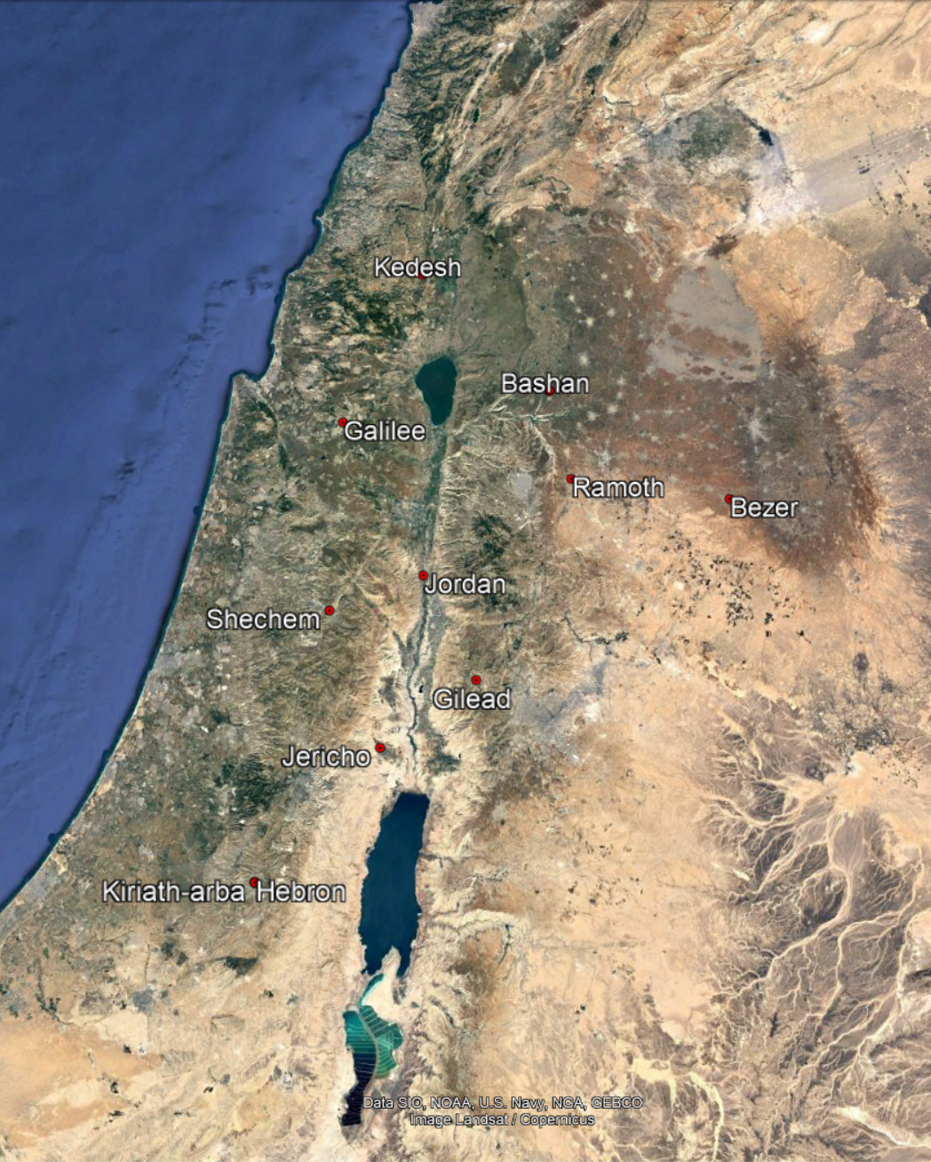
Cities of Refuge
Notes:
We cannot discuss the role of the Avenger of Blood "go'el hadam" (redeemer of blood) without also discussing the cities of refuge. The cities of refuge were codified by God to the Israelis before the conquest of the land (Numbers 35:9-34). Here it is written explicit instructions on the workings of a city of refuge. A city of refuge was a place that an unintentional murderer could run to in order to escape the avenger of blood. If one were guilty of intentional murder, running to a city of refuge is of no help because a council there would determine if the killing were accidental or intentional. If they found the person to have committed willful murder, then the guilty party is handed over to the avenger of blood. If the person was found to have committed an accidental killing, they had to stay within the city of refuge until the death of the High Priest or else face the avenger of blood.
In this description of the workings of the city of refuge we also receive the instruction that a verdict of guilt for murder requires two or more witnesses.
The right of the blood revenge was stopped when the Romans arrived.

Slide 7
Jesus is your kinsman Redeemer and Redeemer of Blood.
Notes:
So if God codified the rules regarding a kinsman redeemer and redeemer of blood, does He also abide by these laws when dealing with us?
Yes, he has and does.
During the events described in Genesis 3, ha-nachash ursurped the authority God had given man over this realm. We lost our place in God's Edenic vision. God, Himself, gave us Jesus. Fully human and fully God. As such, he is a near relative to all mankind. He is also able to fulfill the duties of the kinsman redeemer and he willingly performed those duties. He has paid the price to redeem our slavery to sin. He has paid the price to redeem all of creation to restoration. He has yet to reclaim the title deed to that position and land, but it will happen (revelation 4). At that time, too, he will act as the redeemer of blood. Against all who willingly shed the blood of God's human family. All that is left, then is to become a member of the family of God. If you, dear reader, are on the fence today. Remember that you must choose and the devil owns the fence.

