Slide 1
Book of Revelation

Slide 2
Resources
Bible.
ISV translation (https://isv.org)
את (Eth) Cepher
KJV.
Other sources are linked in the presentation.
Notes:
Two goals of this presentation
Encourage deeper study of the Bible. (apply acts 17:11)
Foster an appreciation for the underlying structure and integrity of these 66 books by 40 authors.

Slide 3
Acts 17:11 Principle
These people [Bereans] were more receptive than those in Thessalonica. They were very willing to receive the message, and every day they carefully examined the Scriptures to see if those things were so.
Notes:
Two goals of this presentation
Encourage deeper study of the Bible. (apply acts 17:11)
Foster an appreciation for the underlying structure and integrity of these 66 books by 40 authors.

Slide 4
Revelation 1
Revelation – Greek word Apocalypse means “the unveiling”.
This is the unveiling of Jesus the Messiah (one unveiling, not RevelationS)
Notice who is being revealed and to whom the revealing is given and from whom it is being given.
The word translated to “must happen soon” is the same word that we get tachometer from. It implies that when these things start they will happen quickly, not that these things will happen the week after next.
Notes:
1 This is the revelation of Jesus the Messiah, which God gave him to show his servants the things that must happen soon. He made it known by sending his messenger to his servant John,
2 who testified about this message from God and the testimony about Jesus the Messiah.

Slide 5
Revelation 1
…signified [It] by his angel…
This message was rendered into signs.
Each of these signs are explained if not in the book itself, then somewhere else in the bible.
The book of Revelation is in code but the code is explained elsewhere in the Bible.
Notes:
KJV:
1 The Revelation of Jesus Christ, which God gave unto him, to shew unto his servants things which must shortly come to pass; and he sent and signified [it] by his angel unto his servant John

Slide 6
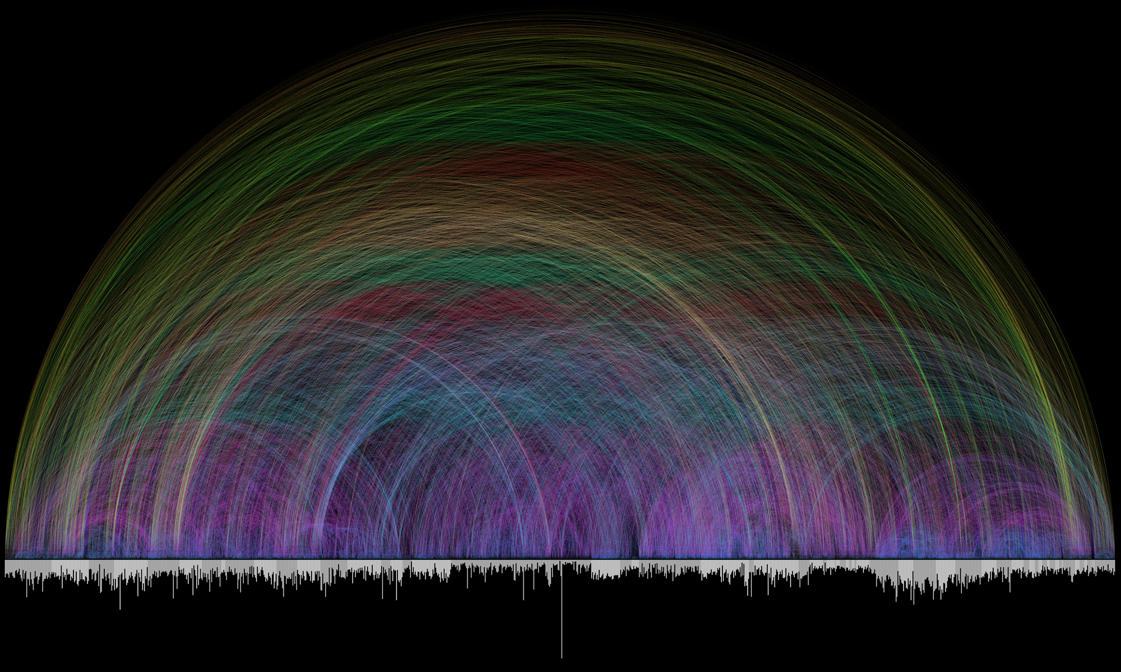
Revelation 1
The bible is a collection of 66 books written by 40 authors over thousands of years.
Yet it contains an integrity of structure and content.
Every word, every detail is placed with deliberate design and control.
It was given to us from outside our time domain. Written by one who knew the end from the beginning.
Notes:
Plot is from http://www.chrisharrison.net/index.php/Visualizations/BibleViz

Slide 7
Revelation 1
Special Blessing
The only book in the Bible that promises a special blessing to the one who reads and obeys it (this book).
Notes:
3 How blessed is the one who reads aloud and those who hear the words of this prophecy and obey what is written in it, for the time is near!

Slide 8
Revelation 1
Titles of Christ
These will be used throughout the book, but particularly in the seven letters.
Notes:
4 From John to the seven churches in Asia. May grace and peace be yours from the one who is, who was, and who is coming, from the seven spirits who are in front of his throne,
5 and from Jesus the Messiah, the witness, the faithful one, the firstborn from the dead, and the ruler over the kings of the earth. To the one who loves us and has freed us from our sins by his blood
6 and has made us a kingdom, priests for his God and Father, be glory and power forever and ever! Amen.
7 Look! He is coming in the clouds.
Every eye will see him,
even those who pierced him,
and all the tribes of the earth will mourn
because of him.
So be it! Amen.
8 “I am the Alpha and the Omega,” declares the Lord God, “the one who is, who was, and who is coming, the Almighty.”

Slide 9
Revelation 1
Chapters two and three, the letters, are the most important to us.
.
Notes:
9 I am John, your brother and partner in the oppression, kingdom, and patience that comes because of Jesus. I was on the island called Patmos because of the word of God and the testimony about Jesus.
10 I came to be in the Spirit on the Day of the Lord, when I heard a loud voice behind me like a trumpet,
11 saying, “Write on a scroll what you see, and send it to the seven churches: Ephesus, Smyrna, Pergamum, Thyatira, Sardis, Philadelphia, and Laodicea.”

Slide 10
Background
Written between 90 and 96 AD.
John was sent to Patmos near the end of Domitian’s reign. Irenaeus (AD175-185) Against Heresies, 5.30.3
Irenaeus was the student of Polycarp who was the student of John.
Eusebius tells us that John was let go from Patmos after Domitian died. Eusebius (340). Ecclesiastical History, 3.23
Where was it written?
Written by John on Patmos. We are told as much within the book itself.

Slide 11
Background
Where is Patmos?
Patmos is an island in the Aegean sea. It is part of Greece, located very close to modern day Turkey.
Notes:
Patmos information source: https://www.greeka.com/dodecanese/patmos/patmos-history.htm
During roman times, the island was used as a place of exile for convicts.
A basilica was built during the Byzantine period after 284 AD. It was destroyed by Arab raiders between the 6th and 9th century. The monastery found there now was built after 1085 on top of the ruins of the basilica.
The island became part of Greece in 1948.
The island is now a popular tourist destination especially among orthodox pilgrims.

Slide 12
Background
“Day of the Lord” / “The Lord’s Day”
Assumed to be Sunday…
Sunday was not made into the “official day of worship” until 4th century. Long after the Bible canon was written.
Everywhere else in the bible that speaks of the Lord’s Day is in reference to the last day. The day of the Lord’s Wrath, the Great and Terrible Day of the Lord, etc.
John was transported through time, to THE last day. He wrote what he actually saw, heard and felt.

Slide 13
Background
Revelation is traditionally thought to be a difficult book to understand.
It contains a great number of symbols and idioms.
One bible teacher explains that Revelation is written in code and that every code is explained somewhere else in the bible.
Becomes much more understandable as one becomes more familiar with the bible as these idioms are used throughout the bible especially in the Old Testament. (Principle of expositional constancy)

Slide 14
Background
Who is John?
Born in Bethsaida.
Father : Zebedee, Mother: Salome
Not the one who is daughter of Herod.
Galilean fisherman partnered with Peter and Andrew.
Early disciple of John the Baptist.
Well connected.
Knew the high priest.
Nicodemus.

Slide 15
Background
Who is John?
One of the twelve disciples of Jesus.
One of the “inner circle”.
Present at the mount of transfiguration.
Present at raising of Jairus daughter.
Olivet Discourse.
Wrote five books in the New Testament.
Gospel of John
John 1 – a sermon
John 2 – a personal letter to Mary, mother of Jesus
John 3 – a letter to his friend Gaius.
Mary’s care consigned to him at the cross.

Slide 16
Background
Who is John?
After being let go from Patmos, he retired in Ephesus.

Slide 17
Background
What is Revelation about?
Revelation is a book of Prophecy about the consummation of all things.
What was started in Genesis, is completed in Revelation.
404 verses with > 800 allusions to the Old Testament.
This is usually why people have such trouble with understanding the book. The old testament is not well taught or understood in modern churches.

Slide 18
Background
Alternative Views
Preterist
Events described in Revelation have already happened.
Historical
Events described in Revelation have already happened.
Idealist
Revelation is allegorical
Futurist
Revelation prophetic

Slide 19
Background
Alternative Views
Revelation, itself, claims to be prophetic.
(1:3; 22:7; 10, 18-19)

Slide 20
Background
Eschatology
Study of end things.
Hermeneutics
Methodology of interpretation.

Slide 21
Background
Amillennial
Post-Millennial
Premillennial
Jesus will not literally reign for a thousand years.
Jesus does not come back until after the millennium.
Jesus literally comes to reign on earth.
Post-Tribulation
Post-Trib
Mid-Tribulational
Mid-Trib
Pre-Tribulational
Pre-Trib
Allegorical
Hermeneutics
Literal

Slide 22
Revelation 1
Physical description of glorified Jesus.
Description features will also be used in the letters.
The Bible does use figures of speech.
Similes
Metaphors
Over 200 uses of figures of speech.
Figures of Speech Used in the Bible by E. W. Bullinger (1837-1913)
I have a copy on my pad computer
Notes:
12 Then I turned to see who was talking to me, and when I turned I saw seven gold lamp stands.
13 Among the lamp stands there was someone like the Son of Man. He was wearing a long robe with a gold sash around his chest.
14 His head and his hair were white like wool, in fact, as white as snow. His eyes were like flames of fire,
15 his feet were like glowing bronze refined in a furnace, and his voice was like the sound of raging waters.
16 In his right hand he held seven stars, and out of his mouth came a sharp, two-edged sword. His face was like the sun when it shines with full force.
Pre-millenial, pre-trib.
Predorists believe that all prophecy has already happened.
Amillenials do not believe in a literal 1000 year reign of Jesus on Earth.

Slide 23
Revelation 1
More titles
Explanation of the seven lamp stands.
Jesus holds them in his hand
AND
Is among them
Notes:
17 When I saw him, I fell down at his feet like a dead man. But he placed his right hand on me and said, “Stop being afraid! I am the first and the last,
18 the living one. I was dead, but look—I am alive forever and ever! I have the keys of Death and Hades.
19 Therefore, write down what you have seen, what is, and what is going to happen after this.
20 The secret meaning of the seven stars that you saw in my right hand and the seven gold lamp stands is this: the seven stars are the messengers of the seven churches, and the seven lamp stands are the seven churches.”

Slide 24
Revelation 1
Verse 19 is the outline to the book.
Write what you have seen
Everything in chapter 1 to this point. The description of Jesus, etc.
What is
Chapter 2 and 3. The seven letters.
What is going to happen after this.
Greek word – meta tauta.
Chapter 4 begins with the same word.

Slide 25
Seven Letters

Slide 26
Seven Letters
Common Structure (7 parts)
Church name
Title of Jesus
Commendation
Concern
Exhortation
Promise to the overcomer
Closing phrase.

Slide 27
Seven Letters
Who is an overcomer?
1 John 5:2-5
This is how we know that we love God’s children: we love God and keep his commandments. For this demonstrates our love for God: We keep his commandments, and his commandments are not difficult, because everyone who is born from God has overcome the world. Our faith is the victory that overcomes the world. Who overcomes the world? Is it not the person who believes that Jesus is the Son of God?

Slide 28
Seven Letters
Some interesting variances.
Two of the letters have no admonition.
Two of the letters have no commendation.
First three have the promise after the closing phrase.
The last four include the promise in the body of the letter.

Slide 29
Seven Letters
Why these seven churches out of all of the ones present at the time of John writing Revelation?
Jerusalem? Antioch? Rome?

Slide 30
Seven Letters
Four levels of understanding of the letters.
Literal – These seven churches did actually exist.
Sir William Ramsey investigated and found not only did these churches exist, but they also had the issues written about in the letters.
Global – Each of these letters is written to the churches. Every church.
Personal – Every letter is written to “he who has an ear”.
Prophetic – The letters, in the order they are written, lay out the history of the church in advance.

Slide 31
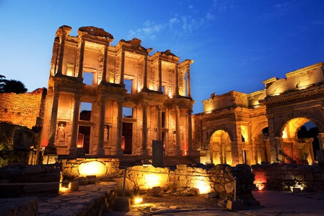
Seven Letters
Ephesus
Meaning: “Desired One”
Location: South of modern Selcuk
Title: “To the messenger of the church in Ephesus, write:
‘The one who holds the seven stars in his right hand, the one who walks among the seven gold lamp stands, says this:
Library of Celsus at Ephesus
Notes:
Acts 18-20
Ephesians 3; 5

Slide 32
Seven Letters
Ephesus
Who is the Desired one?
Is Jesus speaking of God, Himself or you?
Read Ephesians 1 & 2.
Library of Celsus at Ephesus
Notes:
Acts 18-20
Ephesians 3; 5

Slide 33
Seven Letters
Ephesus
Commendation: ‘I know what you’ve been doing, your toil, and your endurance. I also know that you cannot tolerate evil people. You have tested those who call themselves apostles, but are not, and have found them to be false. You have endured and suffered because of my name, yet you have not grown weary.
Library of Celsus at Ephesus

Slide 34
Seven Letters
Ephesus
Paul visited the elders of Ephesus and warned them to watch for “wolves in sheep’s clothing”.
They apparently took his warning to heart. According to the letter they heeded his warning.
Housed the Temple of Artemis called the Artemesium, aka the Temple of Diana.
Library of Celsus at Ephesus
Artemis = Diana = Hecate = Kali = Astarte = Ishtar = Semiramis, wife of Nimrod.

Slide 35
Seven Letters
Ephesus
Concern: However, I have this against you: You have abandoned the love you had at first.
Library of Celsus at Ephesus
While they apparently listened to Paul’s warning, it appears they worked so hard at it that they forgot their first love. Put another way, they became so busy about the business of the King that they did not have time for the King.

Slide 36
Seven Letters
Ephesus
What does this mean?
The Ephesians were so good at rooting out heresy that they lacked devotion.
Love and hope are casualties to the heresy-hunting.
Library of Celsus at Ephesus

Slide 37
Seven Letters
Ephesus
Exhortation: Therefore, remember how far you have fallen. Repent and go back to what you were doing at first. If you don’t, I will come to you and remove your lamp stand from its place—unless you repent. ⁶ But this is to your credit: You hate the actions of the Nicolaitans, which I also hate.
Library of Celsus at Ephesus
Ephesus is a ruin today.

Slide 38
Seven Letters
Ephesus
Promise to the overcomer: ‘Let everyone listen to what the Spirit says to the churches. I will give the privilege of eating from the tree of life that is in God’s paradise to everyone who overcomes.’”
It once contained a “sacred grove” which was called the Ortygia. It was thought to be the birth place of Artemis.
Library of Celsus at Ephesus
Prophetic position: Apostolic church (33-100 AD)

Slide 39
Seven Letters
Ephesus
Ephesus once contained a “sacred grove” which was called the Ortygia. It was thought to be the birth place of Artemis.
Library of Celsus at Ephesus

Slide 40
Seven Letters
Ephesus
Myths of the heathen:
Persians: Homa-tree growing in the spring Arduisur.
Hindu: Halpasoma-tree fed by the waters of immortality.
Arab: Tuba-tree
Greek: Lotus-tree
Assyria: Tree adorned by royal figures and guarded by d’jinn.
Library of Celsus at Ephesus

Slide 41
Seven Letters
Ephesus
Admonitory Level
Ephesus | Devotion, not just doctrine
Library of Celsus at Ephesus

Slide 42
Seven Letters
Ephesus
Personal Level
Ephesus | Neglected priorities
Library of Celsus at Ephesus

Slide 43
Seven Letters
Ephesus
Promise to the Overcomer
Ephesus | Eat of the Tree of Life
Library of Celsus at Ephesus

Slide 44
Seven Letters
Nicolaitans
Who are the Nicolaitans? We know they were apparently teaching the teachings of Balaam.
Could be (strong's concordance) from Niko "conquest, victory, triumph, those who dominate over the defeated", Lai (laos) "people. Tes (or Ton) "the" - Conqueror of the people.

Slide 45
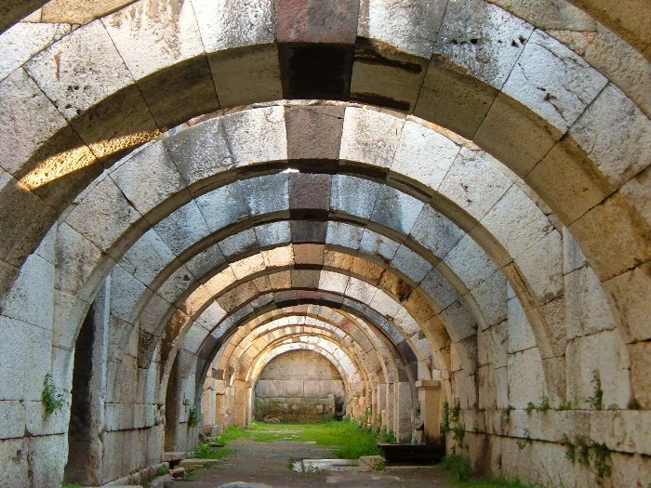
Seven Letters
Smyrna
Meaning: “Myrrh” from Greek Smurna from the Hebrew root that is Myrrh. Meaning death.
Location: Modern city of Izmir
Title: ‘The first and the last, who was dead and became alive
Commendation: ‘I know your suffering and your poverty—though you are rich—and the slander committed by those who claim to be Jews but are not. They are the synagogue of Satan.

Slide 46
Seven Letters
Smyrna
First and the Last: Mentioned in Isaiah 41:4, Isaiah 44:6, Isaiah 48:12, Revelation 1:11, Revelation 1:17-18, Revelation 2:8, Revelation 22:13.
Seven times.
Commendation: ‘I know your suffering and your poverty—though you are rich—and the slander committed by those who claim to be Jews but are not. They are the synagogue of Satan.

Slide 47
Seven Letters
Smyrna
Tribulation as a metaphor for oppression, affliction, distress.
This tribulation isn’t the great tribulation. It isn’t even the oppression of the Romans. That didn’t happen for several years after.
The earliest church persecution came from the Jews.

Slide 48
Seven Letters
Smyrna
The earliest church persecution came from the Jews.
It came in the form of Legalism:
Demands that the Gentiles be circumcised. (Acts 15:1,10)
Peter is rebuked by Paul (Gal 2:11, 3:1-3)
Peter agrees (2 Pet 3:15-16)

Slide 49
Seven Letters
Smyrna
Examples are found to occur in:
Antioch (Acts 13:50)
Iconium (Acts 14:2,5)
Lystra (Acts 14:19)
Thessalonica (Acts 17:5)

Slide 50
Seven Letters
Smyrna
A tragic doctrine made its way into the early church. That is the idea that Israel was replaced by the church. Called replacement theology.

Slide 51
Seven Letters
Smyrna
Some early issues working against the church were:
Legalism : denial of Christ’s completed work.
Gnosticism : denial of Christ’s humanity.
Caesar worship: denial of Christ’s Lordship.

Slide 52
Seven Letters
Smyrna
Myrhh is a tree sap that when crushed releases its aroma. It is used for burials and is representative of death.
What is meant by the ten days? Possibly 10 roman rulers?

Slide 53
Seven Letters
Smyrna
None
Concern:

Slide 54
Seven Letters
Smyrna
Exhortation: Don’t be afraid of what you are going to suffer. Look! The Devil is going to throw some of you into prison so that you may be tested. For ten days you will undergo suffering. Be faithful until death, and I will give you the victor’s crown of life.

Slide 55
Seven Letters
Smyrna
What is meant by the “10 days”?
Perhaps the 10 roman emperors over the next 250 years.

Slide 56
Seven Letters
Smyrna
54-68 Nero
(Paul beheaded; Peter crucified upside down)
95-96 Domitian
(John exiled)
104-117 Trajan
(Ignatius burned at the stake)
161-180 Marcus Aurelius
(Polycarp martyred)
200-211 Septimus Severus
(Killed Irenaeus)

Slide 57
Seven Letters
Smyrna
235-237 Maximus
(Killed Ursula and Hippolytus)
249-251 Decius
Valerian
270-275 Aurelian
303-313 Diocletian
Christians were a convenient scape-goat when disaster effected Rome. According to Fox’s Book of Martyrs, 5 million believers died during this period.

Slide 58
Seven Letters
Smyrna
The bible talks about crowns:
Crown of Life - for those who suffered for His sake. (Jas 1:12; Rev 2:10)
Crown of Righteousness – for those who loved His appearing. (2 Tim 4:8)
Crown of Glory – for those who fed the flock. (1 Pet 5:4)
Crown of Incorruptible – for those who press on steadfastly. (1 Cor 9:25)
Crown of Rejoicing – for those who win souls. (1 Thess 2:19)

Slide 59
Seven Letters
Smyrna
Promise to the Overcomer: ‘Let everyone listen to what the Spirit says to the churches. The one who overcomes will never be hurt by the second death.’
Prophetic position: Persecuted church (100-313 AD)

Slide 60
Seven Letters
Smyrna
Admonitory Level
Ephesus | Devotion, not just doctrine
Smyrna | Endure Persecution
Library of Celsus at Ephesus

Slide 61
Seven Letters
Smyrna
Personal Level
Ephesus | Neglected priorities
Smyrna | Satanic opposition
Library of Celsus at Ephesus

Slide 62
Seven Letters
Smyrna
Promise to the Overcomer
Ephesus | Eat of the Tree of Life
Smyrna | Not hurt of the Second Death
Library of Celsus at Ephesus

Slide 63
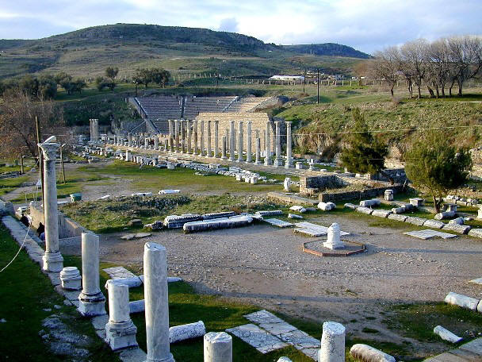
Seven Letters
Pergamos
Meaning: Inappropriate marriage
or Fortified tower
Location: Modern city of Bergama
Title: ‘The one who holds the sharp, two-edged sword’
Commendation: ‘I know where you live. Satan’s throne is there. Yet you hold on to my name and have not denied your faith in me, even in the days of Antipas, my faithful witness, who was killed in your presence, where Satan lives.

Slide 64
Seven Letters
Pergamos
Pergamos was the seat of the provincial koinon who was both the chief and priest of the imperial cult.
This is not Herod Antipas. Only martyr mentioned by name in the Book of Revelation.

Slide 65
Seven Letters
Pergamos
Antipas means “against all”. A story by Simeon Metaphrastes tells us that, during Domitian’s reign, Antipas was placed in a red-hot brazen bull. He died giving thanksgiving and prayers.

Slide 66
Seven Letters
Pergamos
Hold fast my name speaks of ambassadorship of taking on the name of the King.
The third commandment is not about vocabulary, it is about ambassadorship.

Slide 67
Seven Letters
Pergamos
Concern: But I have a few things against you: You have there some who hold to the teaching of Balaam, the one who taught Balak to put a stumbling block before the people of Israel so that they would eat food sacrificed to idols and practice immorality. You also have some who hold to the teaching of the Nicolaitans.

Slide 68
Seven Letters
Nicolaitans
Here we have a clue as to what the Nicolaitans were doing. Notice, however, Jesus isn’t hating the Nicolaitans, he is hating their doctrine.
Also note that in the Ephesus letter their deeds were referred to. Now they have become doctrine.

Slide 69
Seven Letters
Nicolaitans
Apparently the Nicolaitans held a doctrine described to us in Numbers (22, 23, 31:16 and Josephus [Antiquities, 4.6.6]
Balaam was hired to curse the Israelites before they entered the land. However, Balaam did not do that. We learn later that he did tell Balaak how to get the Israelites into trouble. By intermarrying with local people and taking on their religious practices.

Slide 70
Seven Letters
Nicolaitans
Doctrine of Balaam
Spiritually unchaste; marriage with the world.
Way of Balaam
Making a market for his gifts.
Error of Balaam
Sacrificing eternal riches for temporal gain.

Slide 71
Seven Letters
Pergamos
Balaam is the same prophet-for-hire that Balak tried to pay to curse the Israelites as they approached the promised land.
He did not curse them in Genesis but we do learn that he later did instruct King Balaam on what to do to get the Israelites into trouble.

Slide 72
Seven Letters
Pergamos
What Satan could not bring about through persecution, he brought about through joining the church.
The church began blending pagan religious practices and church doctrine. This is "the teaching of Balaam".

Slide 73
Seven Letters
Pergamos
Exhortation: So repent. If you don’t, I will come to you quickly and wage war against them with the sword of my mouth.
The sword used in this way is always referring to the word of God. (Hebrews 4:12)

Slide 74
Seven Letters
Pergamos
Promise to the overcomer: Let everyone listen to what the Spirit says to the churches. I will give some of the hidden manna to everyone who overcomes.’” I will also give him a white stone. On the white stone is written a new name that no one knows except the person who receives it.

Slide 75
Seven Letters
Pergamos
What is Manna?
It means “what is it”.
Collected for 6 days each week (Ex. 16)
Described as “food from heaven” (Ps 105:40), tasted like cakes baked in olive oil. (Num. 11:8)
“I Am the Bread of Life” (John 6:26-58)

Slide 76
Seven Letters
Pergamos
The imperial cult temple had a white stone in it. On the stone was written a decree that Augustus' birthday is to be an official holiday in Asia and mark the beginning of the municipal new year. Issued by Fabius, governor of Asia.

Slide 77
Seven Letters
Pergamos
The practice of Emperor worship involved a person throwing a pinch of incense into the fire before a statue of the emperor. It was largely perfunctory but was done as a statement that the Emperor came before all else. Having done so, one would receive a writ that would allow them to buy and sell for the next year.

Slide 78
Seven Letters
Pergamos
This was a problem for christians.
Prophetic position: Compromised church. Church period starting with Emperor Constantine (313-600AD)

Slide 79
Seven Letters
Pergamos
Admonitory Level
Ephesus | Devotion, not just doctrine
Smyrna | Endure Persecution
Pergamos | Purify ambassadorship
Library of Celsus at Ephesus

Slide 80
Seven Letters
Pergamos
Personal Level
Ephesus | Neglected priorities
Smyrna | Satanic opposition
Pergamos | Spiritual compromise
Library of Celsus at Ephesus

Slide 81
Seven Letters
Pergamos
Promise to the Overcomer
Ephesus | Eat of the Tree of Life
Smyrna | Not hurt of the Second Death
Pergamos | Eat manna, White stone, New name
Library of Celsus at Ephesus

Slide 82
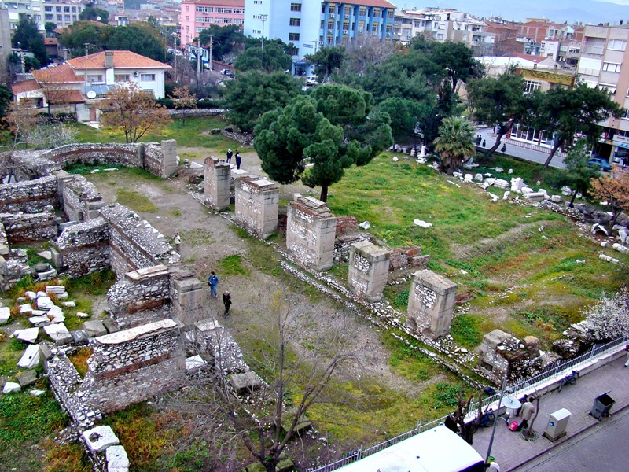
Seven Letters
Thyatira
Meaning: "Sacrifice" or "Castle of Thya" or "Sacrifice offering“
Location: Akhisar
Title: To the messenger of the church in Thyatira, write:
‘The Son of God, whose eyes are like flaming fire and whose feet are like glowing bronze, says this:

Slide 83
Seven Letters
Thyatira
The city of Thyatira was once named Pelopia. It’s name was then changed to Semiramis and then Euhippa.
Seleucus I Nicator named it Thyatira when he learned that he was to have a daughter born to him.

Slide 84
Seven Letters
Thyatira
It is at a trade crossroads and as such contained a number of trade guilds. One was expected to worship the patron deity of one's trade guild.
Among the gods/goddesses worshiped were Ashtoreth (aka Semiramis). Goddess of maidens and childbirth. Known as the queen of heaven.
Among the goods traded here were wool, linen, Dyes, Tanned goods, pottery, baked goods, slaves and bronze items.

Slide 85
Seven Letters
Thyatira
Semiramis was the consort of Nimrod, mother of Tammuz.
Jesus is asserting his power and authority for judgement. “Eyes like fire, feet like brass” are symbols of judgement.

Slide 86
Seven Letters
Thyatira
Commendation: I know what you’ve been doing—your love, faithfulness, service, and endurance—and that your last actions are greater than the first.
Six positives and they are improving.

Slide 87
Seven Letters
Thyatira
Concern: But I have this against you: You tolerate that woman Jezebel, who calls herself a prophet and who teaches and leads my servants to practice immorality and to eat food sacrificed to idols. I gave her time to repent, but she refused to repent of her immorality. Look! I am going to strike her with illness. Those who commit adultery with her will also suffer greatly, unless they repent from acting like her.

Slide 88
Seven Letters
Thyatira
This is the first letter with a reference to the tribulation.
Jezebel was the daughter of Eth-Baal, King of Sidon, Priest of Astarte. Her father murdered his predecessor, Pheles.
She was married to King Ahab to seal a trade alliance between Phoenicia and Israel.

Slide 89
Seven Letters
Thyatira
Baal and Astarte originated in Babylon.
Astarte is synonymous with Ashtoreth (Judges2:13; 10:6; 1 Sam 31:10; 1 Kings 11:5,33).
Astarte worship involved “The Groves” (phallic symbols) in Deuteronomy 16:21.
It was referred to as “The Abomination of Sidonians” (2 Kings 23:3,6,7; Ezekiel 36:15).
She is referred to as “The Queen of Heaven” (Jer 7:18; 44:15-30)

Slide 90
Seven Letters
Thyatira
Apparently the church at Thyatira condoned sinful activity. They took up the Nicolaitan teaching of compromise between pagan practice and Christian teaching. One such practice being that the trade guilds would hold banquets in the temples after which people would engage in sexual immorality.

Slide 91
Seven Letters
Thyatira
I will strike her children dead. Then all the churches will know that I am the one who searches minds and hearts. I will reward each of you as your actions deserve.

Slide 92
Seven Letters
Thyatira
Exhortation: But as for the rest of you in Thyatira—you who do not hold to this teaching and who have not learned what some people call the deep things of Satan—I won’t burden you with anything else. Just hold on to what you have until I come.

Slide 93
Seven Letters
Thyatira
Promise to overcomer: I will give authority over the nations to the person who overcomes and continues to do what I’ve commanded to the end, and
‘He will rule them with an iron scepter; shattering them like clay pots.’ ‘Just as I have received authority from my Father, I will also give him the morning star. ‘Let everyone listen to what the Spirit says to the churches.’”

Slide 94
Seven Letters
Thyatira
Perhaps power over the nations was the goal of Jezebel.
“Rod of Iron” echoes Ps 2:7-9; Ps 110:2
Prophetic position: Medieval Church (600 -1517AD)
Don't get too excited about this being the Catholic Church. See the commendation above. They were doing good things and getting better. Also think about the fact that if this is the medieval catholic church, the next letter then is the reformation or protestant church and it has NO commendation at all.

Slide 95
Seven Letters
Thyatira
Admonitory Level
Ephesus | Devotion, not just doctrine
Smyrna | Endure Persecution
Pergamos | Purify ambassadorship
Thyatira | Pagain practices
Library of Celsus at Ephesus

Slide 96
Seven Letters
Thyatira
Personal Level
Ephesus | Neglected priorities
Smyrna | Satanic opposition
Pergamos | Spiritual compromise
Thyatira | Pagan practices
Library of Celsus at Ephesus

Slide 97
Seven Letters
Thyatira
Promise to the Overcomer
Ephesus | Eat of the Tree of Life
Smyrna | Not hurt of the Second Death
Pergamos | Eat manna, White stone, New name
Thyatira | Power over nations
Library of Celsus at Ephesus

Slide 98
Seven Letters
Medieval Church History History of the Popes, Joseph McCabe
Pope means “Papa” or “Father”. This title initially applied to all western bishops.
About 500 A.D. it began to be restricted to the Bishop of Rome.
Siricius (395-398), Bishop of Rome attempted to claim universal jurisdiction over the church. The Empire in that day was divided into the East and West.
Leo I (440-461) thought of as the first pope among historians. He obtained imperial recognition from Emperor Valentinina III for his claim of Primate of All Bishops (445). In 452, he persuaded the barbarian tribes to spare the city of Rome. He did the same when he persuaded Genseric the Vandal to have mercy on Rome. After this he declared himself Lord of the Whole Church and advocated for universal papacy. Resistance to his authority was declared a sure path to Hell and he advocated for the death penalty for heresy. The Council of Chalcedon (451) made up of bishops from all over the world had given the Patriarch of Constantinople equal standing with the Bishop of Rome.

Slide 99
Seven Letters
Medieval Church History
Simplicius (468-483) The western empire fell around 476 during his papacy. This left a power vacuum which left Simplicius the most commanding figure in the west.
Pope Gregory I (590-604) is thought of as the real first pope. Under his watch he labored toward the purification of the church, deposed neglectful or unworthy bishops, opposed the sale of offices (“simony”).
Zacharius (741-752) helped make Pepin, father of Charlemagne, King of the Franks.
Stephen II (752-757) asked Pepin to lead his army to Italy to conquer the Lombards. After his successful campaign he gave part of Italy to the Pope which began the Papal States. Charlemagne worked closely with the Pope and ruled over what is now Germany, France, Switzerland, Austria, Hungary, Belgium and parts of Spain and Italy. He helped bring the position of Papacy to a position of world power.

Slide 100
Seven Letters
Medieval Church History
After Charlemagne’s death the Treaty of Verdun (843) divided his empire into what became the “Holy Roman Empire” which lasted 1000 years until Napoleon.
Nicolas I (858-867) was the first Pope to wear a crown. At about this time (857) the “Isidorian Decretals” appeared which were said to be letters and decrees from Bishops and Councils of the 2nd and 3rd century exalting the power of the Pope and giving authority from antiquity to the position. Centuries later they were discovered to be forgeries.
Until 869 all Ecumenical Councils took place in Constantinople. Nicolas sought to interfere in the affairs of the Eastern Church and excommunicated Photius (Patriarch of Constantinople) who excommunicated Nicolas.
The treatment of Constantinople by the armies of Pope Innocent II (crusades) and the creation of the dogma of Papal Infallibility (1870) widened the divide between the east and west church.

Slide 101
Seven Letters
Medieval Church History
In the 9th century, the Eastern church seperated itself from the Western church.
East: Primitive Christianity + Greek & Oriental paganism.
West: Primitive Christianity + Greek & Roman paganism.
The 200 years between Nicholas I and Gregory VII (870-1050) are known as the “midnight of the Dark Ages”.
They are marked with bribery, immorality and bloodshed. The darkest period of the church.
Sergius III (904-911) had a mistress, Marozia. She, her mother and her sisters filled the Papal chair with paramours and illegitimate sons. This period of church history is knows as the “Rule of Harlots” (904-963).
John X (914-928) brought from Ravena to Rome and made Pope by Theodora. Was smothered to death by Marozia who put Leo VI in place the next three popes.
Leo VI (928-929)
Stephen VII (929-931)
John XI (931-936)

Slide 102
Seven Letters
Medieval Church History
One of Marozia’s sons appointed the next four popes:
Leo VII (936-939)
Stephen VIII (030-942)
Martin III (942-946)
Agapetus II (946-955)
John XII (955-963) was a grandson of Marozia. He was guilty of almost every crime. Violated virgins and widows, lived with is father’s mistress, made the Papal Palace a brothel. He was killed by a jealous husband while in the act of adultery.
Benedict VIII (1012-1024)
John XIX (1024-1033) both Benedict and John bought the Office of the Pope with bribery.

Slide 103
Seven Letters
Medieval Church History
Benedict IV (1022-1045) [note the overlap] was made Pope as a 12 year old boy through bargains with powerful Roman families. He committed murders and adulteries in broad daylight. Robbed pilgrims. The people drove him out of Rome. Called the worst of all the Popes.
Benedict IX, Gregory VI and Sylvester III (1045-1046) all three rival Popes. Hired assassins swarmed Rome.
Clement II (1046-1047) appointed Pope by Emperor Henry III of Germany “because no Roman clergyman could be found who was free of the pollution of simony and fornication.”

Slide 104
Seven Letters
Medieval Church History
The Golden Age of Papal Power
Hildebrand of Sovana (later Pope Gregory VII) oversaw the appointment of the next five Popes.
Leo IX (1049-1054)
Victor II (1055-1057)
Stephen IX (1057-1058)
Nicolas II (1059-1061)
Alexander II (1061-1073)
Gregory VII (1073-1085) brought about reforms particularly against simony which brought him against Emperor Henry IV, Emperor of Germany. A series of wars followed which resulted Gregory being driven from Rome where he died in exile. However, he did manage to make the Papacy independent of the Empire.

Slide 105
Seven Letters
Medieval Church History
Innocent III (1198-1216) the most powerful of all the Popes. He claimed to be “Vicar of Christ”, “Vicar of God,” “Supreme Sovereign over the Church and the World”. “All things on earth and in heaven and in hell are subject to the Vicar of Christ”.
All the kings of Europe and even the Byzantine Empire obeyed his will.
He ordered two crusades
Decreed transubstantiation
The change of substance or essence by which bread and wine become the body and blood of Christ.
Confirmed auricular confession
Requirement to confess all sins to a human priest as the only way to Heaven.
Declared papal infallibility
Condemned the Magna Carta
Forbade reading of the Bible in the vernacular
Initiated the Inquisition
Ordered the extermination of the Albigenses (Carthari).

Slide 106
Seven Letters
Medieval Church History
More blood was shed under Innocent III and his successor than any other period in church history until the Reformation.

Slide 107
Seven Letters
Medieval Church History
The inquisition, called “The Holy Office” was instituted by Pope Innocent III and perfected by Pope Gregory IX.
Everyone required to inform against Heretics.
Suspects were subject to torture without knowing their accuser.
Proceedings were secret.
Inquisitor pronounced sentence and the victim was turned over to civil authorities for imprisonment or burning.
Victim’s property was confiscated and divided between church and state.

Slide 108
Seven Letters
Cathars
The Cathars, or Albigenses, lived in southern France and northern Spain and Italy.
A Christian dualism faith.
Belief that two principles exist. One good, one evil.
The material world is evil.
Preached against immoralities of the priesthood, the worship of saints and images.
Rejected the clergy and their claims
Opposed the claims of the Church of Rome
Lived self-denying lives
Zealous for moral purity.

Slide 109
Seven Letters
Waldensians
The Waldenses were similar to the Cathars but not identical.
Emphasized Bible reading.
Rejected clerical usurpation and shamelessness.
Sought to follow Christ in poverty and simplicity.

Slide 110
Seven Letters
Medieval Church History
The Cathars and Waldensians were both pre-Protestant Christian movements.
Pope Innocent III invoked a crusade against the Cathars in 1208 which wiped out town after town until the Cathars were wiped out.
The Waldensians were similarly wiped out, though some survived in the Alpine Valleys near Turin.
Between 1540-1570, 900,000 or more “protestants” were put to death by the Pope’s war of extermination of the Waldensians.
The Inquisition lasted over 500 years.

Slide 111
Seven Letters
Medieval Church History
Boniface VIII (1294-1303) – declared in the Unam Sanctam
“We declare, affirm, define and pronounce that it is altogether necessary for salvation that every creature be subject to the Roman Pontiff.”
He was corrupt enough that Dante (who visited Rome during Boniface’s reign) called the Vatican a “sewer of corruption” and assigned Boniface VIII, Nicolas III and Clement V to the lower parts of Hell in his book.

Slide 112
Seven Letters
Medieval Church History
France controlled the Papacy between 1305 and 1377.
During this time there were two Popes. One in Avignon and one in Rome. Both claiming to be the “Vicar of Christ”.
John XXIII (1410-1415) – As Cardinal in Bologna, 200 maidens, nuns and married women fell to his amours.
As Pope:
Violated virgins and nuns
Lived in adultery with his brother’s wife
Guilty of sodomy and other nameless vices
Bought the Papal Office
Sold Cardinalates to children of wealthy family
Openly denied the future life.

Slide 113
Seven Letters
Medieval Church History
Pius II (1458-1464) – fathered many illegitimate children and spoke openly of his methods of seducing women and even offered to instruct young men in methods of self indulgence.
Paul II (1464-1471) – “filled his house with concubines.”
Sixtus IV (1471-1484)-
Sanctioned the Spanish Inquisition
Decreed that money would deliver souls from Purgatory
Implicated in a plot to murder Lorenzo de Medici (and others who opposed his policies)
Made 8 of his nephews Cardinals

Slide 114
Seven Letters
Medieval Church History
Innocent VIII (1484-1492) –
Had 16 children by various married women
Multiplied church offices and sold them
Decreed the extermination of the Waldensians
Appointed Thomas of Torquemada Inquisitor General of Spain
Alexander VI (1492-1503) –
The most corrupt of the Renaissance Popes
Bought the Papacy
Made new Cardinal positions for money
Had a number of Illegitimate children whom he openly acknowledged and appointed to church office
One of his mistresses was the sister of the cardinal who became the next Pope (Pius III)

Slide 115
Seven Letters
Martin Luther
Born in 1483 in Eisleben, Saxony. (near modern Reinsberg, Germany)
His father was a poor coal miner.
He chose to become a lawyer.
Attended the University of Erfurt.
Near the end of his schooling, in 1504, he was walking the campus grounds and a fierce storm broke out.
The thunder struck so forcefully he fell to his face in fear. Lightning struck a tree nearby.
He cried out to the patron saint of coal miners.
Prayed that if Saint Anne would save him he would become a monk.
The storm stopped shortly afterward.
Left law school and entered the Augustinian monastery where he obtained a Doctorate of Theology.

Slide 116
Seven Letters
Martin Luther
He studied well but became more and more troubled by a question.
How can a man find favor with God?
Habbakuk 2:4 became his life text.
On October 31, 1517, he nailed the now famous 95 theses to the door at Wittenburg College.
On December 10, 1520, Luther was excommunicated as he chose not to “retract within 60 days or death”. He burned the papal Bul publicly and thus began the Reformation.
Diet of Wurms: 1521
It means assembly (diet) in the city of Wurms, Germany.
Charles V, Emperor of the Holy Roman Empire summoned Luther to appear at the Diet where Luther made his famous statement:
“Here I stand; I can do naught else; so help me God.”

Slide 117
Seven Letters
Medieval Church History
The following wars were started by Roman Catholic Kings in order to crush the Protestants.
The war on German Protestants (1566-1609)
War on Protestants of Netherlands (1566-1609)
Huguenot Wars in France (1572-1598)
St. Bartholomew’s Massacre. August 23, 1572
70,000 Huguenots massacred.
Rome rejoiced. The Pope and his Cardinals went to the Church of San Marco and ordered the Te Deum be sung in thanksgiving.
Struck a medal to commemorate the massacre
Sent a Cardinal to Paris to bring the congratulations of the Pope and Cardinals.
Philip’s attempt against England (1588)
Spanish Armada incident
Thirty Years War (1618-1648)

Slide 118
Seven Letters
Medieval Church History
The Jesuits were created to counter the Lutheran secession.
The Inquisition under Jesuit leadership was to retake territory lost to the Protestants and Muslims and eventually conquer the entire heathen world for the Roman Catholic Church.
Julius II (1503-1513) –
The warrior Pope.
Richest of the Cardinals.
Bought the Papacy.
Attained and led a vast army.
Issued indulgences for money.

Slide 119
Seven Letters
Medieval Church History
Leo X (1513-1521) –
Pope when Luther started the Protestant Reformation
Sold indulgences
Reaffirmed the Unam Sanctam
Declaration that every human being must be subject to the Roman Pontiff for salvation.
Declared the burning of heretics a divine appointment.
Offered Charles V his army to help exterminate the Protestants.

Slide 120
Seven Letters
—and that your last actions are greater than the first.
May 21, 1995:
Pope John Paul II asked forgiveness for all the wrongs and crimes permitted and committed by the Roman Catholic Church throughout history.

Slide 121
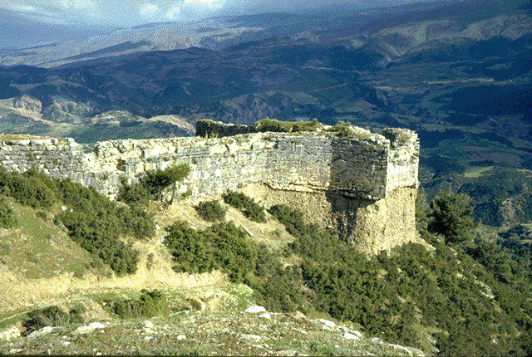
Seven Letters
Sardis
Meaning: Possibly means “red stone”. It is difficult to find agreement on the meaning.
Location: Near Odemis.
Title: To the messenger of the church in Sardis, write:
‘The one who has the seven spirits of God and the seven stars says this:

Slide 122
Seven Letters
Sardis
Consider the Title Jesus uses in this letter.
The Seven Spirits of God is an Old Testament idiom for the Holy Spirit. Many of today’s denominations are uncomfortable with the concept of the Holy Spirit. It is one of the major divisions within churches.

Slide 123
Seven Letters
Sardis
None
Commendation:

Slide 124
Seven Letters
Sardis
Sardis is one of the oldest cities of Asia. Probably dating back to 2000 B.C.
Was the ancient capital of the Lydian Empire (1200B.C.)
It was located on a hill 1000 feet above the Valley of Hermus at the foot of Mount Tmolus.

Slide 125
Seven Letters
Sardis
It appeared to be impregnable but the cliff it was built upon was made of clay which suffered erosion leaving cracks that could be exploited.
When besieged by the Persians in 549 B.C., the king (Croesus) left the cliffside precipice unguarded which was three sides of the city.
The Persian army climbed the cliffs and over the battlements to take the city.

Slide 126
Seven Letters
Sardis
In 214 B.C. the cliffs were again scaled by Antiochus’ army.
History of Sardis
549 BC Fell to Persians
501 BC Burned by Ionians
334 BC Surrendered to Alexander the Great
322 BC Taken by Antigonus
214 BC Fell to the Seleucids.

Slide 127
Seven Letters
Sardis
By the New Testament time, the city’s name had become synonymous with unjustified pretension; promise without performance; appearance without reality; and false confidence.
The city suffered an earthquake in 17 A.D. and was destroyed by Tamerlane in 1402.

Slide 128
Seven Letters
Sardis
Concern: I know what you’ve been doing. You are known for being alive, but you are dead.

Slide 129
Seven Letters
The Reformation
Leaders and followers of the Reformation were not looking to get rid of the church. They simply saw abuses and doctrinal drifts and wanted to correct them.
History marks the beginning of the Reformation on December 10, 1520 when Luther burned the Papal Bul which excommunicated Luther unless he retracted his concerns within 60 days.
The roots of the Reformation, however, existed centuries before.

Slide 130
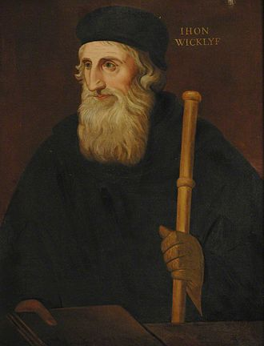
Seven Letters
The Reformation
14th century - John Wycliffe attacked the papacy due to indulgences, excessive veneration of the saints and moral standards of the priesthood.
He translated the bible into English from Latin.
Followers of Wycliffe were known as Lollards.
Lollards regarded the scripture as the only reliable guide to the truth of God. Known as Sola Scriptura.
The Catholic church declared him a heretic but couldn’t do any thing to him while he lived. In 1428, his bones were removed from consecrated ground and burned.
Portrait of John Wycliffe, c. 1828

Slide 131
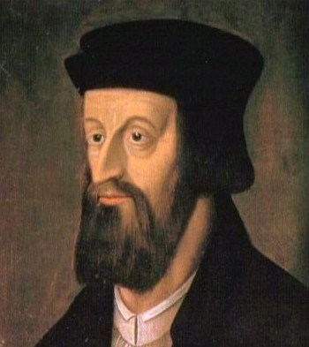
Seven Letters
The Reformation
Wycliffe’s teaches spread to Bohemia (now known as Czechoslovakia. Jan Hus became prominent preaching the ideals of Wycliffe.
His execution in 1415 lead to the Hussite wars (1419-1436) between the Holy Roman Empire (under Sigismund) and Hussites, Taborites and other Hussite spinoffs.
The Hussites, etc. were allowed to practice their rites so long as they submitted to the King and the Church.

Slide 132
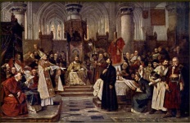
Seven Letters
The Reformation
French Papacy –
In the 14th century the Popes were under the rule of the French King in Avingnon.
The Council of Constance (1414-1418) tried to reorganize the church hierarchy but nothing came of it in the end.
1516 Concordant put the Pope under French royal authority.

Slide 133
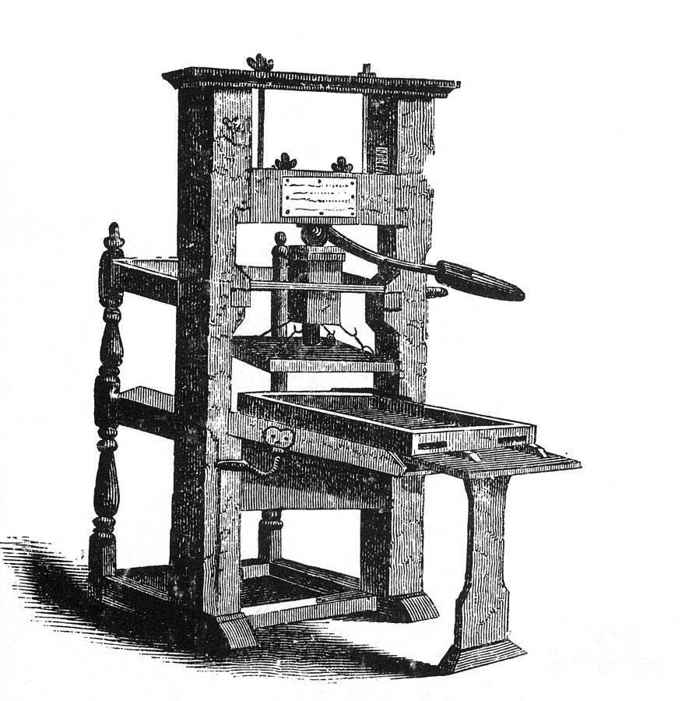
Seven Letters
The Reformation
The Gutenberg Press, invented by Johannes Gutenberg in Mainz, Germany in 1455, lead to increased literacy and spread of ideas.
Scholarly study laid the foundation for Luther, Calvin and other reformers to claim the Bible rather than the church to be the sole authority.

Slide 134
Seven Letters
The Reformation
1054 – Eastern Orthodoxy
1173 – Waldensians (Peter Waldo)
1379 – Lollards (John Wycliffe)
1415 – Hussites (Jan Hus)
1517 – Lutheranism (Martin Luther)
1521 – Anabaptists (Scandanavian Lutherans)
1523 – Swinglianism (Huldreich Zwingli)
1534 – Anglicanism (Henry VIII)
1536 – Mennonites (Menno Simons)
– Calvinism (John Calvin)

Slide 135
Seven Letters
The Reformation
1540s – German Reformation Church
1550s – Hungarian Reformation Church
1560s – French Calvinists (Hugueonots)
-- Scottish Presbyterians (John Knox)
-- Congregationalism (Puritans)
1570s – Dutch Reformed Church
1606 – English Baptists (John Smyth)
1647 – Quakers (George Fox)
1690 – Amish (Jacom Ammon)
1739 – Methodism (John Wesley)
1785 – Protestant Episcopal Church

Slide 136
Seven Letters
The Reformation
1800 – United Brethren in Christ
1819 – Unitarianism (William Channing)
1831 – Disciples of Christ (Thomas Campbell)
1863 – Seventh-day Adventists (William Miller)
1865 – Savlation Army (William Booth)
1879 – Christian Science (Mary Baker Eddy)
1914 – Assemblies of God
At the time of these notes AOG had approximately 11,900 churches, 2,530,000 members in the US. ~175,000 churches in 158 countries. World wide membership is ~32million.

Slide 137
Seven Letters
The Denominational Church
The denominational church made great strides in soteriology (study of salvation) but has some failures that persist through today.
“Soft” hermeneutical traditions
Allegorization of the bible.
Denial of the Millennial Reign
Denial of Israel’s prophetic destiny
Replacement Theology
De-emphasis of the Gospel of Christ
Been to many churches where you rarely if ever hear the straight up gospel. The power of the blood of Christ for our salvation.
Ordination of homosexuals.
Change of focus to environmentalism (Gaia worship)
Voting on doctrine.
Prosperity gospel.

Slide 138
Seven Letters
Evangelicals & Catholics Together
On March 29, 1994 a joint declaration named “Evangelicals and Catholics Together: The Christian Mission in the Third Millennium” was signed.
At it’s heart is the compromise of the Gospel.

Slide 139
Seven Letters
Evangelicals & Catholics Together
The gospel:
Now I’m making known to you, brothers, the gospel that I proclaimed to you, which you accepted, on which you have taken your stand, and by which you are also being saved if you hold firmly to the message I proclaimed to you—unless, of course, your faith was worthless.
For I passed on to you the most important points that I received: The Messiah died for our sins according to the Scriptures, he was buried, he was raised on the third day according to the Scriptures—and is still alive!
(1 Corinthians 15:1-4, ISV)

Slide 140
Seven Letters
Life Cycle of Churches
People- oriented Pastor.
Pulpit- oriented Pastor
Property-oriented Pastorate
See Gideon for example
Power-oriented Pastorate
Politically-driven decay
Accountability; management by hearsay; lack of an “Objective Function”

Slide 141
Seven Letters
Sardis
Admonitory Level
Ephesus | Devotion, not just doctrine
Smyrna | Endure Persecution
Pergamos | Purify ambassadorship
Thyatira | Pagain practices
Sardis | Be watchful, diligent

Slide 142
Seven Letters
Sardis
Personal Level
Ephesus | Neglected priorities
Smyrna | Satanic opposition
Pergamos | Spiritual compromise
Thyatira | Pagan practices
Sardis | Watchfullness and Diligence

Slide 143
Seven Letters
Sardis
Promise to the Overcomer
Ephesus | Eat of the Tree of Life
Smyrna | Not hurt of the Second Death
Pergamos | Eat manna, White stone, New name
Thyatira | Power over nations
Sardis | Walk with Him in white; Name not blotted out

Slide 144
Seven Letters
Sardis
Exhortation: Be alert, and strengthen the things that are left, which are about to die. I note that your actions are incomplete before my God. So remember what you received and heard.
Obey it, and repent. If you are not alert, I will come like a thief, and you won’t know the time when I will come to you. But you have a few people in Sardis who have not soiled their clothes. They will walk with me in white clothes because they are worthy.

Slide 145
Seven Letters
Sardis
Promise to overcomer: The person who overcomes in this way will wear white clothes, and I will never erase his name from the Book of Life. I will acknowledge his name in the presence of my Father and his angels.
‘Let everyone listen to what the Spirit says to the churches.

Slide 146
Seven Letters
Sardis
Greek cities kept a list of citizens in a public registry. When someone was condemned for committing a crime, their name was removed from the registry. Sardis was also known for its quality white wool with which clothes were made.
Prophetic position: Reformation church (1587-1648 AD)

Slide 147
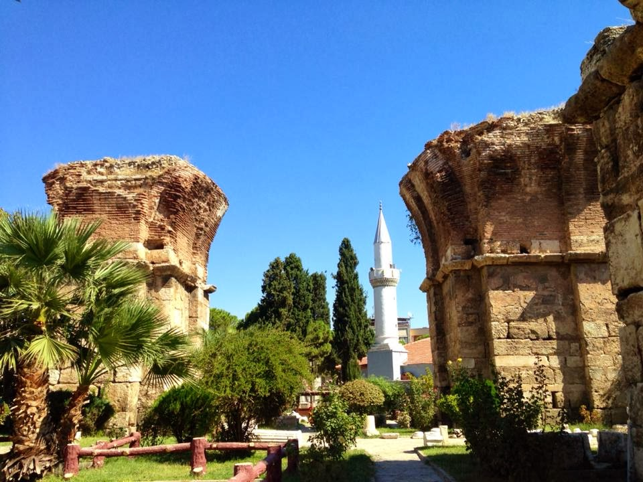
Seven Letters
Philadelphia
Meaning: Literally friendship city, but brotherly love works, too.
Location: Alasehir.
Title: To the messenger of the church in Philadelphia, write: ‘The one who is holy, who is true, who has the key of David, who opens a door that no one can shut, and who shuts a door that no one can open’ says this:

Slide 148
Seven Letters
Philadelphia
Youngest of the seven cities. Today known as Alashehir.
It was named as such due to King Eumenes II, King of Pergamos, having a younger brother who was his successor. They loved each other very much giving Attalus II the nickname Philadelphus (“One who loves his brother”).
Philadelphian coins were minted with the two brothers depicted on them.

Slide 149
Seven Letters
Philadelphia
It was in wine country so Dionysus was their local god.
Even before it was the location of a Christian church, its location was such that Rome had used it to spread Greek culture throughout the eastern empire.

Slide 150
Seven Letters
Philadelphia
The 17 AD earthquake which also affected Sardis and ten other cities, completely ruined Philadelphia. It was rebuilt with money from Emperor Tiberius and so the name of the city was changed to Neo-Caesarea.

Slide 151
Seven Letters
Philadelphia
Later the name was changed to Flavia in honor of the new emperor, Vespasian.
None of the new names stuck long and the old name Philadelphia was revived.

Slide 152
Seven Letters
Philadelphia
The church here suffered from persecution coming from a large Jewish community in the city.

Slide 153
Seven Letters
Keys of David
The title Jesus has chosen for this letter may bring to mind an incident with Peter at Caesarea.
Those “keys” were not just given to Peter (Matthew 16:19) but also to all the Apostles two chapters later (Matthew 18:18).
These keys refer to a door being opened to the Gentiles (Acts 10) and Peter even clarifies this in his first letter (1 Peter 2:4-9)

Slide 154
Seven Letters
Keys of David
Isaiah 22:20-25 speaks of keys.
Eliakim is replacing the former treasurer of the kingdom.
Eliakim held a heavy key on a loop over his shoulder as a symbol of his office.
Holding this key means that in order to have access to the king, one must go through the holder of this key.

Slide 155
Seven Letters
Keys of David
Interestingly enough, Eliakim is described as a nail. Which is a messianic prophecy.

Slide 156
Seven Letters
Keys of David
This is described in messianic terms in:
Authority is on his shoulders
Isaiah 9:6,7
His throne is that of the Kingdom of David
Luke 1:32-33
Authority in heaven and on earth
Matthew 28:18
Hold the keys to death and hades
Revelation 1:18

Slide 157
Seven Letters
Philadelphia
Commendation: ‘I know what you’ve been doing. Look! I have put in front of you an open door that no one can shut. You have only a little strength, but you have obeyed my word and have not denied my name. I will make those who belong to the synagogue of Satan—those who claim to be Jews and aren’t, but are lying—come and bow down at your feet.
Then they will realize that I have loved you. Because you have obeyed my command to endure, I will keep you from the hour of testing that is coming to the whole world to test those living on the earth.

Slide 158
Seven Letters
Doors of deliverance
“I am the door” (Jonah 10:7,9)
Noah’s Ark had a door.
Closed by God, Himself 7 days before the flood. (Genesis 7:16)
Open doors (1 Cor 16:9; 2 Cor 2:12; Col 4:3)

Slide 159
Seven Letters
Synagogue of Satan
Second time these are mentioned (revelation 2:9)
False Jews = Reconstructionists?
Replacement theology
Legalists?

Slide 160
Seven Letters
Kept from the Hour of Temptation
Is this removal or immunity?
“From” (Greek ek) means “out of” as in removal.
The Greek definite articles say this is The hour and THE temptation.
It is upon ALL the world.
Its purpose is to try those who dwell on the earth.

Slide 161
Seven Letters
Kept from the Hour of Temptation
Earth Dwellers is not simply someone living on the earth (as the ISV translates).
The Greek word is not oikeo it is katoideo which is identified with Philippians 3:20 and Hebrews 11:13)
These are citizens of earth not simply people living on earth.

Slide 162
Seven Letters
Kept from the Hour of Temptation
This is the only letter with a promise of keeping out of the time of the “Great Tribulation”.
Not told to prepare for it.

Slide 163
Seven Letters
Philadelphia
None
Concern:

Slide 164
Seven Letters
Philadelphia
Exhortation: I am coming soon! Hold on to what you have so that no one takes your victor’s crown.

Slide 165
Seven Letters
Philadelphia
This implies they already have said crown but to hold on and not let it be taken or lost.
Esau lost his place to Jacob (Gen. 25:34; 27:36)
Reuben lost his place to Judah (Gen 49:4, 8)
Moses was replaced by Joshua for what he did at Meribah (Num 20:12; Deut 3:26-28)
Saul lost the kingship to David (1 Sam 16:1,13)
Shebna lost his place to Eliakim (Isa 22:15-25)
Joab and Abiathar lost their placs to Benaiah and Zadok (1 Kgs 2:25)
Elijah was replace by Elisha (1 Kgs 19:13-16)

Slide 166
Seven Letters
Philadelphia
Promise to overcomer: I will make the one who overcomes to become a pillar in the sanctuary of my God, and he will never go out of it again. I will write on him the name of my God, the name of the city of my God (the new Jerusalem coming down out of heaven from God), and my own new name.
‘Let everyone listen to what the Spirit says to the churches.’

Slide 167
Seven Letters
Philadelphia
Temples were built on a foundation of charcoal and wool fleece.
This let the structure "float" when an earthquake hit thus making the temples the safest place during an earthquake (a pillar in the temple).
Names are inscribed on the temple pillars.

Slide 168
Seven Letters
Philadelphia
Neither the letters to Smyrna nor Philadelphia have a concern. Both of these cities are still in existence today.
During the 14th century, Philadelphia stood alone against the Turkish empire as a free, Christian city. They resisted to the end. It fell to a combined Turkish and Byzantine army by 1390.
Today the Christians in the city are underground (not literally) as it is an Islamic city.

Slide 169
Seven Letters
Philadelphia
Prophetic position: Missionary church (1648-1900 AD)

Slide 170
Seven Letters
Philadelphia
Admonitory Level
Ephesus | Devotion, not just doctrine
Smyrna | Endure Persecution
Pergamos | Purify ambassadorship
Thyatira | Pagain practices
Sardis | Be watchful, diligent
Philadelphia | Missionary outreach

Slide 171
Seven Letters
Philadelphia
Personal Level
Ephesus | Neglected priorities
Smyrna | Satanic opposition
Pergamos | Spiritual compromise
Thyatira | Pagan practices
Sardis | Watchfullness and Diligence
Philadelphia | Loyal ambassadorship

Slide 172
Seven Letters
Philadelphia
Promise to the Overcomer
Ephesus | Eat of the Tree of Life
Smyrna | Not hurt of the Second Death
Pergamos | Eat manna, White stone, New name
Thyatira | Power over nations
Sardis | Walk with Him in white; Name not blotted out
Philadelphia | Pillar in the Temple, name of God, name of His city, new name

Slide 173
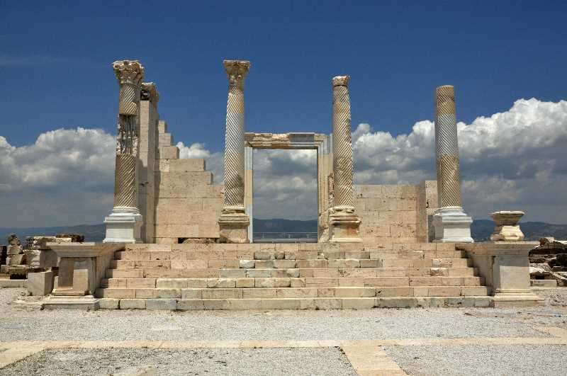
Seven Letters
Laodicea
Meaning: Named after the mother of Seleucus I Nicator, Laodice.
Location: Near Denizli, not far from Collassae.
Title: To the messenger of the church in Laodicea, write:
‘The Amen, the witness who is faithful and true, the originator of God’s creation, says this:
Roman Temple. Photo by Leon Mauldin.

Slide 174
Seven Letters
Laodicea
None
Commendation:
Roman Temple. Photo by Leon Mauldin.

Slide 175
Seven Letters
Laodicea
Concern: ‘I know your actions, that you are neither cold nor hot. I wish you were cold or hot. Since you are lukewarm and neither hot nor cold, I am going to spit you out of my mouth. You say, “I am rich. I have become wealthy. I don’t need anything.” Yet you don’t realize that you are miserable, pitiful, poor, blind, and naked.
Roman Temple. Photo by Leon Mauldin.

Slide 176
Seven Letters
Laodicea
Laodicea was south of Philadelphia, near Colossae.
Its twin city, Hierapolis was six miles away and was known for its hot springs.
Laodicea’s water source was this hot springs area through an aqueduct. By the time it reached Laodicea it was no longer hot but lukewarm.
Roman Temple. Photo by Leon Mauldin.
Notes:
Several sermons are done on the idea that what Jesus means by being hot or cold is to be either for him or against him or that the lukewarm Christians are carnal Christians.
That just doesn’t hold up.
A thing we tend to do is superimpose our own culture on the text.

Slide 177
Seven Letters
Laodicea
Not being in a defensible position, the posture of Laodicea was one of compromise.
Laodicea was a successful commercial and financial center. It was known for its merchants, bankers and gold refiners.
Roman Temple. Photo by Leon Mauldin.

Slide 178
Seven Letters
Laodicea
Trade as far away as the Yellow River in Punjab by the China Sea.
It was also known for its textile manufacturing which was made from a high quality black wool produced from a particular strain of sheep in the area.
Roman Temple. Photo by Leon Mauldin.

Slide 179
Seven Letters
Laodicea
Laodicea also had a famous medical school which was known for a special ophthalmic ointment made of a mixture of oil and collyrium powder (called Phrygian powder by Aristotle). An ophthalmic ointment is an eye salve.
Roman Temple. Photo by Leon Mauldin.

Slide 180
Seven Letters
Laodicea
When the earthquake of 62 A.D. devastated many of the cities in the area, Laodicea was rebuilt with the money of its wealthy citizens. They refused the help of Rome. [Tacitus, Annals 14:27]
Roman Temple. Photo by Leon Mauldin.

Slide 181
Seven Letters
Laodicea
If we break down the name Laodicea into its parts we find Lao (people) and Diceans (rulers).
Rule of/by the People or the self-satisfied church.
Roman Temple. Photo by Leon Mauldin.

Slide 182
Seven Letters
Laodicea
Concern: ‘I know your actions, that you are neither cold nor hot. I wish you were cold or hot. Since you are lukewarm and neither hot nor cold, I am going to spit you out of my mouth. You say, “I am rich. I have become wealthy. I don’t need anything.” Yet you don’t realize that you are miserable, pitiful, poor, blind, and naked.
Roman Temple. Photo by Leon Mauldin.

Slide 183
Seven Letters
Laodicea
Jesus has used a list of idioms that the people living in Laodicea would understand well.
The church at Laodicea was guilty of being indifferent.
“They will hold to an outward form of godliness but deny its power. Stay away from such people.” 2 Timothy 3:5
Roman Temple. Photo by Leon Mauldin.

Slide 184
Seven Letters
Laodicea
The concern also brings to mind the “Name it and claim it” ‘gospel’.
The Laodicean church is self reliant, and they were indifferent to their spiritual status.
Roman Temple. Photo by Leon Mauldin.

Slide 185
Seven Letters
Laodicea
Exhortation: Therefore, I advise you to buy from me gold purified in fire so you may be rich, white clothes to wear so your shameful nakedness won’t show, and ointment to put on your eyes so you may see. I correct and discipline those whom I love, so be serious and repent! Look! I am standing at the door and knocking. If anyone listens to my voice and opens the door, I will come in to him and eat with him, and he will eat with me.
Roman Temple. Photo by Leon Mauldin.

Slide 186
Seven Letters
Laodicea
Jesus is admonishing them to:
receive gold from the ultimate refiner (Ps 19:7-11; 12:6, 1 Cor 3:12)
The bridegroom offers His covering: White raiments in contrast to the black glossy ones the city was known for.
The Great Physician offers His remedy to open their eyes.
Roman Temple. Photo by Leon Mauldin.

Slide 187
Seven Letters
Laodicea
Promise to overcomer:
I will give a place to sit with me on my throne to the one who overcomes, just as I have overcome and have sat down with my Father on his throne.
‘Let everyone listen to what the Spirit says to the churches.’”
Roman Temple. Photo by Leon Mauldin.

Slide 188
Seven Letters
Laodicea
In this context, the church of Laodicea has a major problem.
Jesus is OUTSIDE.
Contrast this to the seven lampstands (the churches) where Jesus was among them.
Roman Temple. Photo by Leon Mauldin.
Prophetic Position: Apostate church (1900 - Present)

Slide 189
Seven Letters
Laodicea
Admonitory Level
Ephesus | Devotion, not just doctrine
Smyrna | Endure Persecution
Pergamos | Purify ambassadorship
Thyatira | Pagain practices
Sardis | Be watchful, diligent
Philadelphia | Missionary outreach
Laodicea | Prosperous compromise
Roman Temple. Photo by Leon Mauldin.

Slide 190
Seven Letters
Laodicea
Personal Level
Ephesus | Neglected priorities
Smyrna | Satanic opposition
Pergamos | Spiritual compromise
Thyatira | Pagan practices
Sardis | Watchfullness and Diligence
Philadelphia | Loyal ambassadorship
Laodicea | Materialistic Apostasy
Roman Temple. Photo by Leon Mauldin.

Slide 191
Seven Letters
Laodicea
Promise to the Overcomer
Ephesus | Eat of the Tree of Life
Smyrna | Not hurt of the Second Death
Pergamos | Eat manna, White stone, New name
Thyatira | Power over nations
Sardis | Walk with Him in white; Name not blotted out
Philadelphia | Pillar in the Temple, name of God, name of His city, new name
Laodicea | Sit with Him on His throne.
Roman Temple. Photo by Leon Mauldin.
Notes:
Notice Whose throne Jesus is sitting on.

Slide 192
Seven Letters
Seven Letters Summary
Already reviewed the prophetic level of the seven letters.
Prophetic Position
Ephesus | Apostolic church (33-100 AD)
Smyrna | Persecuted church (100-313 AD)
Pergamos | Church period starting with Emperor Constantine (313-600AD)
Thyatira | Medieval Church (600 -1517AD)
Sardis | Reformation church (1587-1648 AD)
Philadelphia | Missionary church (1648-1900 AD)
Laodicea | Apostate church (1900 - Present)

Slide 193
Seven Letters
Seven Letters Summary
He who has an ear… Perhaps you recall seeing this elsewhere.
Matthew 13
“Kingdom” parables

Slide 194
Seven Letters
Seven Letters Summary
We are told that from then on, Jesus only spoke in parables when in public.
Why did he speak in parables?
Notes:
Might have learned in Sunday school that it was so the people could understand more clearly.
It is exactly the opposite. Jesus tells us so.

Slide 195
Seven Letters
Seven Letters Summary
Matthew 13 ISV
¹⁰ Then the disciples came and asked Jesus, “Why do you speak to people in parables?”
¹¹ He answered them, “You have been given knowledge about the secrets of the kingdom from heaven, but it hasn’t been given to them, ¹² because to anyone who has something, more will be given, and he will have more than enough. But from the one who doesn’t have anything, even what he has will be taken away from him. ¹³ That’s why I speak to them in parables, because
‘they look but don’t see, and they listen but don’t hear or understand.’
¹⁴ “With them the prophecy of Isaiah is being fulfilled
Notes:
Reiterates this reason in Matthew 13: 34-35

Slide 196
Seven Letters
Seven Letters Summary
Matthew 13 ISV
³⁴ Jesus told the crowds all these things in parables. He did not tell them anything without using a parable. ³⁵ This was to fulfill what was declared by the prophet when he said,
“I will open my mouth to speak in parables. I will declare what has been hidden since the creation of the world.”

Slide 197
Seven Letters
Seven Letters Summary
What has been hidden?
Paul explains in his letter to the Ephesians.
The Church is the secret hidden from the beginning of the world.
Not just that the Gentiles will be converted but that they will be co-heirs and of the same body and partakers of His promise.
Notes:
Ephesians 3:4-6
⁴ By reading this, you will be able to grasp my understanding of the secret about the Messiah, ⁵ which in previous generations was not made known to human beings as it has now been revealed by the Spirit to God’s holy apostles and prophets. This is that secret: ⁶ The gentiles are heirs-in-common, members-in-common of the body, and common participants in what was promised by the Messiah Jesus through the gospel.

Slide 198
Seven Letters
Concept of Expositional Constancy
The terms and symbols used by the Holy Spirit tend to be consistent.
Birds – The evil one (demons)
Field – The world
Seed – The word of God.
Sower – God or Jesus
Trees – people
Bronze and Fire – judgement
Etc.
Notes:
Jesus’ apostles do us a favor and asks Jesus to explain three of the parables.

Slide 199
Seven Letters
Kingdom Parables
Sower and the Seed (Matthew 13:18-23)
Explained
Birds – The evil one (demons)
Field – The world
Seed – The word of God.
Sower – God or Jesus
Four soils – different types of hearers of the word.

Slide 200
Seven Letters
Kingdom Parables
Tares and Wheat (Matthew 13:24-30)
Explained
Sower – God or Jesus
Field – The world
Seed – The word of God.
Tares – fruit of the evil one
The enemy – the devil
Notes:
Tares are the Zizania. It is a weed that grows in Israel and looks like wheat as it is growing until maturity. At maturity it turns black.
If it is mixed with the wheat in bread, the bread is poisonous.

Slide 201
Seven Letters
Kingdom Parables
Mustard Seed (Matthew 13:31-32)
Sower – God or Jesus
Field – The world
The resulting mustard plant grows into a grotesque version of itself. So much so that the evil one roosts within its branches.
Notes:
Often this parable is told from the nice point of view that this small seed grows so large and all the people of the world come in.
Viewed from the viewpoint of expositional constancy, the birds are not people but minions of the evil one.
Do not assume that the devil does not get people into the church.

Slide 202
Seven Letters
Kingdom Parables
Woman and Leaven (Matthew 13:33)
Leaven – sin
When leaven is used as a metaphor it is always used to represent sin.
Leaven puffs up. Like pride. The root of all sin.
Loaves – the Church
The three loaves brings us back to Genesis when Sarah prepared three measures of meal. It is the fellowship offering. It is wrong to hide leaven in the fellowship offering.
Notes:
We begin to see that perhaps these parables aren’t just a colorful description of the church but instead prophesies of the church age.

Slide 203
Seven Letters
Kingdom Parables
Treasure in the Field (Matthew 13:44)
Field – the world
Treasure – the Church
The buyer - Jesus
Sometimes this one is preached that we are to sell everything to attain the treasure of Jesus.
Jesus is the buyer. He paid with His blood to purchase you and me.

Slide 204
Seven Letters
Kingdom Parables
Pearl of Great Price (Matthew 13:45-46)
Pearl – the Church? Gentiles
The buyer - Jesus
Very similar to the treasure in the field.

Slide 205
Seven Letters
Kingdom Parables
Oysters are not Kosher (can only eat seafood with scales).
Pearls are the only precious jewel that is made by a living organism through irritation.
Pearls are then removed from their place of growth and become an adornment.

Slide 206
Seven Letters
Kingdom Parables
Drag Net (Matthew 13:47-48)
Explained
Sea – People/Humanity
Fish sorters - angels
The judgement. Separation of the good from the bad. Sheep and goats.

Slide 207
Seven Letters
Kingdom Parables
Kingdom Parables | Rev 2&3 Letters
Sower and the Seed | Ephesus
Wheat and Tares | Smyrna
Mustard Seed | Pergamos
Woman and the Leaven | Thyatira
Treasure in the Field | Sardis
Pearl of Great Price | Philadelphia
Dragnet | Loadicea

Slide 208
Seven Letters
Paul’s Church Epistles
Paul wrote 13 letters but three are sequels and three are to pastors. This leaves seven written to churches. There is consistency in the architecture of the Bible.
Paul’s Letter | Rev 2&3 Letters
Ephesus | Ephesus
Philippians (Resources through suffering) | Smyrna
Corinthians (Marriage to the world) | Pergamos
Galatians (Religious externalism) | Thyatira
Romans (Definitive orthodoxy) | Sardis
Thessalonians (The raptured church) | Philadelphia
Colossians (near laodicea and shared letters) | Loadicea

Slide 209
Seven Letters
Church History Between Acts and 1700
220 - Origen introduces infant baptism.
312 - Constantine “adopts” Christianity.
325 - Edict of Toleration: state endorsed religion.
The rags of caves exchanged for silks of the court.
Clergy professionalized.
Churches “fit for a king.”
380 - House churches outlawed.
Bishops Theodosius and Gratian order that there should be only one state-recognized Orthodox church.
Every Roman citizen was forced to be a member and should be made to believe “lex fidei,” the law of faith.

Slide 210
Seven Letters
Church History Between Acts and 1700
431 - Council of Ephesus.
Mary worshiped as the “God Bearer.” Theotokos.
Infant baptism become compulsory in the western world by 416.
440 - Leo the Great: “Bishop of Rome.”
445 - Valentian confirmed as “Spiritual leader” of Western Empire.
500 - Common priestly dress code.
565 - Justinian: state-ordained church.
607 - Boniface III: 1st “Pope” of Catholic Church.
709 - Kissing Pope’s foot begins.

Slide 211
Seven Letters
Church History Between Acts and 1700
786 - Worship of images and relics develops.
850 - Use of holy water begins.
995 - Canonization of dead Saints.
998 - Fasting on Fridays and before Lent.
1070 - Celibacy of the priesthood instituted.
1090 - Prayer beads adopted from paganism.
1184 - Inquisition begins.
Jews, witches, etc.
Napoleon’s brother Joseph declares it illegal in 1808.
Last heretic hanged in Valencia Spain 1826, 18 years later.

Slide 212
Seven Letters
Church History Between Acts and 1700
1254 - Pope Innocence IV officially establishes sale of indulgences.
1215 - Transubstantiation of water & wine
1229 - Reading the Bible forbidden to laymen.
1414 - Communion cup forbidden to lay people.
1439 - Doctrine of Purgatory decreed.
1492 - Jews outlawed in Spain. Columbus sails.
1517 - Luther’s 95 Theses (Zwingli, Melanchton, Calvin, John
Knox, and others…).
1526 - Reversions to traditional forms of services (vs. “Anabaptists” et al.).
1530 - “All lay pastors teaching publicly are to be killed.”
Schwenckfeld outlawed; disciples jailed.

Slide 213
Seven Letters
Church History Between Acts and 1700
1545 - Tradition granted equal authority with Bible (Council of
Trent).
1600 - 40 translations from the Latin Bible.
1700 - Huguenots (Claude Brousson publicly executed before 10,000).

Slide 214
Throne Room
Chapter 4
Μετὰ ταῦτα
After these things, I saw a door standing open in heaven. The first voice that I had heard speaking to me like a trumpet said, “Come up here, and I will show you what must happen after this.”
Μετὰ ταῦτα
Notes:
Meta Touta - the same word used in Revelation 1:19.
A voice like a trumpet is reminiscent of 1:10 ‘…when I heard a loud voice behind me like a trumpet’.
Verse 1 ends with the same word it begins with.

Slide 215
Throne Room
Chapter 4
John SAW, FELT, HEARD these things. These weren’t just visions or some dream.
He was in the throne room of the universe as a witness to these events.
Notes:
Instantly I was in the Spirit, and I saw a throne in heaven with a person seated on the throne. The person sitting there looked like jasper and carnelian, and there was a rainbow around the throne that looked like an emerald.
The one on the throne is pretty clear.
Gem stones are used as a description of colored light.
Incidentally, the jasper and carnelian are stones on the Levitical priestly breastplate. (Exodus 38:15-)
Each stone represents one of the tribes of Israel.

Slide 216
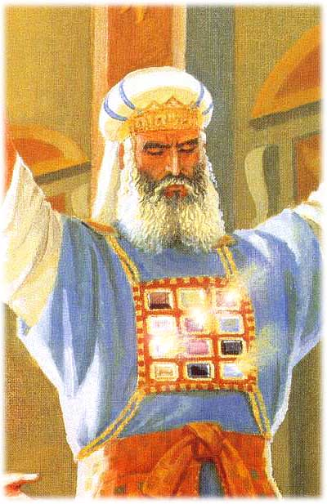
Throne Room
Chapter 4
Notes:
Instantly I was in the Spirit, and I saw a throne in heaven with a person seated on the throne. The person sitting there looked like jasper and carnelian, and there was a rainbow around the throne that looked like an emerald.
The one on the throne is pretty clear.
Gem stones are used as a description of colored light.
Incidentally, the jasper and carnelian are stones on the Levitical priestly breastplate. (Exodus 38:15-)
Each stone represents one of the tribes of Israel.
Carnelian is the stone of the first born of Israel, Reuben.
Jasper is the stone of the last born of Israel, Benjamin.

Slide 217
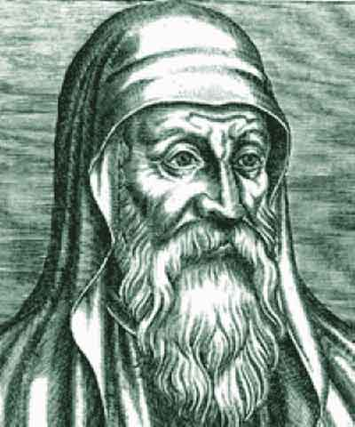
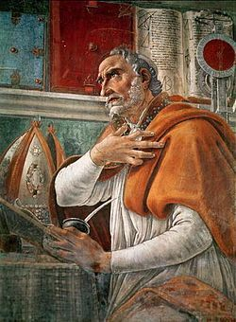
Throne Room
Chapter 4
Origen Adamantius
Origen of Alexandria
AD 184-253
Augustin of Hippo
AD 354-430
Notes:
Views of Revelation and prophecy in general. Some believe revelation has already happened
Ran into a web site of someone who viewed revelation as already having happened.
They explain the fact that we aren’t in heaven by stretching out the time line of the 3.5 years while simultaneously explaining that one can not stretch out the time line of the 70 weeks of Daniel.
Origen started an allegorical view of the Bible.
Augustin took that further.
By Augustin’s time the church was financed by the State. It was difficult, then to be preaching that Jesus was going to come back and rid the world of all these evil rulers. So he turned Jesus’ rule into “ruling within our hearts”.
Hippo is modern day Annaba, Algeria.
This allegorical view is held by a number of major denominations. It is the view point of the Catholic Church. The protestant churches derived from the Catholic Church and while they made great strides in the are of Soteriology, they kept the same eschatology.
Allegorizing the bible tends to lead to a concept of Replacement Theology which leaves open the way to anti-Semitism.
It makes God a liar.
Romans 9, 10, 11 go on about how God is not finished with Israel.
The first council of Jerusalem in Acts 15 addresses two questions.
Do Gentiles have to be circumcised (become Jews) to be saved?
If not, (which they didn’t), what of Israel?

Slide 218
Throne Room
Chapter 4
24 Elders
Who are they?
Notes:
Around the throne were 24 other thrones, and on these thrones sat 24 elders wearing white robes and gold victor’s crowns on their heads.
Revelation never comes out and says who they are BUT we have many clues.

Slide 219
Throne Room
Chapter 4
Who are they?
Not the Tribulation Saints | Rev 7:13-14
Not Angels | Rev 7:11
Not the Nation of Israel | Rev 7 & 12
Notes:
There are three classes of saints.
Old testament saints
Church age saints (that’s you and I)
Tribulation saints (Rev 7)
24 is used in another place in the Bible. 1 Corinthians 24, David divides the priesthood into 24 courses.

Slide 220
Throne Room
Chapter 4
Who are they?
Wearing crowns of gold
(Rev 2:10; 3:11)
They are named Elders and Kings and Priests
(Rev 5:10)
They sit on thrones
(Rev 3:21)
Wearing white robes
(Rev 3:25)
They sing a song of the redeemed
(Rev 5:9,10)
Notes:
There are three classes of saints.
Old testament saints
Church age saints (that’s you and I)
Tribulation saints (Rev 7)
24 is used in another place in the Bible. 1 Corinthians 24, David divides the priesthood into 24 courses.
The word for crowns here is a stephanos which is a crown of reward. A crown of ruling is the word diadem.

Slide 221
Throne Room
Chapter 4
Flashes of lightning, noises, and peals of thunder came from the throne. Burning in front of the throne were seven flaming torches, which are the seven spirits of God.
Notes:
Occurs many times throughout revelation.

Slide 222
Throne Room
Chapter 4
The word translated to beast in some translations is the Greek word zoa.
The word thereon is what we think of as a ravenous beast. A zoa is a living creature.
Notes:
In front of the throne was something like a sea of glass as clear as crystal. In the center of the throne and on each side of the throne were four living creatures full of eyes in front and in back. ⁷ The first living creature was like a lion, the second living creature was like an ox, the third living creature had a face like a human, and the fourth living creature was like a flying eagle. ⁸ Each of the four living creatures had six wings and were full of eyes inside and out. Without stopping day or night they were saying,
“Holy, holy, holy is the Lord God Almighty, who was, who is, and who is coming.”
⁹ Whenever the living creatures give glory, honor, and thanks to the one who sits on the throne, who lives forever and ever, ¹⁰ the 24 elders bow down and worship in front of the one who sits on the throne, the one who lives forever and ever. They throw their victor’s crowns in front of the throne and say,
¹¹ “You are worthy, our Lord and God, to receive glory, honor, and power, because you created all things; they came into existence and were created because of your will.”

Slide 223
Throne Room
Chapter 4
The Throne Guardians
The description of the four living creatures should bring to mind Ezekiel’s description at the river Chebar.
Notes:
Ezekiel 1:5,10

Slide 224
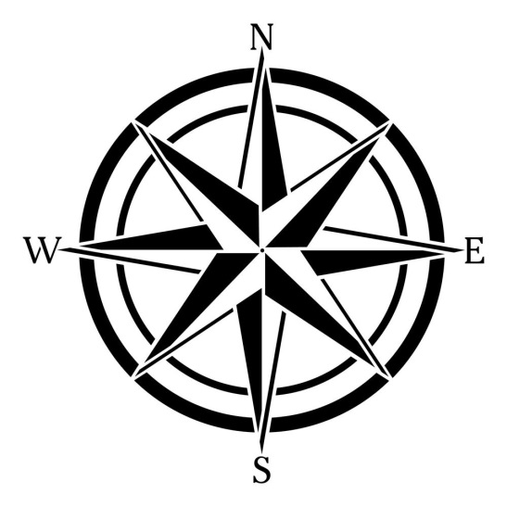
Throne Room
Chapter 4
}
Eagle
Dan – 62,700
Asher – 41,500
Naphtali – 53,400
157,600
}
Ephraim – 40,500
Benjamin – 35,400
Manasseh – 32,200
108,100
Judah – 74,600
Issachar – 54,400
Zebulun – 57,400
}
Ox
Levi
Lion
186,400
Man
}
Reuben – 46,500
Simeon – 59,300
Gad – 45,650
151,450
Notes:
The four faces are also the same found on the banners of the tribes of Israel.
Why Holy, Holy, Holy? Holy 3 times?
The trinity.
Camping arrangement and marching order (Numbers 2-4)

Slide 225
Seven Sealed Scroll
Chapter 5
Will the church go through the Tribulation?
1260 days
Time, Times and Half a Time
3 ½ years
Notes:
“The Tribulation”
One of the most documented segments of time in the bible.

Slide 226
Seven Sealed Scroll
Chapter 5
Will the church go through the Tribulation?
The “Wrath” does not start until Jesus is opening the scroll (Revelation 6)
Jesus doesn’t open the scroll until he has received it from God. (Rev 5)
Jesus takes the scroll in the presence of the 24 Elders. (Rev 5)
The 24 Elders are a representation of the completed group of the church age believers. (Rev 4)
The seven lampstands that we were told were the church in chapter 1 are in heaven in chapter 4.
Notes:
“The Tribulation”
One of the most documented segments of time in the bible.

Slide 227
Seven Sealed Scroll
Chapter 5
Title Deed
Written on the outside of the scroll are the terms and conditions that must be met in order to be worthy of opening the scroll.
Notes:
Revelation
Then I saw in the right hand of the one who sits on the throne a scroll written on the inside and on the outside, sealed with seven seals. ² I also saw a powerful angel proclaiming with a loud voice, “Who is worthy to open the scroll and break its seals?”
The scroll is described as being written within and without.
This indicates that the scroll is either a title deed or a will.
Jeremiah 32
⁸ “Then my cousin Hanamel came to me in the courtyard of the guard just as the Lord had said, and he told me, ‘Please buy my field in Anathoth in the territory of Benjamin because you have the right to possess it, and the right to redeem it belongs to you. Buy it for yourself.’ So I knew that this was a message from the Lord.
⁹ “Then I bought the field in Anathoth from my cousin Hanamel. I weighed out the silver for him—seventeen shekels of silver. ¹⁰ I signed the deed and sealed it. I called in witnesses and used scales to weigh out the silver. ¹¹ Then I took the deed of purchase—both the sealed one with the terms and conditions and the open one— ¹² and I gave the deed of purchase to Neriah’s son Baruch, the grandson of Mahseiah, in the presence of my cousin Hanamel, in the presence of the witnesses who signed the deed of purchase, and in the presence of all the Judeans sitting in the courtyard of the guard. ¹³ In their presence, I instructed Baruch as follows: ¹⁴ ‘This is what the Lord of the Heavenly Armies, the God of Israel, says: “Take these deeds—both this sealed deed of purchase and this open deed—and put them in a clay pot so they’ll last for a long time.

Slide 228
Seven Sealed Scroll
Chapter 5
Heptatic Structure: 7 seals
Notes:
Sevens throughout Revelation.
7 letters
7 seals
7 trumpets
7 bowls (or censors)
Many many more 7s

Slide 229
Seven Sealed Scroll
Chapter 5
Opening the seals begins a series of events.
The Great and Terrible Day of the Lord (Joel 2:31)
The Time of Jacob’s Trouble (Jer 30:7)
A Time of Trouble (Daniel 12:1)
Great Tribulation (Matthew 24:22)

Slide 230
Seven Sealed Scroll
Chapter 5
The purpose of the Tribulation?
Hosea 5:15
“I will leave and go back to my place until they admit their offense and seek my face. When affliction comes to them, they will eagerly seek me.”
Notes:
The purpose is to drive Israel to the wall so they will seek Jesus earnestly.

Slide 231
Seven Sealed Scroll
Chapter 5
The Key to Prophecy
Daniel’s 70 weeks (Daniel 9)
Artaxerxes, King of Persia decrees the rebuilding of Jerusalem.
Nisan 445 BC (1 Nisan was 14 March)
Jesus Triumphal entry (6 April 32 AD)
69 weeks (173,880 days)
70th week
70 Weeks of Daniel
Notes:
Jesus tells us the key as recorded in Matthew 24:15-21
¹⁵ “So when you see the destructive desecration, mentioned by the prophet Daniel, standing in the Holy Place (let the reader take note), ¹⁶ then those who are in Judea must flee to the mountains. ¹⁷ Anyone who’s on the housetop must not come down to get what is in his house, ¹⁸ and anyone who’s in the field must not turn back to get his coat.
¹⁹ “How terrible it will be for women who are pregnant or who are nursing babies in those days! ²⁰ Pray that it may not be in winter or on a Sabbath when you flee, ²¹ because at that time there will be great suffering, the kind that hasn’t happened from the beginning of the world until now and certainly won’t ever happen again.
70 weeks prophecy given to Daniel through Gabriel.
‘Daniel, I’ve now come to give you insight and understanding. ²³ Because you’re highly regarded, the answer was issued when you began your prayer, and I’ve come to tell you. Pay attention to my message and you’ll understand the vision.
[Click]
²⁴ Seventy weeks have been decreed concerning your people and your holy city: to restrain transgression, to put an end to sin, to make atonement for lawlessness, to establish everlasting righteousness, to conclude vision and prophecy, and to anoint the Most Holy Place. ²⁵ So be informed and discern that seven weeks and 62 weeks will elapse from the issuance of the command to restore and rebuild Jerusalem until the Anointed Commander. The plaza and moat will be rebuilt, though in troubled times.
[Click]
²⁶ Then after the 62 weeks, the anointed one will be cut down (but not for himself). Then the people of the Coming Commander will destroy both the city and the Sanctuary. Its ending will come like a flood, and until the end there will be war, with desolations having been decreed.
[Click]
²⁷ He will make a binding covenant with many for one week, and for half of the week he will suspend both the sacrifice and grain offerings. Destructive people will cause desolation on the uttermost edge of the Sanctuary until it is complete and what has been decreed is poured out on the desolator.’”
[Click]
The gap between the 69 weeks and the 70th week is the church age.
The events of revelation are this 70th week.
This gap has been ~2000 years so far.
Sir Robert Anderson, “The Coming Prince” can be read online.
https://www.whatsaiththescripture.com/Voice/The.Coming.Prince.html
The gap structure follows throughout Revelation.
Gap between Seal 6 and 7.
Gap between Trumpet 6 and 7.
Gap between Bowl/Censor 6 and 7.

Slide 232
Seven Sealed Scroll
Chapter 5
Who is worthy to open the scroll and break its seals?
Our Goel, Yeshua Ha Meshiach
Notes:
Revelation 5
² I also saw a powerful angel proclaiming with a loud voice, “Who is worthy to open the scroll and break its seals?” ³ No one in heaven, on earth, or under the earth could open the scroll or look inside it. ⁴ I began to cry bitterly because no one was found worthy to open the scroll or look inside it.
⁵ “Stop crying,” one of the elders told me. “Look! The Lion from the tribe of Judah, the Root of David, has conquered. He can open the scroll and its seven seals.”
⁶ Then I saw a lamb standing in the middle of the throne, the four living creatures, and the elders. He looked^{[a]} like he had been slaughtered. He had seven horns and seven eyes, which are the seven spirits of God sent into all the earth.
[Click]
Jesus is fulfilling the role of the Goel.

Slide 233
Seven Sealed Scroll
Chapter 5
Boaz – Lord of the Harvest, Type of Jesus
Naomi – Type of Israel
Ruth - Gentile bride, Type of the Church
Notes:
The concept of the Goel, or kinsman redeemer is given to us by God in Leviticus 25:25.
The role of the kinsman redeemer is demonstrated in the book of Ruth.

Slide 234
Seven Sealed Scroll
Chapter 5
Qualifications of a kinsman redeemer
Must be a relative
Must be ABLE to perform the obligations
Must be WILLING to perform the obligations
Must fulfill the obligations

Slide 235
Seven Sealed Scroll
Chapter 5
Adam (which means man) lost his dominion over the earth.
Satan stole it away.
Jesus redeems the land through the shedding of his blood. As part of that also accepts the bride (Church).
His interest is not so much in the land as it is in the bride. Just as Boaz’s interest was foremost in Ruth.

Slide 236
Seven Sealed Scroll
Chapter 5
Jewish Titles of Jesus
The Lion of the Tribe of Judah
The Root of David
The Lamb
Notes:
The focus of the book changes in chapter 4.
Chapter 4 the titles Jesus uses are gentile or church age titles.
From chapter 4 on, the titles for Jesus are Jewish titles.

Slide 237
Seven Sealed Scroll
Chapter 5
Horns are a symbol of power throughout the Bible
The Elder’s New Song, clue to their identity
Only three people in the bible are both Kings and Priests
Melech Tzedek (Gen 14:19) [king] [justice/righteousness]
Jesus (Hebrews 5,6,7)
Us
Notes:
Revelation 5
⁷ He went and took the scroll from the right hand of the one who sits on the throne.
⁸ When the lamb had taken the scroll, the four living creatures and the twenty-four elders bowed down in front of him. Each held a harp and a gold bowl full of incense, the prayers of the saints. ⁹ They sang a new song:
“You are worthy to take the scroll and open its seals, because you were slaughtered. With your blood you purchased us for God from every tribe, language, people, and nation. ¹⁰ You made us a kingdom and priests for our God, and they will reign on the earth.”
The Vision of the Song of the Lamb
¹¹ Then I looked, and I heard the voices of many angels, the living creatures, and the elders surrounding the throne. They numbered 10,000’s times 10,000 and thousands times thousands. ¹² They sang with a loud voice,
“Worthy is the lamb who was slaughtered to receive power, wealth, wisdom, strength, honor, glory, and praise!”
¹³ I heard every creature in heaven, on earth, under the earth, and on the sea, and everything that is in them, saying,
“To the one who sits on the throne and to the lamb be praise, honor, glory, and power forever and ever!”
¹⁴ Then the four living creatures said, “Amen!”, and the elders bowed down and worshipped.
1 of 25 manuscripts of revelation comes from Alexandria (home of the Gnostics) and it reads “them” in place of “us”.

Slide 238
Seven Sealed Scroll
Chapter 5
Levitical Priests
Come from the line of Levi
Cannot be Kings
Judean Kings
Come from the line of Judah
Cannot be Priests

Slide 239
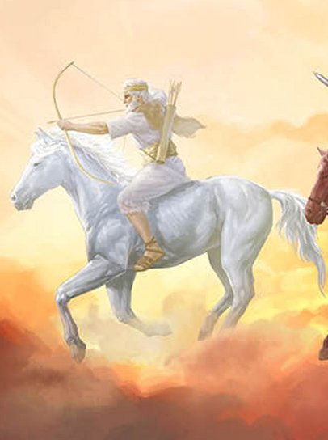
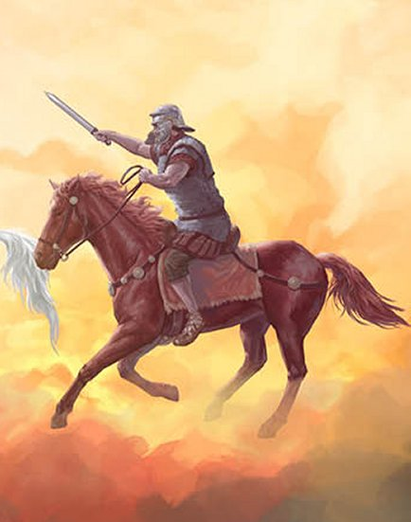
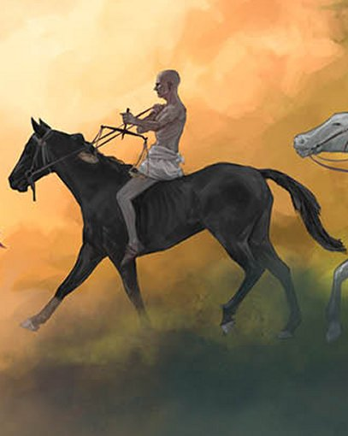
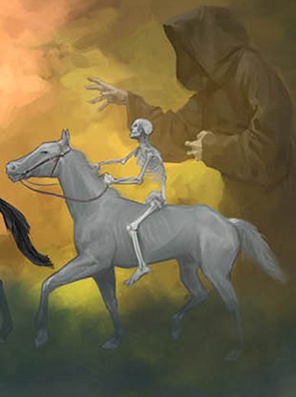
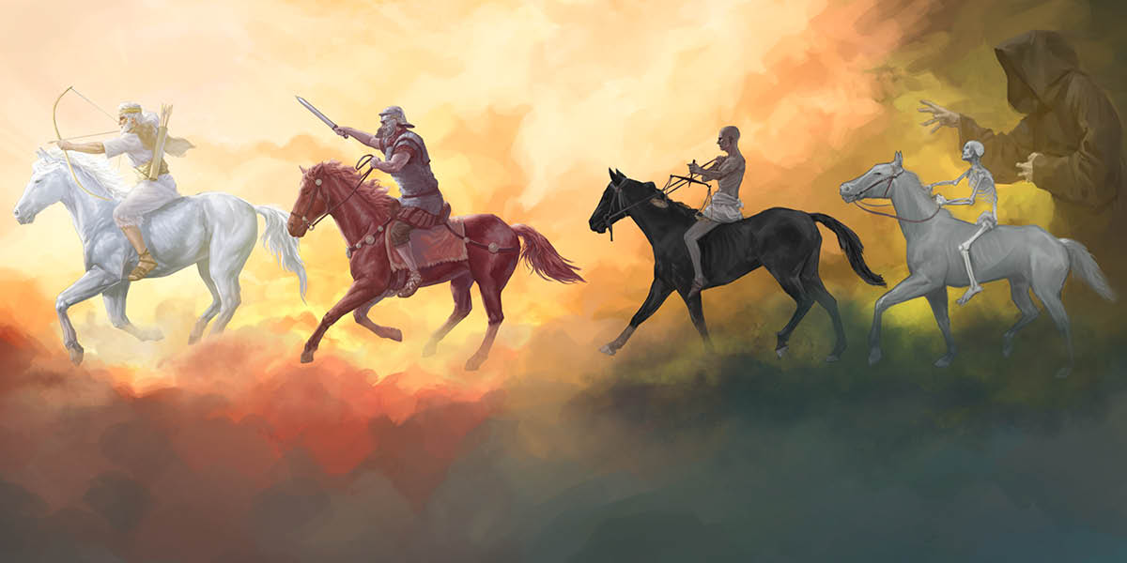
Wrath of the Lamb
Chapter 6
Notes:
Revelation 6
Then I saw the lamb open the first of the seven seals. I heard one of the four living creatures say with a voice like thunder, “Go!” ² Then I looked, and there was a white horse! Its rider had a bow, and a victor’s crown had been given to him. He went out as a conqueror to conquer.
[Click]
This white rider is NOT Jesus. Jesus is opening the scroll. This is an imposter. If this is Jesus, he’s riding with a bad crew.
Daniel 8 tells us about this one.
KJV Daniel 8:25
²⁵ And through his policy also he shall cause craft to prosper in his hand; and he shall magnify himself in his heart, and by peace shall destroy many: he shall also stand up against the Prince of princes; but he shall be broken without hand.
We also know from Daniel 9 that he will enforce or confirm the covenant for 7 years, that’s the 70th week.
Daniel 9:27
He will make a binding covenant with many for one week, and for half of the week he will suspend both the sacrifice and grain offerings. Destructive people will cause desolation on the uttermost edge of the Sanctuary until it is complete and what has been decreed is poured out on the desolator.’”
The bow in this rider’s hand brings to mind Nimrod, the first world dictator. His bow is in opposition to the sword that Jesus will wield later on.
The crown he is wearing is a stephanos. That is a victor’s crown, not a ruling crown.
In addition, the word for bow here may be a deliberate pun on the part of the Holy Spirit. It is the Greek word Toxon. It is the same word used in the septuagent translation of Genesis 9:13 for the rainbow. A token of a covenent.
[Click]
Revelation
³ When the lamb opened the second seal, I heard the second living creature say, “Go!” ⁴ A second horse went out. It was fiery red, and its rider was given permission to take peace away from the earth and to make people slaughter one another. So he was given a large sword.
[Click]
Revelation
⁵ When the lamb opened the third seal, I heard the third living creature say, “Go!” I looked, and there was a black horse! Its rider held a scale in his hand. ⁶ I heard what sounded like a voice from among the four living creatures, saying, “One day’s ration of wheat for a day’s wage, or three day’s ration of barley for a day’s wage! But don’t damage the olive oil or the wine!”
Black has been used as a symbol of famine before.(Lamentations 5:10)
An examination of famines finds that most famines are not caused by scarcity and that may be the same thing going on here as the luxury items, olive oil and wine, are apparently plentiful. Many famines are caused by political reasons. Such as the potato famine in Ireland. While the potatoes were indeed infected by a fungus. The United Kingdom had plenty of other food sources that they simply didn’t share with their subjects in Ireland.
[Click]
Revelation
⁷ When the lamb opened the fourth seal, I heard the voice of the fourth living creature say, “Go!” ⁸ I looked, and there was a pale green horse! Its rider’s name was Death, and Hades followed him. They were given authority over one-fourth of the earth to kill people using wars, famines, plagues, and the wild animals of the earth.
Keep in mind that one form of beasts is microscopic.
Two riders here, death takes the body, Hades takes the soul.
These are the four sore judgements (KJV) mentioned in Ezekiel 14:21.
Ezekiel 14
This is what the Lord God says, “I’m sending four of my most destructive judgments—military invasion, famine, wild animals, and pestilence—into Jerusalem to destroy both human beings and livestock in it.
Fifth Seal
Revelation
⁹ When the lamb opened the fifth seal, I saw under the altar the souls of those who had been slaughtered because of the word of God and the testimony they had given. ¹⁰ They cried out in a loud voice,
“Holy and true Sovereign, how long will it be before you judge and take revenge on those living on the earth who shed our blood?”
¹¹ Each of them was given a white robe. They were told to rest a little longer until the number of their fellow servants and their brothers was completed, who would be killed as they themselves had been.
They are not seeking personal revenge, but establishment of God’s justice.

Slide 240
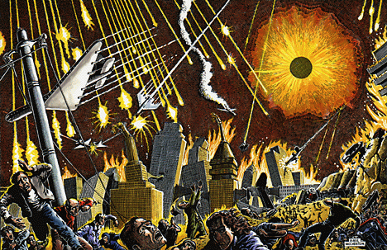
Wrath of the Lamb
Chapter 6
Notes:
Revelation
¹² Then I saw the lamb open the sixth seal. There was a powerful earthquake. The sun turned as black as sackcloth made of hair, and the full moon turned as red as blood. ¹³ The stars in the sky fell to the earth like a fig tree drops its fruit when it is shaken by a strong wind. ¹⁴ The sky vanished like a scroll being rolled up, and every mountain and island was moved from its place. ¹⁵ Then the kings of the earth, the important people, the generals, the rich, the powerful, and all the slaves and free people concealed themselves in caves and among the rocks in the mountains. ¹⁶ They told the mountains and rocks, “Fall on us and hide us from the face of the one who sits on the throne and from the wrath of the lamb. ¹⁷ For the great day of their wrath has come, and who is able to endure it?”
Image is from Basil Wolverton. He was asked by evangelist Herbert Armstrong to create a series of apocalyptic scenes for the end of the world. THis one is for Revelation 6:12-14.
Chapter 6 askes “Who can Stand?” (Who is able to endure it?)
Chapter 7 is the answer to that question.
Notice two things here. The people hide themselves in caves. Where did this happen before? (Joshua 10:16-27)
There are quite a few paralles between Joshua and Revelation.

Slide 241
Wrath of the Lamb
Chapter 6
Olivet Discourse and Seals Comparison
 | Matthew | Luke | Revelation
False messiah/false prophets | 24:4-5 | 21:4 | White horse = False messiah [6:1-2]
Wars and rumors of war | 24:6 | 21:9,10 | Red horse = war [6:3-4]
Famines and earthquakes | 24:7a | 21:11 | Black horse = famine / inflation [6:5-6]
Death | 24:7b-8 | 21:12 | Pale (green) horse = death / pestilence [6:7-8]
Martyrs | 24:9 | 21:24 | Seal 5 souls under the altar [6:9-11]
Global chaos | 24:29-30 | 21:25 | Seal 6 global upheaval [6:12-14]

Slide 242
Who Can Stand?
Chapter 7
144,000
Results of the 144,000’s work
Notes:
Chapter 7 is in two parts, the 144,000 and the results of their work.
Revelation
After this, I saw four angels standing at the four corners of the earth. They were holding back the four winds of the earth so that no wind could blow on the land, on the sea, or on any tree. ² I saw another angel coming from the east having the seal of the living God. He cried out in a loud voice to the four angels who had been permitted to harm the land and sea, ³ “Don’t harm the land, the sea, or the trees until we have marked the servants of our God with a seal on their foreheads.”
⁴ I heard the number of those who were sealed: 144,000. Those who were sealed were from every tribe of Israel: ⁵ 12,000 from the tribe of Judah were sealed, 12,000 from the tribe of Reuben, 12,000 from the tribe of Gad, ⁶ 12,000 from the tribe of Asher, 12,000 from the tribe of Naphtali, 12,000 from the tribe of Manasseh, ⁷ 12,000 from the tribe of Simeon, 12,000 from the tribe of Levi, 12,000 from the tribe of Issachar, ⁸ 12,000 from the tribe of Zebulun, 12,000 from the tribe of Joseph, and 12,000 from the tribe of Benjamin were sealed.
Two tribes are missing.

Slide 243
Who Can Stand?
Chapter 7
Jacob/Israel
Leah
Bilah
Zilpah
Rachel
Manasseh
Reuben
Dan
Gad
Joseph
Ephraim
Simeon
Naphtali
Asher
Benjamin
Levi
Judah
Issachar
Zebulun
Notes:
Genesis 29:31-30:24. Tribes are born.
Genesis 48. Jacob adopts Manasseh and Ephraim.
So we have 14 names to distribute among 12 tribes listings. So that if any one is missing, 12 can still be listed.
This next part causes people to become very upset. It has even split up congregations and I don’t understand why myself.
There is a belief that there are 10 lost tribes. This is completely untrue. It isn’t even biblical.
James and Peter (1 Peter) writes “to the 12 tribes.”
Prophecies of 12 tribes (Jacob – Genesis 49 and Moses – Deuteronomy 33).
The concept comes from a misreading of 2 Kings 17:7-23 and 2 Chronicles 6:6-11
The bible, itself tells us what happened.
2 Chronicles 15
⁹ Then he gathered together all of Judah, Benjamin, and people from Ephraim, Manasseh, and Simeon who were living among them, since many people had defected to him from Israel when they learned that the Lord his God was with him.

Slide 244
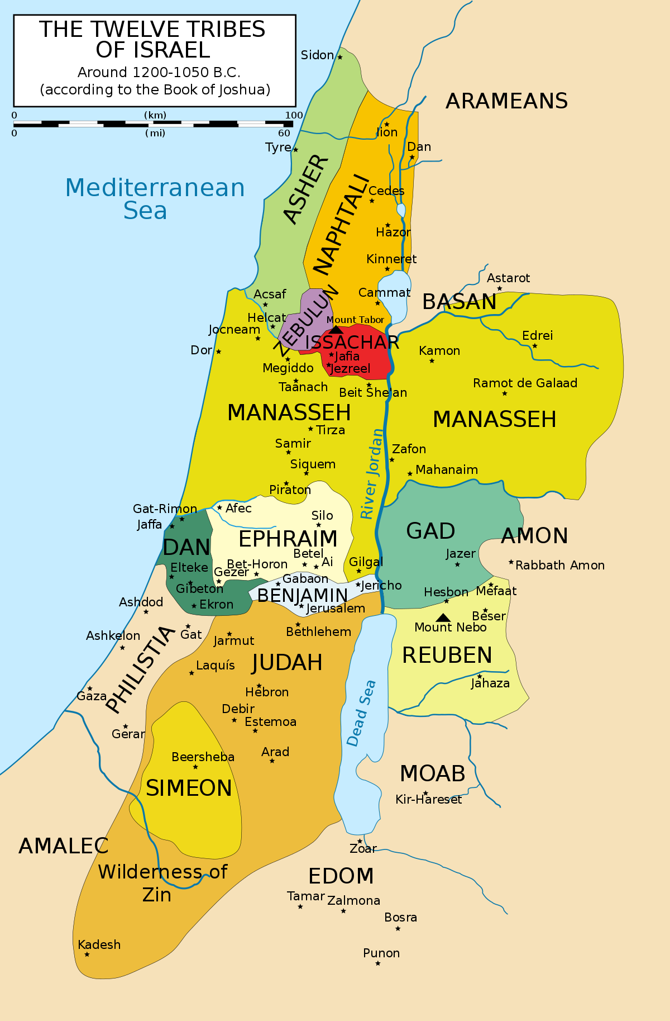
Chapter 7
Notes:
Original distribution of the land.
The territories share the names of the tribes.
Dan couldn’t manage the philistines in their territory after Samson died and so looked for a new area.
They found a peaceful town of laish to the north and conquered it. Renaming it Dan. This new city of Dan is at the base of Mt. Hermon (or Mount Tsaphon/Zaphon).
During the time of the judges, the tribe of Dan was chastised by Deborah for not helping to Sisera. Dan apparently had taken to ships and didn’t really care much for their brethren.

Slide 245
Who Can Stand?
Chapter 7
930 BC – Jeroboam rules the northern kingdom from Samaria.
724 BC - Assyria (Shalmaneser V) conquers the northern territories and deports a number of them to other parts of Assyria’s empire while also mixing foreigners with those left in Samaria.
Notes:
This begins the period of the two kingdoms. For a while, the bible refers to the northern kingdom as Israel and the southern kingdom as Judah.
At the end of the split kingdom period, these two names will once again begin to be used synonymously.
Jeroboam didn’t want his people leaving to go worship in Jerusalem. So he set up two golden calves. One in the now territory of Dan and one at Bethel. Bethel is in the territory of Ephraim.
I choose the word territory carefully. Do not confuse the territory with the people who live there.
2 Chronicles 11:14
³ The priests and descendants of Levi throughout Israel also supported him in their districts, ¹⁴ because the descendants of Levi left their pasture lands and their property to live in Judah and Jerusalem, since Jeroboam and his sons had excluded them from participating in priestly services to the Lord. ¹⁵ Jeroboam had appointed his own priests to serve at the high places and to serve the satyrs and calves that he had made. ¹⁶ As a result, anyone from all of the tribes of Israel who was determined to seek the Lord God of Israel followed the descendants of Levi to Jerusalem so they could sacrifice to the Lord God of their ancestors, ¹⁷ and they continued to strengthen the kingdom of Judah, supporting Solomon’s son Rehoboam for three years, by living the way David and Solomon did for three years.

Slide 246
Who Can Stand?
Chapter 7
Hezekiah, long after the Assyrian deportation, calls for ALL Israel to come to worship in Jerusalem (2 Chronicles 30:5-21).
80 years later, King Josiah also calls for all of Israel and an offering for the temple is received from “Manasseh and Ephraim and all the remnant of Israel…” (2 Chronicles 34:9)
Notes:
I am from New Mexico. If New Mexico were to be lost, I wouldn’t suddenly disappear.
Jesus offered Himself to the nation “the lost sheep of the house of Israel” (Matthew 10:5-6; 15:24)
Anna knew her tribal identity as Asher (Luke 2:30)
Paul knew he was from Benjamin, a Jew and an Israelite. (Romans 11:1)
The dry bones vision declares Judah and Israel shall be joined. We saw this in 1948.

Slide 247
Who Can Stand?
Chapter 7
Why is Dan missing?
Ephraim is also missing but only sort of. He is there behind the name Joseph.
Notes:
Dan To Be’er Sheva is used as a idiom to speak of all Israel. Dan in the north, Be’er Sheva in the south.
Jeroboam built idols at Dan and one at Bethel (that is in Ephraim – not Be’er Sheva). Dan to Ephraim is the territory of the northern kingdom.
Idolatry entered the land through Dan.
Deuteronomy 29
¹⁸ Be alert so there is no man, woman, family, or tribe whose heart is turning away from the Lord your God to go and serve the gods of those nations. Be alert so there will be no root among you that produces poisonous and bitter fruit, ¹⁹ because when such a person hears the words of this oath, he will bless himself and say:
‘I will have a peaceful life, even though I’m determined to be stubborn.’ By doing this he will be sweeping away both watered and parched ground alike.’
²⁰ “The Lord won’t forgive such a person. Instead, the zealous anger of the Lord will blaze against him. All the curses that were written in this book will fall on him. Then the Lord will wipe out his memory from under heaven. ²¹ The Lord will set him apart from all the tribes of Israel for destruction, according to the curses of the covenant that were written in this Book of the Law.”
Dan does judge (as in rule) his people as one of the tribes of Israel (Gen 49:16) and inherits land in the millennium (Ezekiel 48:1). The tribe of Dan is apparently NOT protected through the tribulation but does arrive the hard way so to speak.

Slide 248
Who Can Stand?
Chapter 7
Results of the work of the 144,000
Heptatic Structure!
How many praises in verse 11?
Notes:
Revelation
⁹ After these things, I looked, and there was a crowd so large that no one was able to count it! They were from every nation, tribe, people, and language. They were standing in front of the throne and the lamb and were wearing white robes, with palm branches in their hands. ¹⁰ They cried out in a loud voice,
“Salvation belongs to our God, who sits on the throne, and to the lamb!”
¹¹ All the angels stood around the throne and around the elders and the four living creatures. They fell on their faces in front of the throne and worshipped God, ¹² saying,
“Amen! Praise, glory, wisdom, thanks, honor, power, and strength be to our God forever and ever! Amen!”
¹³ “Who are these people wearing white robes,” one of the elders asked me, “and where did they come from?”
¹⁴ I told him, “Sir, you know.”
Then he told me, “These are the people who are coming out of the terrible suffering. They have washed their robes and made them white in the blood of the lamb. ¹⁵ That is why:
“They are in front of the throne of God and worship him night and day in his Temple. The one who sits on the throne will shelter them. ¹⁶ They will never be hungry or thirsty again. Neither the sun nor its heat will ever beat down on them, ¹⁷ because the lamb in the center of the throne will be their shepherd. He will lead them to springs filled with the water of life, and God will wipe every tear from their eyes.”

Slide 249
Who Can Stand?
Chapter 7
Comparison of Elders and Tribulation Saints
24 Elders | Tribulation Saints
Wearing crowns | Not crowned
Holding harps | Holding palms
Kept out of the tribulation (Rev 3:10) | Saved out of the tribulation
Sitting on thrones | Standing before thrones
Reign as kings and priests | Serve Him day and Night
John associates himself with the elders (Rev 1:5) | Not recognized by John

Slide 250
Trumpet Judgements
Chapter 8
Prophecy is Pattern
Mishnaic
Notes:
Revelation 8
When the lamb opened the seventh seal, there was silence in heaven for about half an hour. Then I saw the seven angels who stand in God’s presence, and seven trumpets were given to them.
Could the book of Joshua be an ancient pattern of the Revelation?

Slide 251
Trumpet Judgements
Chapter 8
Joshua (yohoshua) is a variant of yeshua.
The book of Joshua tells of a military commander dispossessing the usurpers of the land.
The campaign of Joshua is a seven year campaign.
Joshua sent in two witnesses. They were spies, but didn’t do anything apparently but get Rahab and her family saved.
There are seven trumpet events at the battle of Jericho.
The trumpet events were preceded by silence.
Joshua’s enemies rally under a leader who calls himself Adonai-Tzedek (Lord of Righteousness).
Joshua’s enemies experience hailstones from heaven.
There are signs in the sun and moon.
The kings and leaders hide in caves.
Initiates the Jubilee (Restoration of all things)

Slide 252
Trumpet Judgements
Chapter 8
Notes:
Revelation
³ Another angel came with a gold censer and stood at the altar. He was given a large quantity of incense to offer on the gold altar before the throne, along with the prayers of all the saints. ⁴ The smoke from the incense and the prayers of the saints went up from the angel’s hand to God. ⁵ The angel took the censer, filled it with fire from the altar, and threw it on the earth. Then there were peals of thunder, noises, flashes of lightning, and an earthquake. ⁶ The seven angels who had the seven trumpets got ready to blow them.
Two words in Greek for another.
Allos means another of the same kind.
Heteros is another of a different kind.
Therefore this angel at the altar is not Jesus.
Incense smoke is used idiomatically for prayers throughout the bible. This may be a case of being both literal and idiomatic.
Remember chapter 5 where the saints were petitioning for vengeance for the Lord and they were told to wait a bit more.
This is now those prayers being answered.

Slide 253
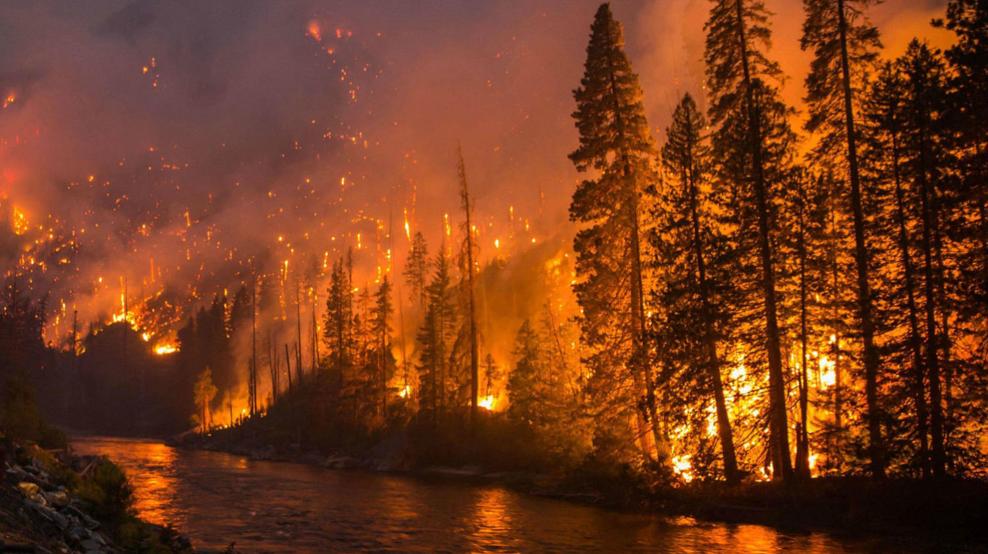
Trumpet Judgements
Chapter 8
Notes:
Revelation 8
⁷ When the first angel blew his trumpet, hail and fire were mixed with blood and thrown on the earth. One-third of the earth was burned up, one-third of the trees was burned up, and all the green grass was burned up.
Devastation of the vegetation.

Slide 254
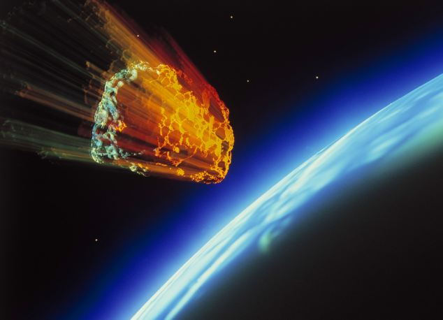
Trumpet Judgements
Chapter 8
Notes:
Revelation 8
⁸ When the second angel blew his trumpet, something like a huge mountain burning with fire was thrown into the sea. One-third of the sea turned into blood, ⁹ one-third of the creatures that were living in the sea died, and one-third of the ships was destroyed.
Possibly a meteor. It is something LIKE a mountain.

Slide 255
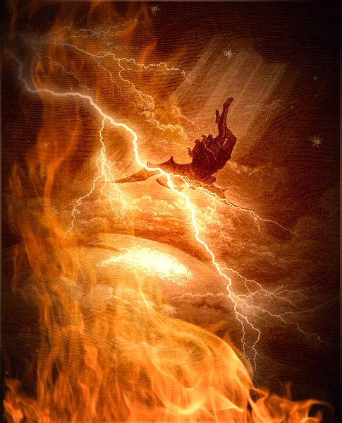
Trumpet Judgements
Chapter 8
Notes:
Revelation 8
¹⁰ When the third angel blew his trumpet, a huge star blazing like a torch fell from heaven. It fell on one-third of the rivers and on the springs of water. ¹¹ The name of the star is Wormwood. One-third of the water turned into wormwood, and many people died from the water because it had turned bitter.
Stars are often used idiomatically to talk of Angels.
Many scholars believe this one is Satan.
When did Satan fall? There are debates about this.
We know that Satan had fallen by Genesis 3. The most popular conjecture is what is called the Gap theory. That is an amount of time passed between Genesis 1:1 and Genesis 1:2. It has nothing to do with dinosaurs or things like that.
We know from Job that even so, Satan has access to Heaven and the Heavenly Council.
THIS event is Satan finally losing that access.
As an aside, it is important to know the difference between fallen angels and demons. Satan is a fallen angel. One of the apkullu according to Mesopotamian lore or what we know as the Watchers.
Angels can materialize. Demons apparently cannot, but are constantly seeking a body to inhabit. They can only do so with permission. Which we learn from the instance of the Gerasene Demoniac.
Likewise Satan, though he is a fallen angel and not a demon, must obey God. He cannot do anything to you unless he has permission to do so. We learn this from Job.

Slide 256
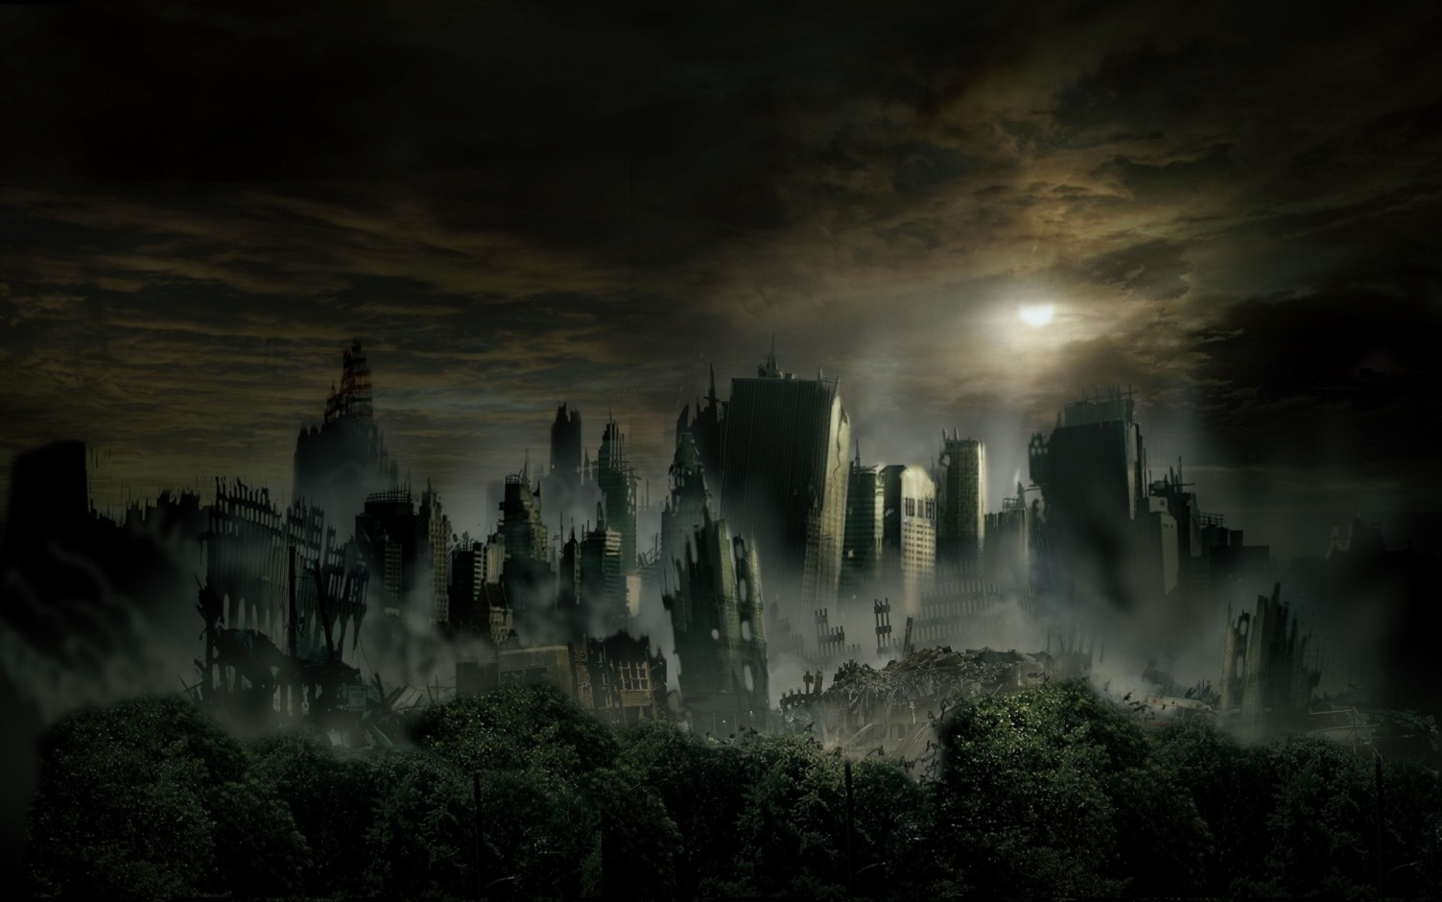
Trumpet Judgements
Chapter 8
Notes:
Revelation 8
¹² When the fourth angel blew his trumpet, one-third of the sun, one-third of the moon, and one-third of the stars were struck so that one-third of them turned dark. One-third of the day was kept from having light, as was the night.
These four trumpets are known as the judgement of the thirds. Almost like a warning of what is coming with the bowls.

Slide 257
Trumpet Judgements
Chapter 8
Notes:
Revelation
¹³ Then I looked, and I heard an eagle flying overhead say in a loud voice,
“How terrible, how terrible, how terrible for those living on the earth, because of the blasts of the remaining trumpets that the three angels are about to blow!”
Some translations say “I heard an angel flying overhead” the Greek word here is ἀετοῦ (aetou).
Woe is used three times because there are three trumpets left to go.
Similarly the angels sing Holy Holy Holy about God because of the trinity.

Slide 258
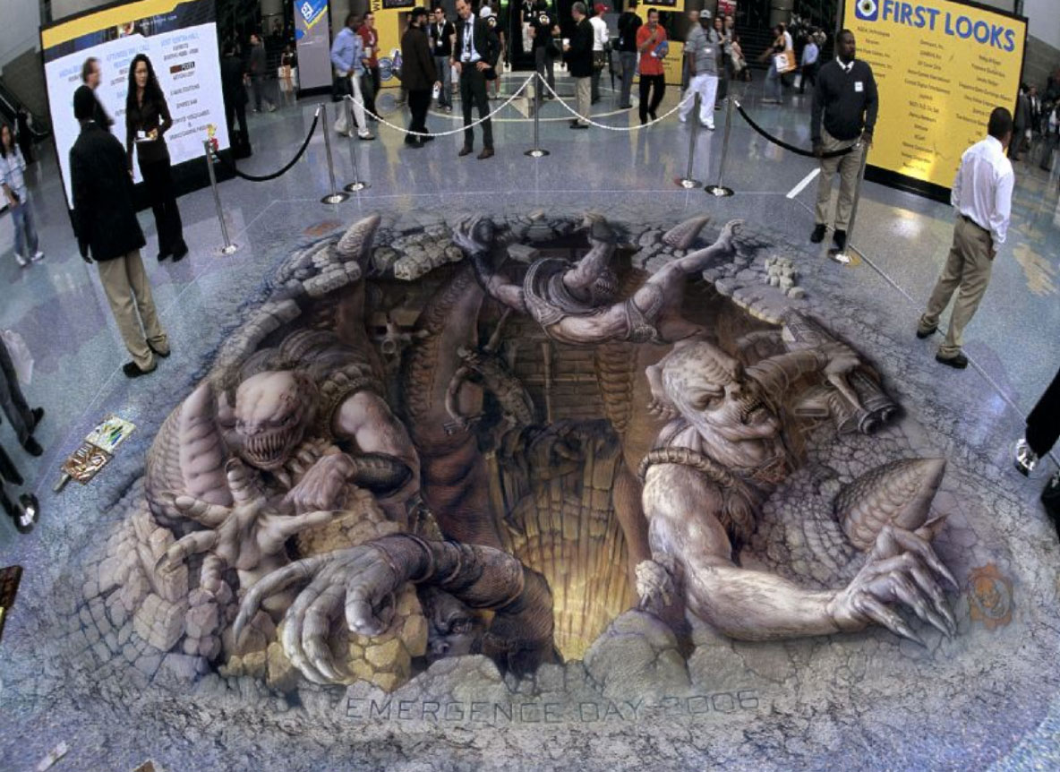
Trumpet Judgements
Chapter 9
Who is Gog of Magog?
Comparing the Septuagint and King James Bibles
http://www.ecmarsh.com/lxx-kjv/
Notes:
Revelation
When the fifth angel blew his trumpet, I saw a star that had fallen to earth from the sky. The star was given the key to the shaft of the bottomless pit. ² It opened the shaft of the bottomless pit, and smoke came out of the shaft like the smoke from a large furnace. The sun and the air were darkened with the smoke from the shaft.
Here it is fairly clear this is Satan. Since the star is being described as “he”.
Notice that Satan is given the key. He doesn’t already have it.
One of the popular myths, derived from English literature, is that Satan is ruling in hell. He isn’t ruling anything. Hell is a place made for him and his false prophet.
Anyone else who ends up there is there by their own choice.
³ Locusts came out of the smoke onto the earth, and they were given power like that of earthly scorpions. ⁴ They were told not to harm the grass on the earth, any green plant, or any tree. They could harm only the people who do not have the seal of God on their foreheads. ⁵ They were not allowed to kill them, but were only allowed to torture them for five months. Their torture was like the pain of a scorpion when it stings someone. ⁶ In those days people will seek death, but never find it. They will long to die, but death will escape them.
⁷ The locusts looked like horses prepared for battle. On their heads were victor’s crowns that looked like gold, and their faces were like human faces. ⁸ They had hair like women’s hair and teeth like lions’ teeth. ⁹ They had breastplates like iron, and the noise of their wings was like the roar of chariots with many horses rushing into battle. ¹⁰ They had tails and stingers like scorpions, and they had the power to hurt people with their tails for five months. ¹¹ They had the angel of the bottomless pit ruling over them as king. In Hebrew he is called Abaddon, and in Greek he is called Apollyon.
¹² The first catastrophe is over. After these things, there are still two more catastrophes to come.
Abaddon and Apollyon, in both instances mean destroyer.
There are commentators who try to make this helicopters or other modern war machines. I am in the school of thought that thinks they are an actual demon army.
Notice here, too, that these guys are GIVEN power. They don’t have it on their own.
There is an apparent contradiction I have to bring up here. Proverbs 30:27 tells us that the locusts have no king yet here we are told the locusts are ruled by a Abaddon/Apollyon.
We can see pretty clearly that these aren’t actual locusts. They are described sort of like locusts until verse 10 where they clearly diverge.
Gog from Magog is mentioned 1 time in the bible. That is Ezekiel 38. It is unusual for a thing to be present in the bible only once.
As it turns out, Gog may be mentioned at least one other time in Amos.
Our modern translation of Amos 7:1 reads as follows:
ISV Amos 7:1 This is what the Lord God showed me: Look! He was forming locust swarms as the latter plantings were just beginning to sprout. Indeed, the king had just taken his first fruit tax.
Most every bible translates this from the Masoretic Texts which were written between the 7th and 10th century AD.
If you have an ISV you might notice a footnote is applied to this verse which gives away an interesting fact.
The Septuagint reads quite a bit differently. This is from an English translation of the Septuagint and is how the Jewish scholars at the time of Ptolemy Philadelphus interpreted the words of Amos 7:1
Thus has the Lord God shewed me; and, behold, a swarm of locusts coming from the east; and, behold, one caterpillar, king Gog.
http://www.ecmarsh.com/lxx-kjv/
How does one seek death but are not able to find it? Maybe this is just a statement trying to describe just how bad things are going to be, but maybe there is some technology involved. Transhumanists are striving to achieve virtual immortality through nanobots, pharmaceuticals and computer technology.

Slide 259
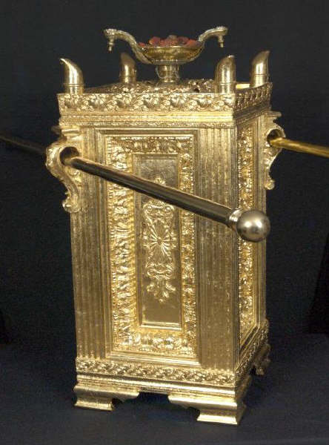
Trumpet Judgements
Chapter 9
dismyriades myriadōn
δισμυριάδες μυριάδων
Twice 10,000 two myriads
Notes:
Revelation
¹³ When the sixth angel blew his trumpet, I heard a voice from the four horns of the gold altar in front of God. ¹⁴ It told the sixth angel who had the trumpet, “Release the four angels who are held at the great Euphrates River.” ¹⁵ So the four angels who were ready for that hour, day, month, and year were released to kill one-third of humanity. ¹⁶ The number of cavalry troops was 200,000,000. I heard how many there were.
The golden altar in front of God is the golden incense altar which Moses was told to copy for the earthly tabernacle in Exodus 30. Hebrews 8:5 tells us that the heavenly temple is a copy. We’ll talk more on this in a few chapters.
The Euphrates river is one of the four in the Garden of Eden which is east of Eden. If the Garden was east of Eden where is Eden?
West of the Garden is Israel. That piece of land has God’s name on it.
The Euphrates river served as a boundary between the Roman and Parthian empires. The Parthian empire is where the Magi came from. The Magi were known as king makers and this, among other things, is why Herod was so shaken when the Magi and their military entourage arrived. It wasn’t just three old guys crossing the desert with a vast sum of wealth.
200 million sounds like a large number indeed. The actual words translated to 200 million are :
The number 10,000 has been assigned to myriad but may not be exact. It could also be literal, so come to your own conclusion.

Slide 260
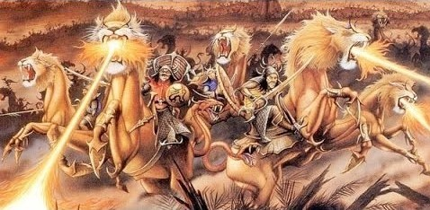
Trumpet Judgements
Chapter 9
Notes:
Revelation
This was how I saw the horses in my vision: The riders wore breastplates that had the color of fire, sapphire, and sulfur. The heads of the horses were like lions’ heads, and fire, smoke, and sulfur came out of their mouths. ¹⁸ By these three plagues—the fire, the smoke, and the sulfur that came out of their mouths—one-third of humanity was killed. ¹⁹ For the power of these horses is in their mouths and their tails. Their tails have heads like snakes, which they use to inflict pain.
More similes.
²⁰ The rest of the people who survived these plagues did not repent from their evil actions or stop worshiping demons and idols made of gold, silver, bronze, stone, and wood, which cannot see, hear, or walk. ²¹ They did not repent from their murders, their witchcraft, their sexual immorality, or their thefts.
This is one of the most bizarre things in Revelation. The people see and experience what is happening. They know why it is happening and yet they do not repent.
Interesting that 4 specific sins are listed here. Murder, witchcraft (or sorcery or in the greek Pharmakia), sexual immorality (sex sells is a phrase you may have heard. Everything has somehow been associated with it.)
Theft. This isn’t just individual level theft but worse, institutional theft.
Socialism is the plundering of the productive by the unaccountable.
This is the 6th trumpet and so we are about to move on to another pause in the action. This gap covers chapters 10 – 14.
We’ll talk about a powerful angel.
“These two witnesses of mine.”
The history of Israel.
The two beasts of the antechristos.
The bloody harvest.

Slide 261
Mighty Angel
Chapter 10
Notes:
We begin the prophetic pause between the sixth and seventh trumpet.
Revelation
Then I saw another mighty angel coming down from heaven. He was robed in a cloud, with a rainbow above his head; his face was like the sun, and his legs were like fiery pillars. ² He was holding a little scroll, which lay open in his hand. He planted his right foot on the sea and his left foot on the land, ³ and he gave a loud shout like the roar of a lion.
Who is the mighty angel?
Some think this is Jesus, himself. The reason being that the descriptors of this angel are reminiscent of His description from Revelation 1.
Jesus has been referred to as the Angel of the Lord in the old testament.
The slide here shows the interlinear of this passage. The word here is “allon” (a form of “allos”) which is to say another of the same kind rather than heteros which is another of a different kind.
So I am of the school that this isn’t Jesus but is clearly some important angel on behalf of Jesus.
Gabriel, one of the named angels in the canonical scripture, is one possibility. His name means “strength of God”.
Michael is another named angel. He is always in a position of fighting or defending. He is said to be one of the chief princes (Daniel 10:13). He contended with Satan over the body of Moses (Jude 9). His name means “who is like God”.
Either way, there is no doctrinal issue no matter if one think this is Jesus or an important angel acting on His behalf.
When he shouted, the voices of the seven thunders spoke. ⁴ And when the seven thunders spoke, I was about to write; but I heard a voice from heaven say, “Seal up what the seven thunders have said and do not write it down.”
The seven thunders utterance is the only sealed thing in this otherwise open book of prophecy. Contrast this with Daniel which is was said to be closed until the end. Revelation is intentionally open.
Why even keep the fact that there were seven thunders who said a thing when told to not write what they said?
My guess on what they said is that it something that if it was visible would give enough of a clue as to when all of this was to occur.
⁵ Then the angel I had seen standing on the sea and on the land raised his right hand to heaven. ⁶ And he swore by him who lives for ever and ever, who created the heavens and all that is in them, the earth and all that is in it, and the sea and all that is in it, and said, “There will be no more delay!
Some translations read “there should be time no longer”. This isn’t to sway that time stops, this is just a way of saying let there be no more delay. God has been holding off judgement so that the lost will have time to repent (2 Peter 3:1-9).
The time for that is now up. The prayers of the souls under the altar were asking for vengeance for God and were told to wait a little longer. That waiting is not over.
⁷ But in the days when the seventh angel is about to sound his trumpet, the mystery of God will be accomplished, just as he announced to his servants the prophets.”
⁸ Then the voice that I had heard from heaven spoke to me once more: “Go, take the scroll that lies open in the hand of the angel who is standing on the sea and on the land.”
⁹ So I went to the angel and asked him to give me the little scroll. He said to me, “Take it and eat it. It will turn your stomach sour, but ‘in your mouth it will be as sweet as honey.’” ¹⁰ I took the little scroll from the angel’s hand and ate it. It tasted as sweet as honey in my mouth, but when I had eaten it, my stomach turned sour. ¹¹ Then I was told, “You must prophesy again about many peoples, nations, languages and kings.”
The little scroll is widely believed to be the now unsealed scroll Jesus had just finished. John is being told to assimilate the word. Just as we are to assimilate God’s word. This is different from just reading it.
Indeed, as you begin to become more mature in your walk with God, His word is sweet but you begin to realize just how empty the world is.
John is then told to go back to what he was doing (you must prophecy again). Some scholars take this to mean that he is one of the two witnesses in the next chapter. I am of the group of people who don’t agree with that line of thought.

Slide 262
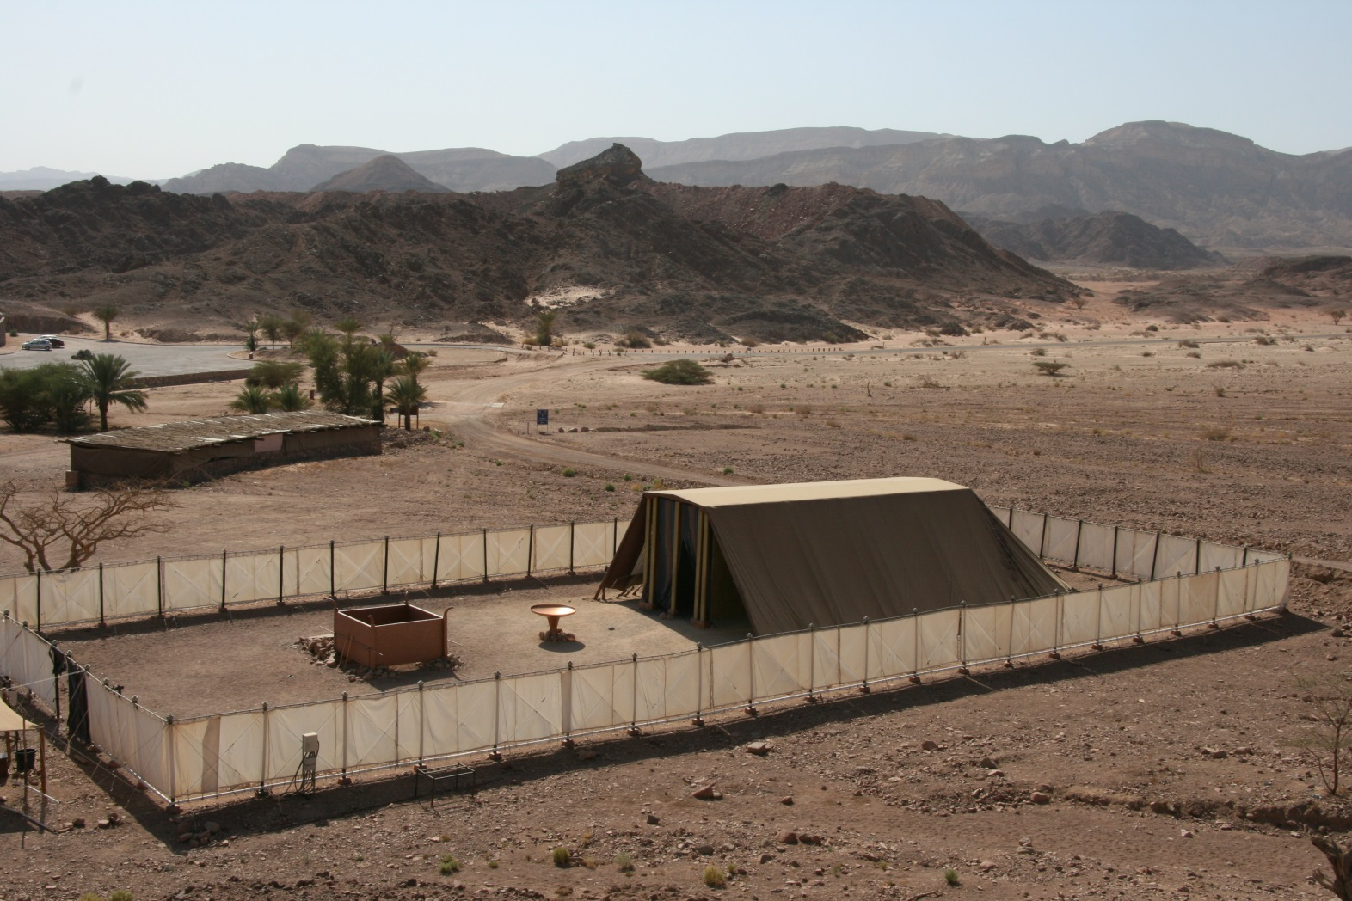
Third Temple
Chapter 11
Tabernacle
Plans given to Moses as a copy of that which was in Heaven (Exodus 26:30)
Notes:
Revelation 11
Then I was given a stick like a measuring rod. I was told, “Stand up and measure the Temple of God and the altar, and count those who worship there. ² But don’t measure the courtyard outside the Temple. Leave that out, because it is given to the nations, and they will trample the Holy City for 42 months.
This word for Temple is the Greek word, “Naos” which means the temple proper rather than the grounds around it which would be “heiron”.
We know the temple must exist for the events in the tribulation to take place. We know this because Jesus tells us as much in Matthew 24:15.
Paul mentions it in 2 Thessalonians 2:4 and John mentions it here.
History of the temple:
The temple started with Moses being given the plans to make a replica of the Temple in Heaven.

Slide 263
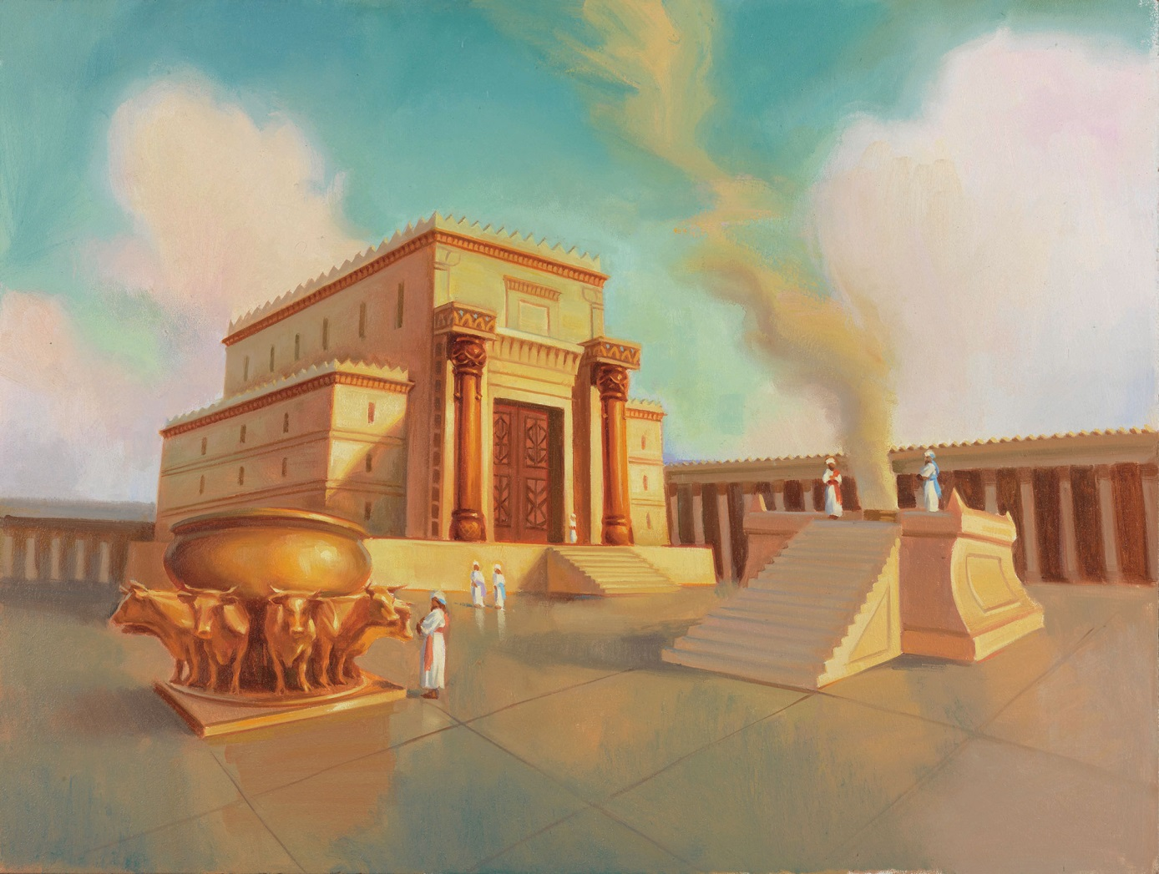
Third Temple
Chapter 11
Solomon’s Temple
1st Temple
Notes:
After Israel entered “the land” and after the period of the judges we come to the monarchy. During this time, the “temple” was still the tent of meeting. It moved from time to time. This was the case up through King David. David wanted to build a permanent structure but was not allowed to. His son, Solomon did build it.
Solomon’s Temple is known as the first temple. It was never matched in its splender. (~960BC)
Later, the nation split into the northern and southern kingdoms. The northern kingdom was conquered and its people scattered by Assyria.
The southern kingdom lasted a bit longer but was eventually conquered by Nebuchadnezzar of Babylon. Solomon’s temple was destroyed and the people taken to Babylon for 70 years.

Slide 264
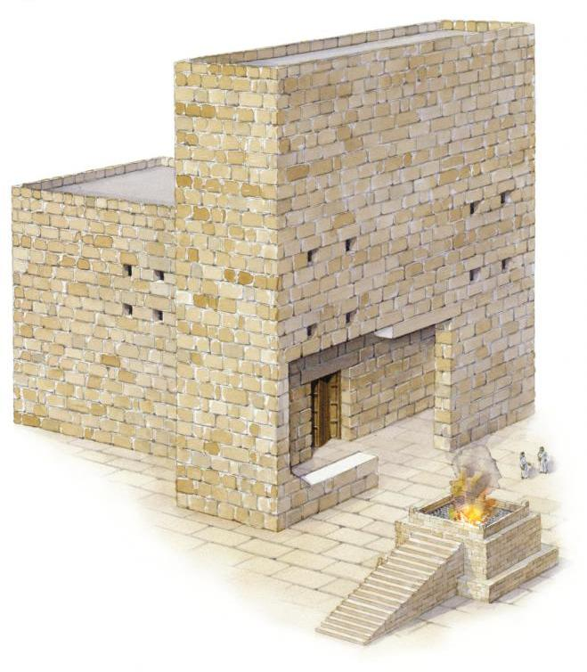
Third Temple
Chapter 11
Zerrubbabel’s Temple
2nd Temple
Notes:
After the 70 years of captivity, Daniel gives King Cyrus was a scroll which was a letter written to him 100 years before (Isaiah 45). He is so impressed he gives people money and leave to return to Judea to rebuild the Temple.
They have several problems in its construction but eventually get it done. This is told in the books of Ezra and Nehemiah.

Slide 265
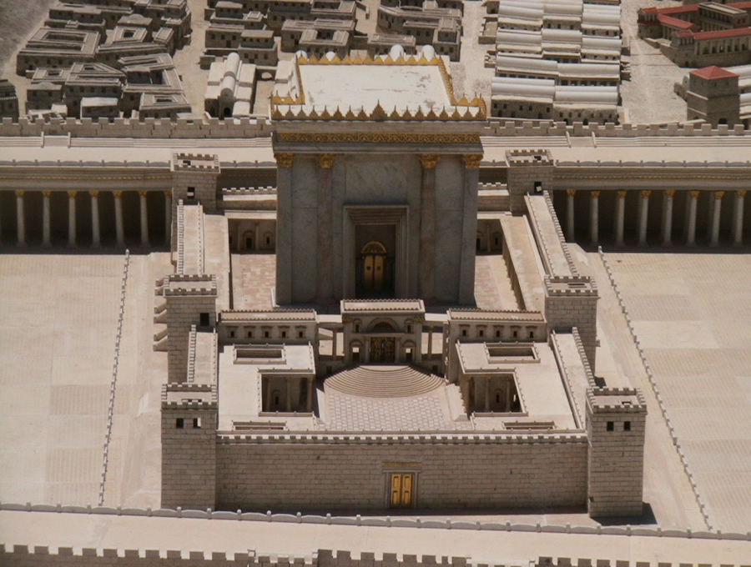
Third Temple
Chapter 11
Herod’s Temple
2nd Temple (renovated)
Notes:
Centuries later, near the time of Jesus’ birth, Herod renovates and adds to Zerubbabel’s temple. We might think of it as the third temple, but it is really the second with additions and upgrades.

Slide 266
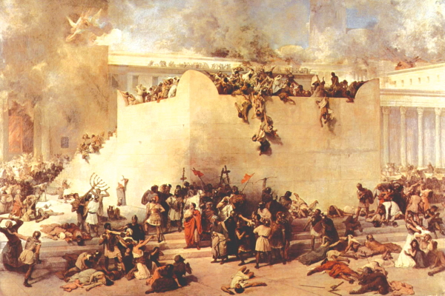
Third Temple
Chapter 11
10th, 12th & 15th Legions destroys the 2nd Temple
(70 AD)
Notes:
In 70 AD, the Romans destroy the 2nd temple. 65 years later, Simon bar Kokhba leads a revolt against the Romans. He is declared the messiah by Rabbi Akiva but his rebellion ends disastrously.
Emperor Hadrian decids that the only solution to the Judean problem is to destroy the city of Jerusalem and remove all Israelites who live there. The city is razed and plowed under. A Roman city, Aelia Capitolina is built on top of the ruins and the Jewish people are banished.

Slide 267
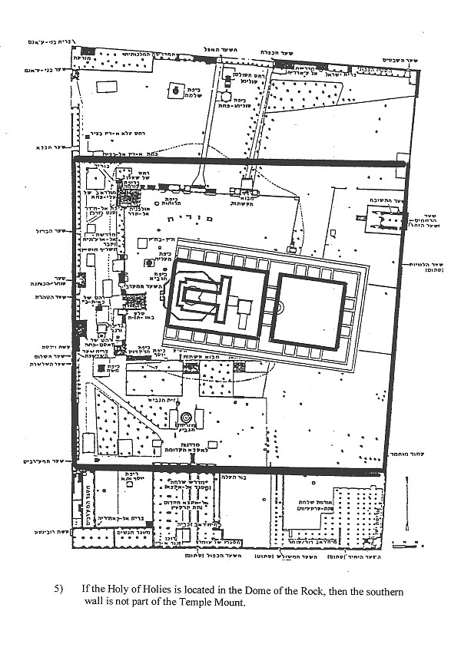
Third Temple
Chapter 11
Notes:
The traditional view of the temple location places the Holy of Holies at the Dome of the Rock. This view is widely held by the Jewish people. Most experts doubt this to be the actual location for various reasons.

Slide 268
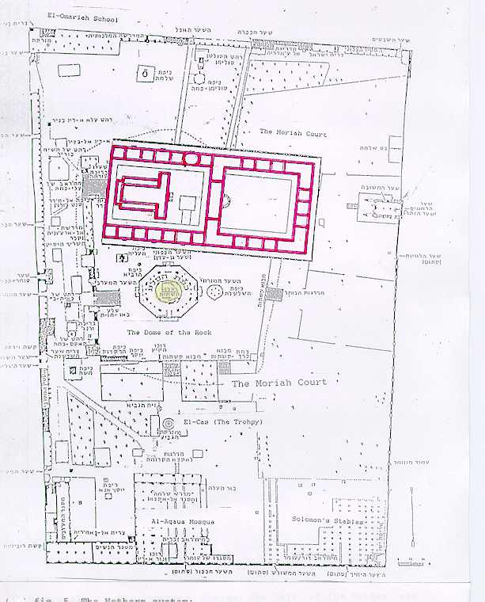
Third Temple
Chapter 11
Notes:
This is the Northern Conjecture. Dr. Asher Kaufman bases this position on alignments with the Shushan Gate and certain rock outcroppings. This places the Holy of Holies (and thus the Ark of the Covenant) at the Dome of the Tables (Dome of the Spirits).
If true, this would interestingly place the Dome of the Rock in the outer court (Court of the Gentiles).

Slide 269
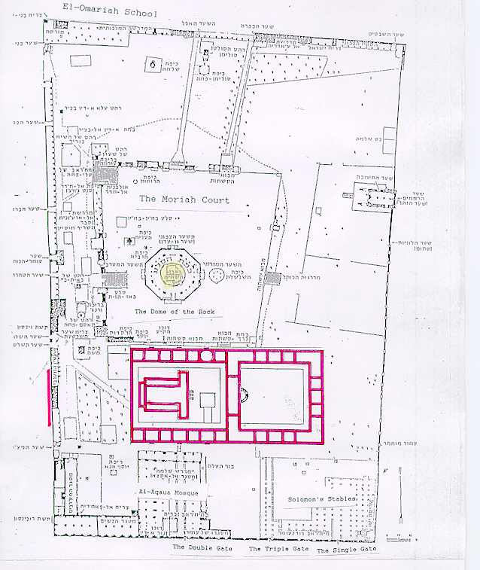
Third Temple
Chapter 11
Notes:
Tuvia Sagiv propsed what is called the Southern Conjecture. Bob Cornuke has also done some work in this area basing his hypothesis on 5 criteria.
Location over the Gihon Springs.
Water was supplied to the Temple from the Gihon Spring.
No stone would be left upon another.
The Temple Mount was Fort Antonia
The Temple was within the City of David.
How many romans would have been stationed at Fort Anotina.

Slide 270
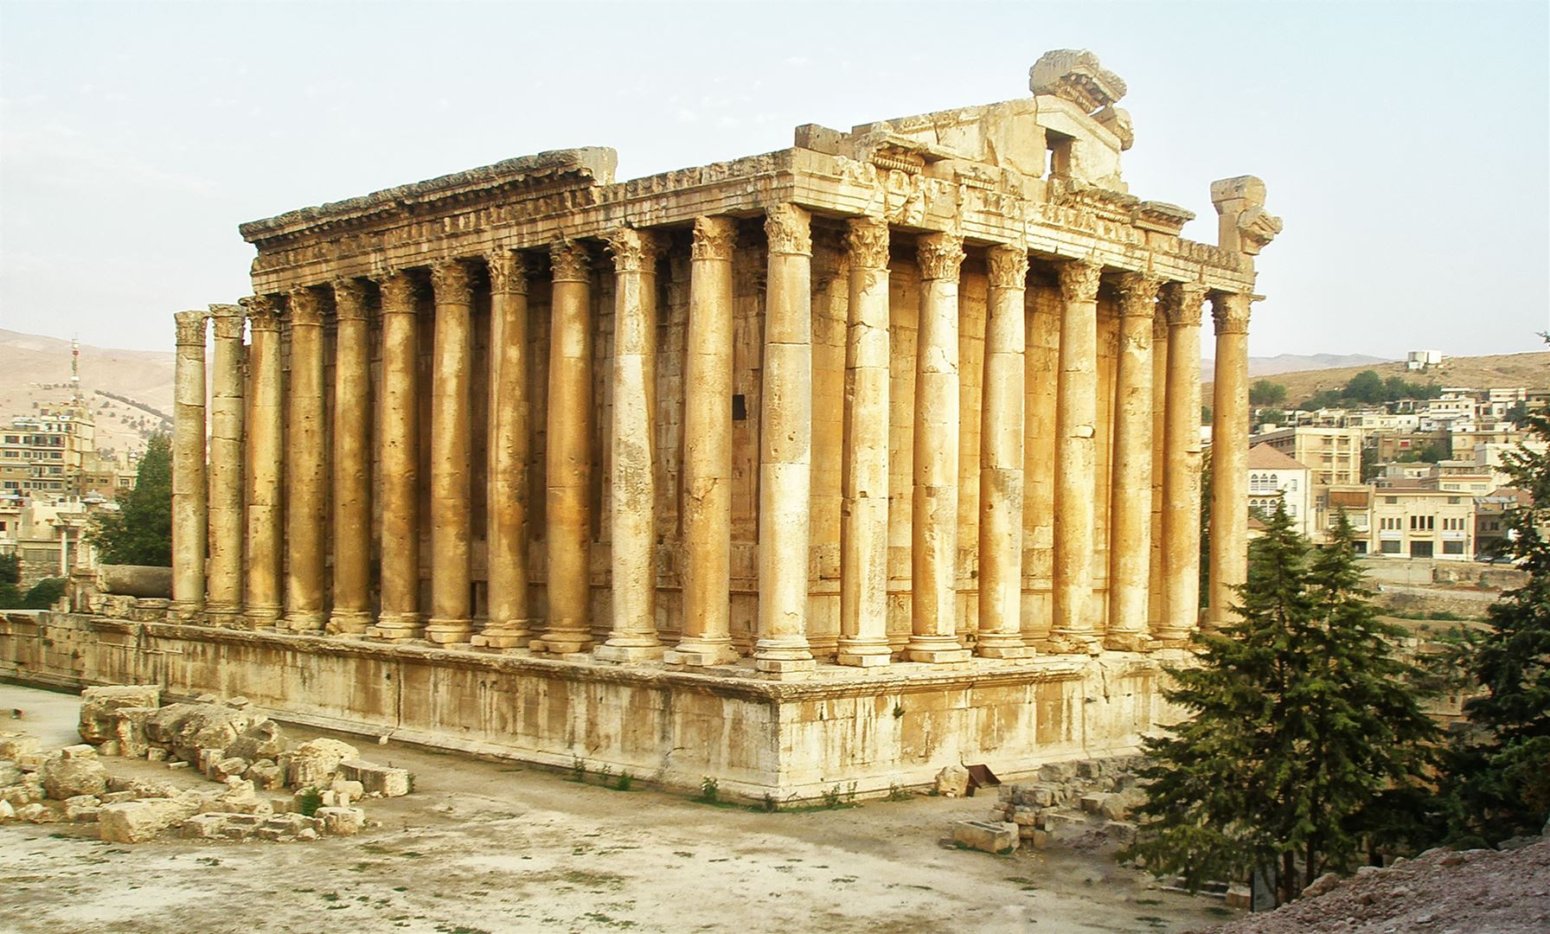
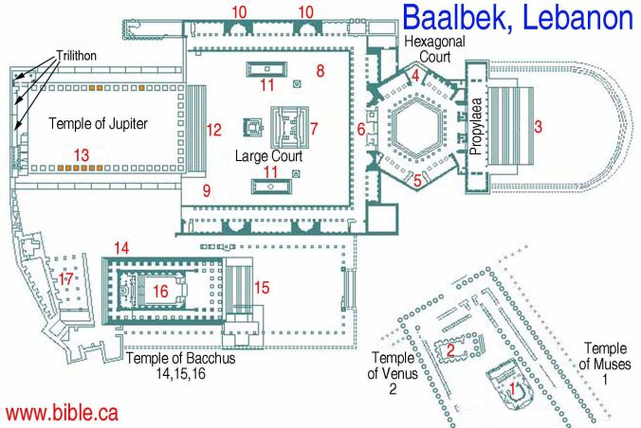
Third Temple
Chapter 11
Notes:
Some background.
A temple to Jupiter was built on top of the foundation of the Jewish Temple. According to Jerome, an equestrian statue of Hadrian was then installed over the location of the Holy of Holies.
Baalbek, Lebanon has a temple to Jupiter built by the same architect and can be used to determine what the one in Aelia Capitolina looked like.

Slide 271
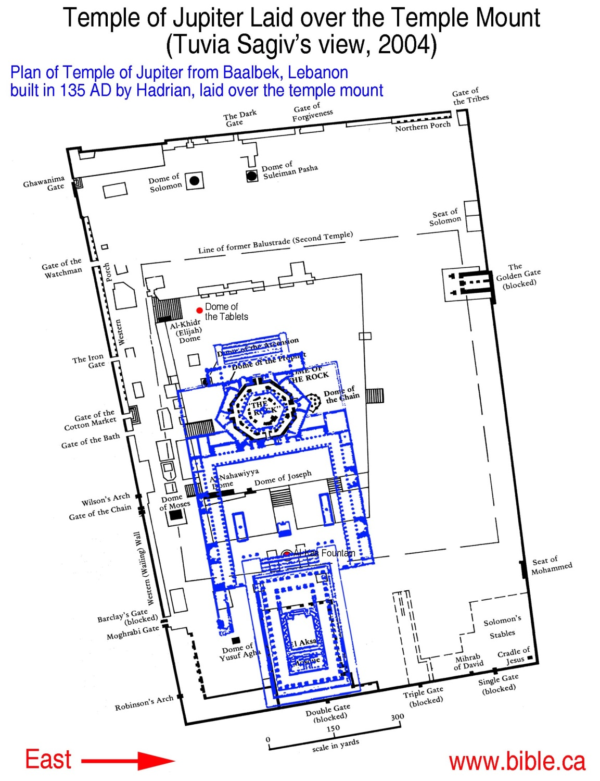
Third Temple
Chapter 11
Notes:
When superimposed over the foundations at the temple mount, this places the actual temple on the south side of the mountain. The Hexagon court placed on top of the octogon shaped foundation of the Dome of the Rock and the Equestian Statue puts the Holy of Holies south of the current Dome of the Rock and interestingly enough outside the part of the Temple Mount controlled by the WAQF.
The Temple Institute and the majority of the Jewish people adhere to the traditional view and so these alternatives won’t make anyone happy. However we won’t know for sure unless some good archaeology can be done in the area. The Jordan High Council is working hard to obliterate any evidence of Jewish historical presence on the mountain in the meantime.
If the southern conjecture is true, oddly enough, then the Jewish people are closer to the Holy of Holies than they think and they can’t accidently walk over it as it is currently covered by the Al-Kas fountain.

Slide 272
These Two Witnesses of Mine
Chapter 11
? ??
?
Notes:
Revelation 11
³ I will give my two witnesses who wear sackcloth the authority to prophesy for 1,260 days.”
⁴ These witnesses are the two olive trees and the two lamp stands standing in the presence of the Lord of the earth. ⁵ And if anyone should want to hurt them, fire comes out of their mouths and burns up their enemies. If anyone wants to hurt them, he must be killed in this manner. ⁶ These witnesses have authority to close the heavens in order to keep rain from falling while they are prophesying. They also have authority to turn bodies of water into blood and to strike the earth with any plague, as often as they desire.
Who are the two witnesses?
The english translation does not carry across the full meaning from the Greek. In Greek the word THE here is speaking of specificity. One might read it as These Two Witnesses of Mine. It is to indicate that we are to be familiar with these two already.

Slide 273
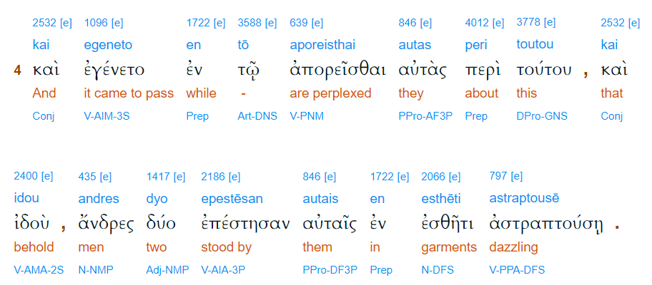
These Two Witnesses of Mine
Chapter 11
Notes:
Luke 24:4 interlinear.
There is a belief (tradition?) that these two here at the tomb were angels. You can see here the Greek word andres. There were two MEN at the resurrection.

Slide 274
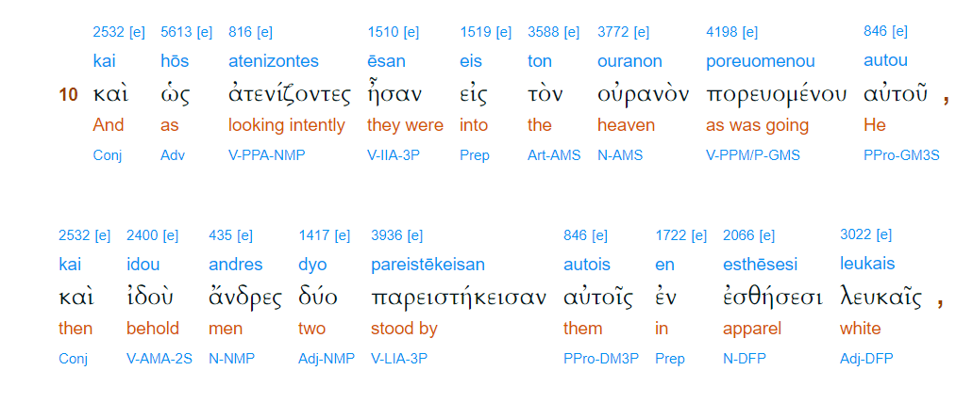
These Two Witnesses of Mine
Chapter 11
Notes:
Acts 1:10 interlinear.
Here again at the ascension are two MEN.
Likewise we are told who the two men with Jesus are at the Mount of transfiguration.
Except for the transfiguration event, men in glorified bodies began to appear after Jesus death and resurrection. Indication that we aren’t just sitting on clouds strumming harps for all eternity. We’ll have things to do.

Slide 275
These Two Witnesses of Mine
Chapter 11
Enoch
Elijah
? ??
?
Call down fire from heaven
Elijah
Shut the heavens (stop rain)
Elijah
Turn water into blood
Moses
Smite the earth with plagues
Moses
Moses
Notes:
So who are the two witnesses?
There are several conjectures. Most scholars agree that one of them is Elijah.
Click slide.
Largely due to Malachi 4:5.
⁵ “Pay attention! I’m sending Elijah the prophet to you before the great and dreadful Day of the Lord comes, ⁶ and he will turn the hearts of fathers to children, and the hearts of children to their fathers. Otherwise, I’ll come, strike the land, and utterly destroy it.”
So who is the other one?
One conjecture is Enoch.
Click slide.
This is due to the fact that both Elijah and Enoch did not die.
Enoch is a type of the church. Traditionally he was raptured on his birthday which, again traditionally, was coincident with the day that would later be declared as the Feast of Pentecost.
There is another popular conjecture.
Given the description of their abilities and thinking back on who in the bible had those abilities during their earth bound life time.
Click slide through table.

Slide 276
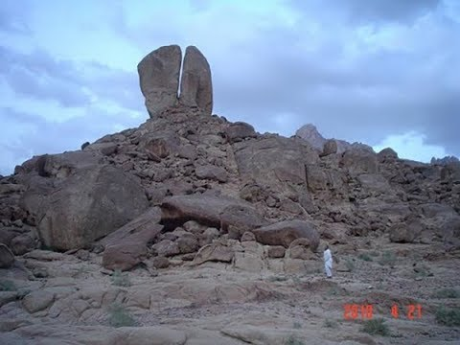
These Two Witnesses of Mine
Chapter 11
Split rock at Horeb, Midian
Notes:
We are familiar with Elijah, he was taken bodily to heaven.
Moses, however, also didn’t finish his ministry. He spent 40 years in Egypt training to be a prince and the next Pharaoh.
He left Egypt, after killing the Egyptian, to Midian where he spent another 40 years.
He then was sent back to Egypt to lead the Israelites out of Egypt to their land. During that process there were two incidents where Moses was to use a rock to get water from. The first time he was told to strike the rock. Which he did.
However, years later when the Israelites are complaining again for water God tells Moses to speak to the rock. Moses is very frustrated and strikes the rock this second time instead of speaking to the rock.
The two rock incidents were to be a type of Jesus (messiah). However, Moses messed up that imagery.
God calls him aside and tells him that he will not enter the promised land but can look at it from a mountain. God wasn’t mad at his people, but Moses made it appear so.

Slide 277
These Two Witnesses of Mine
Chapter 11
Enoch
Elijah
? ??
?
John
Moses
Notes:
There are some who believe the second witness may be John, himself. However, he’s writing about the events while they happen, not participating.
This supposition is based on the previous chapter where the mighty angel tells John he must prophecy again.

Slide 278
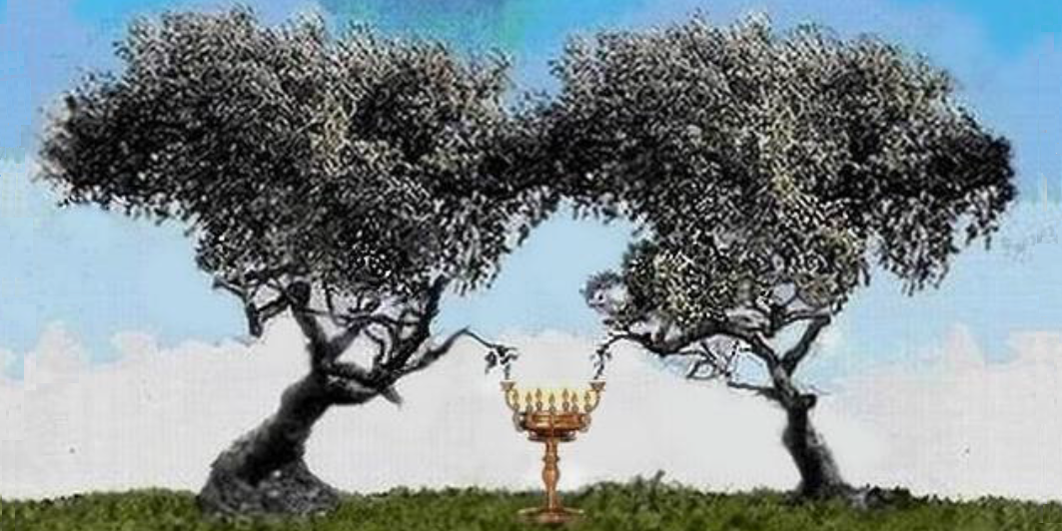
These Two Witnesses of Mine
Chapter 11
Notes:
We are told to think about Zechariah’s vision of the two olive trees. In Zechariah’s case it referred to Zerubbabel and Jeshua.
The vision was to show that these two have a constant filling of the holy spirit.
During the old testament period, the holy spirit was given as needed. We in the church age enjoy a constant presence of the holy spirit and have no idea what it is like not to have that.
During the tribulation it will be as before the church age, the holy spirit will be busy, but not be a constant presence to everyone.

Slide 279
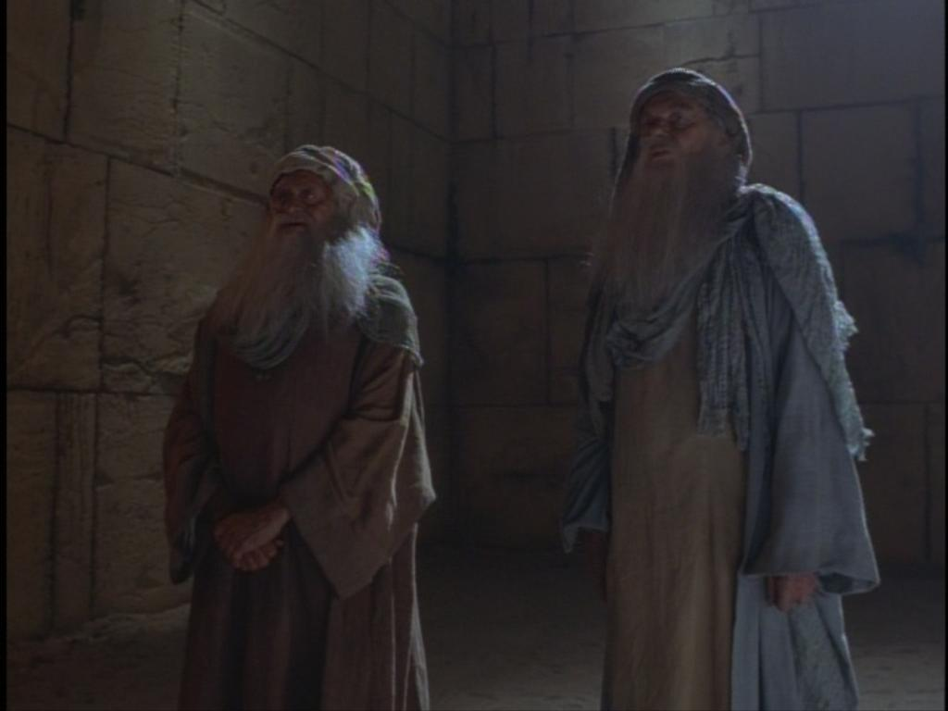
These Two Witnesses of Mine
Chapter 11
Notes:
Revelation 11
⁷ When they have finished their testimony, the beast that comes up from the bottomless pit will wage war against them, conquer them, and kill them. ⁸ Their dead bodies will lie in the street of the great city that is spiritually called Sodom and Egypt, where their Lord was crucified. ⁹ For three and a half days some members of the people, tribes, languages, and nations will look at their dead bodies and will not allow them to be placed in a tomb. ¹⁰ Those living on earth will gloat over them, celebrate, and send gifts to each other, because these two prophets had tormented those living on earth.
They do not die until their ministry is complete, JUST like you and I.
This is the only time in Revelation where the world (earth dwellers) are joyful.
There is speculation as to where these two will be killed. It is pretty clear here, spiritual Sodom and Egypt. In case that wasn’t clear, “where their Lord was crucified.” Clearly in Jerusalem.
This party is short lived, however. God has the final say.
Revelation 11
¹¹ But after the three and a half days, the breath of life from God entered them, and they stood on their feet. Those who watched them were terrified. ¹² Then the witnesses heard a loud voice from heaven calling to them, “Come up here!” So they went up to heaven in a cloud, and their enemies watched them. ¹³ At that moment a powerful earthquake struck. One-tenth of the city collapsed, 7,000 people were killed by the earthquake, and the rest were terrified and gave glory to the God of heaven.

Slide 280
These Two Witnesses of Mine
Chapter 11
Seventh Trumpet: King of this world is now the Kingdom of our Lord and of his Messiah.
Notes:
Verse 14 is a reminder that we are still in the period of the trumpets.
Revelation 11
¹⁴ The second catastrophe is over. The third catastrophe is coming very soon.
¹⁵ When the seventh angel blew his trumpet, there were loud voices in heaven, saying,
“The world’s kingdom has become the kingdom of our Lord and of his Messiah, and he will rule forever and ever.”
¹⁶ Then the twenty-four elders who were sitting on their thrones in God’s presence fell on their faces and worshipped God. ¹⁷ They said,
“We give thanks to you, Lord God Almighty, who is and who was, because you have taken your great power and have begun to rule. ¹⁸ The nations were angry, but the time for your wrath has come. It is time for the dead to be judged— to reward your servants, the prophets, the saints, and all who fear your name, both unimportant and important, and to destroy those who destroy the earth.”

Slide 281
These Two Witnesses of Mine
Chapter 11
Nathan, Jewish Rabbi, 1448
Divided the Tanach (old testament) into verses.
Robert Estienne (also known as Stephanus), 1555
Divided the new testament into verses.
Stephen Langton, ArchBishop of Canterbury, 1277
Added chapters to the Bible.
Notes:
Verse 19 is probably supposed to be at the beginning of chapter 12.
The bible did not come originally with chapters and verses.
These were added much later and are not inspired. They are useful for referencing material.
Revelation 11
¹⁹ Then the Temple of God in heaven was opened, and the ark of his covenant was seen inside his Temple. There were flashes of lightning, noises, peals of thunder, an earthquake, and heavy hail.
Still in the interlude. Coming up:
History of Israel in sign form from Genesis 3 to Revelation.
Satan’s strategy.

Slide 282
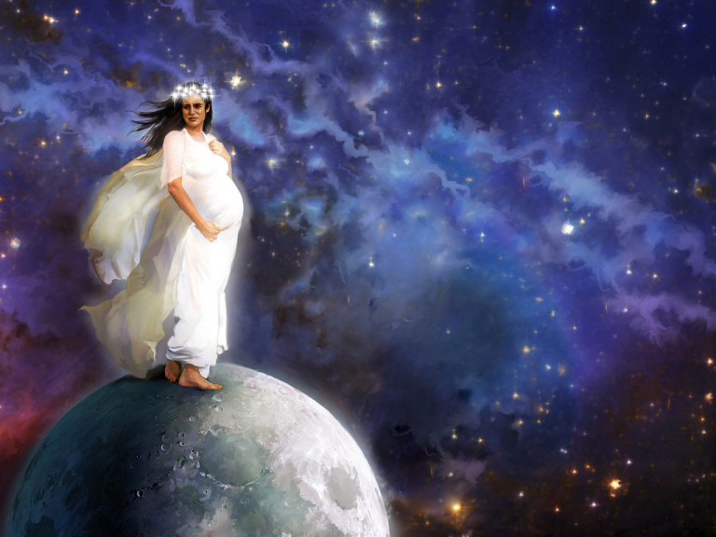
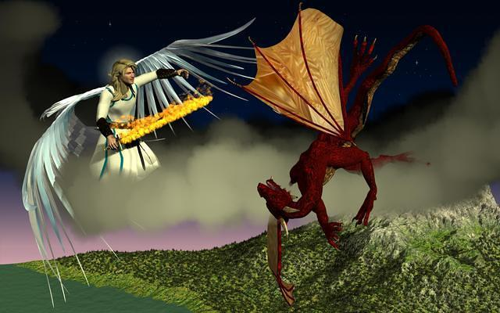
History of Israel
Chapter 12
Notes:
Revelation 12
A spectacular sign appeared in the sky: a woman dressed with the sun, who had the moon under her feet and a victor’s crown of twelve stars on her head. ² She was pregnant and was crying out from her labor pains, the agony of giving birth.
³ Then another sign appeared in the sky: a huge red dragon with seven heads, ten horns, and seven royal crowns on its heads. ⁴ Its tail swept away one-third of the stars in the sky and knocked them down to the earth. Then the dragon stood in front of the woman who was about to give birth so that it could devour her child when it was born. ⁵ She gave birth to a son, a boy, who is to rule all the nations with an iron scepter. But her child was snatched away and taken to God and to his throne. ⁶ Then the woman fled into the wilderness, where a place had been prepared for her by God so that she might be taken care of for 1,260 days.
⁷ Then a war broke out in heaven. Michael and his angels fought with the dragon, and the dragon and its angels fought back. ⁸ But it was not strong enough, and there was no longer any place for them in heaven. ⁹ The huge dragon was hurled down. That ancient serpent, called the Devil and Satan, the deceiver of the whole world, was hurled down to the earth, along with its angels.
¹⁰ Then I heard a loud voice in heaven say,
“Now the salvation, the power, the kingdom of our God, and the authority of his Messiah have come. For the one who accuses our brothers, who accuses them day and night in the presence of our God, has been thrown out. ¹¹ Our brothers conquered him by the blood of the lamb and by the word of their testimony, for they did not cling to their lives even in the face of death. ¹² So be glad, heavens, and those who live in them! How terrible it is for the earth and the sea, because the Devil has come down to you, filled with rage, knowing that his time is short!”
¹³ When the dragon saw that it had been thrown down to the earth, it pursued the woman who had given birth to the boy. ¹⁴ However, the woman was given the two wings of a large eagle so that she could fly away from the serpent to her place in the wilderness, where she could be taken care of for a time, times, and half a time. ¹⁵ From its mouth the serpent spewed water like a river behind the woman in order to sweep her away with the flood. ¹⁶ But the earth helped the woman by opening its mouth and swallowing the river that the dragon had spewed from its mouth. ¹⁷ The dragon became angry with the woman and went away to do battle against the rest of her children, the ones who keep God’s commandments and hold on to the testimony about Jesus. ¹⁸ Then the dragon stood on the sand of the seashore.

Slide 283
History of Israel
Chapter 12
Notes:
Who is this woman?
The woman cannot be the church for two reasons. She’s pregnant and the church does not give birth to Jesus who is the man child we read about later.
As with all signs in Revelation, the answer is given to us either right in the text itself or elsewhere in the Bible. In this case, we can turn to Jacob to interpret this sign for us.
Genesis 37:5-11
⁵ Right about this time, Joseph had a dream and then told it to his brothers. As a result, his brothers hated him all the more! ⁶ “Let me tell you about this dream that I had!” he said. ⁷ “We were tying sheaves together out in the middle of the fields, when all of a sudden, my sheaf stood up erect! And then your sheaves gathered around it and bowed down to my sheaf!”
⁸ At this, his brothers replied, “Do you really think you’re going to rule us or lord it over us?” So they hated him even more because of his dreams and his interpretations of them.
⁹ But then he had another dream, and he proceeded to tell his brothers about that one, too. “I had another dream,” he said. “The sun, moon, and eleven of the stars were bowing down before me!”
¹⁰ When Joseph told his father about this, his father rebuked him and asked him, “What kind of dream is that? Will I, your mother, and your brothers really come to you and bow down to the ground in front of you?” ¹¹ As a result, his brothers became more envious of him. But his father kept thinking about all of this.
Israel is described as the wife of YHVH (Isaiah 54:5) and pregnant (Isaiah 66:7).
The daughter of Zion in labor (Micah 4:10) who gives birth (Micah 5:2-3)

Slide 284
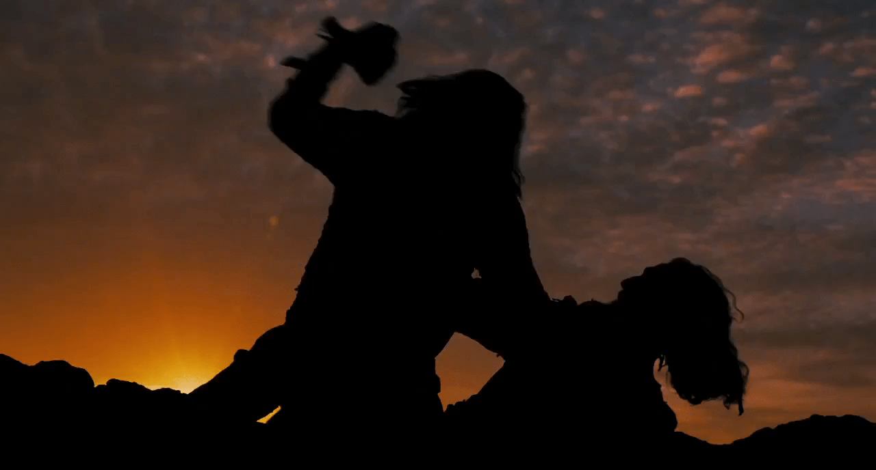
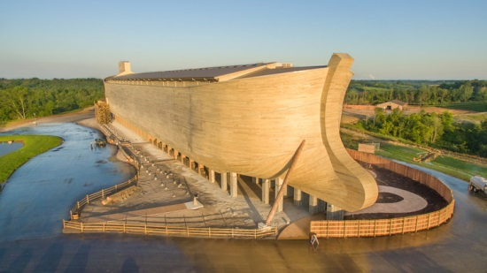
History of Israel
Notes:
We can follow Satan’s (the dragon) strategy to attempt to thwart God’s plan and it all goes through the nation of Israel (the woman).
Genesis 3:15. God declares war on Satan.
“I’ll place hostility between you and the woman, between your offspring and her offspring. He’ll strike you on the head, and you’ll strike him on the heel.”
BTW – Ha Satan simply means the accuser and is not his name. I use it as a matter of convenience.
So, Satan begins his attack by likely contriving a fight between Cain and Abel.
God does not have Cain killed and allows nobody else to kill him.
Satan and his co-conspirators then carry out their plan they made with an oath on Mount Hermon (Enoch 7) – not canonical. Second temple Judaism viewed Genesis 6:1-4 as a central to understand God’s plan in history. The Fall (Genesis 3) is important to why the world is as wicked as it is, but the second temple Jews also equated the events of Genesis 6 to contributing to the state of the world.
Enoch expands on this event in Genesis 6. Peter and Jude both quote from this book in their letters.
We now have a genetic problem. Remember that the kinsman redeemer must be a kinsman. Therefore must be a man. Satan and his conspirators have now tainted the gene pool in hopes of making having any humans left.
God selects Noah. He was blameless (or KJV perfect) in his generation. The word is “tamim” means blameless, complete, entire, prefect, unblemished.
God saves Noah and his family while cleansing the earth of the watchers immediate corruption.
Later it is revealed that God’s plan will go through Abraham. Abraham survives several attempts to put an end to him.
He has Ishmael and Isaac and it is then revealed that it is through Isaac that God‘s plan will come.
Finally Jacob is the one whom will be used to start the nation of Israel through which the messiah will come. So his family is attacked by Satan. The regional famine, for instance.
God saves them through Joseph’s situation that his brothers put him. Arranging for them to move to the best part of Egypt.
That city has been found, by the way. It is being called Avris and is under what was once known as the city of Ramses.

Slide 285
History of Israel
Chapter 12
Notes:
Then Satan attempted to thwart God’s plan by inciting a new Pharoah to kill all the male children.
God not only approved of the midwives NOT killing them but also saved Moses.
Moses brings the Israelites back to the promised land. God with Joshua’s help conquers the land which Satan had 400 some years to prepare for their return.
It is eventually revealed that the messiah will come through the line of David, so Satan can focus his efforts in there.
There is attempt to wipe out all of the line of David, but one escapes.
The royal line becomes so corrupt that God pronounces a blood curse on Jechoniah. Which may look like He made a mistake.
However, we then get the virgin birth. Jesus is born of the house of David through the second surviving son of Bathsheba and is adopted to the royal line because Joseph is of the royal line.
Satan now knows who the messiah is and makes many attempts on his life. The strange storms on a lake that the fisherman were familiar with yet afraid of these storms. Attempts to through him from a cliff. He might have thought he finally won when Jesus was crucified but then there was the resurrection and he now knows he has lost.
So why does he continue?
Hosea tells us in chapter 5 verse 15.
“I will leave and go back to my place until they admit their offense and seek my face. When affliction comes to them, they will eagerly seek me.”
There is a pre-requisite to Jesus’ return. Not for the rapture.
So Satan is trying to wipe out the believing Jews because if he can do that, he is vindicated.
Satan can’t take away your salvation, but he can keep you from being productive.

Slide 286
History of Israel
Chapter 12
Notes:
The portion about the child being snatched away is the word we are now familiar with harpazo. ? Pemberton ? suggests the idea that this is not speaking of Jesus’ Ascension, but instead the body of Christ’s rapture.
Having been unsuccessful putting an end to Israel and the child (Jesus). Satan turns his attention toward the believing remnant. The “rest of her children”.
We know that Satan is a fallen angel, but as to when exactly he fell is up to much debate. It had certainly happened by Genesis 3. However, we know that even though he is fallen he still apparently has access to heaven and the heavenly council. We see this in both Job 1 and Zechariah.
However, it is at this point that he has his access revoked.
Where does the woman (Israel) escape to? According to Daniel (11:41) the nations of Moab, Edom and certain Ammonite officials.

Slide 287
History of Israel
Chapter 12
Notes:
Where does the woman (Israel) escape to? According to Daniel (11:41) the nations of Moab, Edom and Ammon.

Slide 288
Strategy of Satan
7
Chapter 13
Heptatic structure!
How many persons in chapters 12 + 13?
The Woman
Man-Child
Red Dragon
Michael
The Remnant of Israel
The Beast out of the Sea
The Beast out of the earth
Notes:
The first verse of chapter 13 has a known mis translation. Some translations read “I stood on the shore”. Manuscript evidence indicates that this should be “He stood on the shore.” speaking of Satan.
First a heptatic structure alert.
Revelation
13 I saw a beast coming out of the sea. It had ten horns, seven heads, and ten royal crowns on its horns. On its heads were blasphemous names. ² The beast that I saw was like a leopard. Its feet were like bear’s feet, and its mouth was like a lion’s mouth. The dragon gave it his power, his throne, and complete authority.

Slide 289
Strategy of Satan
Chapter 13
Notes:
Horns are symbolically an indicator of authority.
The horns and heads should bring to mind Daniel 7.
Daniel 7 is the vision of the four beasts. Three, Daniel is able to describe but the fourth perplexes him. He just calls it the voracious beast.
We will look more into this when we get to chapter 16.

Slide 290
Strategy of Satan
Chapter 13
And the beast that was, and is not, even he is the eighth.
Egypt
Assyria
Babylon
Persia
Greece
All of these have made a return except one.
Rome
Rome II
Notes:
Among those on this list there is one that fits this criteria.
Micah 5:5b-6
“When the Assyrian invades our land, trampling through our palaces, we will raise up seven shepherds against him, even eight significant men. ⁶ The shepherds will devastate the land of Assyria with the sword, along with the entrances to the land of Nimrod.
“This is how he will vanquish Assyria when he invades our land, trampling within our borders:

Slide 291
Strategy of Satan
Chapter 13
Names of Satan’s man (Old Testament)
Adversary
Assyrian
Belial
Bloody and Deceitful Man
Branch of the Terrible Ones
Chief Prince
Crooked Serpent
Cruel One
Destroyer of the Gentiles
Enemy
Evil Man
Head over many countries
Head of Northern Army
Idol Shepherd
King of Princes
King of Babylon
Little Horn
Man of the Earth
Merchant, with balances of deceit
Mighty Man
Nail
Prince that shall come
Prince of Tyre
Profane Wicked Prince of Israel
Proud Man
Rod of God’s anger
Seed of the Serpent
Son of the Morning
Spoiler, Destroyer
Vile Person
Violent Man
Wicked One
Willful King
Notes:
There are 33 names of Satan’s man (it is two really as we are about to see) in the old testament.

Slide 292
Strategy of Satan
Chapter 13
Names of Satan’s man (New Testament)
Angel of the Bottomless Pit
Antichrist (pseudo-Christ)
Beast
False Prophet
Father of lies
Lawless One
Man of Sin
One who comes in his own name
Prince of Darkness
Son of Perdition
Star
Unclean Spirit
Vine of the earth
Notes:
13 names for him in the new testament.
We have a description of the one we call the anit christ in Zechariah 11.
Zechariah 11
“Woe to the worthless shepherd, who deserts the flock! May the sword strike his arm and his right eye. May his arm wither and his right eye be completely blind.”
Revelation 13
³ One of the beast’s heads looked like it had sustained a mortal wound, but its fatal wound was healed. Rapt with amazement, the whole world followed the beast. ⁴ They worshipped the dragon because it had given authority to the beast. They also worshipped the beast, saying, “Who is like the beast, and who can fight a war with it?”
We will see who can make war against it in the next chapter.

Slide 293
Strategy of Satan
Chapter 13
Characteristics of the Antichrist
“Big Mouth” Dan 7:8,11,20; 11:36; Ps 52; 2 Thess 2:4
Son of Satan
Gen 3:15; Isa 27:1; Ezek 28:12-19; Rev 13
Intellectual genius
Dan 7:20; 8:23; Ezek 28:3
Political genius
Dan 11:21
Commercial genius
Dan 9:25’ Rev 13:17; Ps 52:7; Dan 11:38,43; Ezek 28:4,5
Military genius
Dan 8:24; Rev 6:2; Rev 13:4; Isa 14:16
Placed above all that is called god
2 Thess 2:4; Rev 13:3,14,15
Notes:
One of the leading characteristics of the anti christ is his big mouth.
Here is a list of others according to the bible.
Revelation
⁵ The beast was allowed to speak arrogant and blasphemous things, and it was given authority for 42 months. ⁶ It uttered blasphemies against God, against his name, and against his residence, that is, against those who are living in heaven. ⁷ It was allowed to wage war against the saints and to conquer them. It was also given authority over every tribe, people, language, and nation. ⁸ All those who had become settled down and at home, living on the earth, will worship it, everyone whose name had not been written in the Book of Life belonging to the lamb that had been slaughtered since the foundation of the world.
⁹ Let everyone listen:
¹⁰ If anyone is to be taken captive, into captivity he will go. If anyone is to be killed with a sword, with a sword he will be killed.

Slide 294
Strategy of Satan
Chapter 13
Notes:
Here it is again, 42 months.
You might have noticed that the beast is allowed to conquer the saints. This would seem to be in opposition to what Jesus said at Caesarea-Philippi in Matthew 16:18
Matthew 16:18
I tell you that you are Peter, and it is on this rock that I will build my congregation, and the powers of hell will not conquer it.
Here we see a picture of ancient Caesarea-Philippi. Interestingly enough, Jesus did not pick this location on accident. Here we can see a location at ancient Caesarea-Philippi. The niches were used to worship various gods. The cave entrance is called the Grotto of Pan and was thought to be the entrance to the underworld.
Further, this location is at the base of Mount Hermon. The very mountain of Satan’s assembly upon which he and his coconspirators made their vow to corrupt God’s people.
The fact that the beast is allowed to defeat the saints is further evidence that the church is not on earth at the time of the tribulation.
In view here are the tribulation saints. To become a follower of Christ at this time is death.

Slide 295
Strategy of Satan
Chapter 13
Classifications of Saints
Old Testament Saints
New Testament (Church age) Saints
Tribulation Saints
Notes:
Here it is again, 42 months.
You might have noticed that the beast is allowed to conquer the saints. This would seem to be in opposition to what Jesus said at Caesarea-Philippi in Matthew 16:18
Matthew 16:18
I tell you that you are Peter, and it is on this rock that I will build my congregation, and the powers of hell will not conquer it.
Here we see a picture of ancient Caesarea-Philippi. Interestingly enough, Jesus did not pick this location on accident. Here we can see a location at ancient Caesarea-Philippi. The niches were used to worship various gods. The cave entrance is called the Grotto of Pan and was thought to be the entrance to the underworld.
Further, this location is at the base of Mount Hermon. The very mountain of Satan’s assembly upon which he and his coconspirators made their vow to corrupt God’s people.
The fact that the beast is allowed to defeat the saints is further evidence that the church is not on earth at the time of the tribulation.
In view here are the tribulation saints. To become a follower of Christ at this time is death.
You might also notice a familiar phrase here. Slightly different in the ISV:
He who has an ear…
Same as in the letters and same as in the kingdom parables.

Slide 296
Strategy of Satan
Chapter 13
Notes:
Revelation
Here is a call for endurance and faith of the saints:
¹¹ I saw another beast coming up out of the earth. It had two horns like a lamb and it talked like a dragon. ¹² It uses all the authority of the first beast on its behalf, and it makes the earth and those living on it worship the first beast, whose mortal wound was healed.
There is that head wound again.
¹³ It performs spectacular signs, even making fire come down from heaven to earth in front of people. ¹⁴ It deceives those living on earth with the signs that it is allowed to do on behalf of the first beast, telling them to make an image for the beast who was wounded by a sword and yet lived.
Again the wound. It really is a major identifier of this guy.
Also here is a warning against trusting in signs and wonders. Pharoah’s men were able to repeat a number of the plagues Moses brought to Egypt. This is occult power. Not simple tricks.
¹⁵ The second beast was allowed to impart life to the image of the first beast so that the image of the beast could talk and order the execution of those who would not worship the image of the beast. ¹⁶ The second beast forces all people—important and unimportant, rich and poor, free and slaves—to be marked on their right hands or on their foreheads, ¹⁷ so that no one may buy or sell unless he has the mark, which is the beast’s name or the number of its name.
¹⁸ In this case wisdom is needed: Let the person who has understanding calculate the total of the beast, since it is a human multitude, and the sum of the multitude is 600, 60, and six.

Slide 297
Strategy of Satan
Chapter 13
The second beast forces all people—important and unimportant, rich and poor, free and slaves—to be marked on their right hands or on their foreheads, ¹⁷ so that no one may buy or sell unless he has the mark, which is the beast’s name or the number of its name.
13
“Whoever worships the beast and its image and receives a mark on his forehead or his hand ¹⁰ will drink the wine of God’s wrath, which has been poured undiluted into the cup of his anger. He will be tortured with fire and sulfur in the presence of the holy angels and the lamb.
14
Notes:
There is a great deal of interest in this mark and the number of the beast. Those who know nothing else about Revelation know about the mark and the number.
First, why is it of such concern?
Looking ahead to chapter 14 we see that accepting the mark of the beast forever denies one the chance for salvation.

Slide 298
Strategy of Satan
Chapter 13
Notes:
Pictured are two if the most popular guesses on what the mark is.
However, all of these conjectures miss some important points.
The reason the bar code is a favorite is that the double line at the beginning, middle and end is a 6. 6 is a separator using this bar code encoding. Not all of them use that format.
First, it is not your number that is a problem. It is taking on the name and number of the beast that is the problem.
Second, taking it on is voluntary. He might be able to enforce people taking a mark in order to buy and sell but in the end it is a voluntary.
Third, if we are right about the pretribulation scenario, then we won’t be on the Earth for this part anyway.
The Greek word used for mark is a charugma. In Leviticus, the Israelites are forbidden to receive marks on their body. Probably in anticipation to this event.

Slide 299
Strategy of Satan
Chapter 13
Notes:
Greek and Hebrew letters are also their numbers. This brings about the practice of Gemetria.
People go crazy with this. If you look hard enough you can find anyone someone doesn’t like having 666 applied to them in one way or another. Some people even try to do this with English but English letters do not possess this numeric quality.
Interestingly enough, if you look at the Greek letters in Christos, take the first and last letter then insert a Greek letter that looks a bit like a snake, you get the word Anti-Christos. The number this word adds up to is 666.

Slide 300
6 6 6
Chapter 13
John the Apostle
Polycarp
Irenaeus
Notes:
Ireneaus suggests that the number 666 may refer to the return of the Titans.
“Although certain as to the number of the name of Antichrist, yet we should come to no rash conclusion as to the name itself, because this number [666] is capable of being fitted to many names … Teitan too, (Teitan, the first syllable being written with the two Greek vowels E and I), among all the names with are found among us, is rather worthy of credit.”
“…Inasumch, then, as this name “Titan” has so much to recommend it, there is a strong degree of probability, that from among the many [names suggested], we infer, that perchance he who is to come shall be called “Titan”.
Irenaeus was the student of Polycarp and bishop of Lyon. Polycarp was the student of John the Apostle.

Slide 301
Strategy of Satan
Chapter 13
Notes:
I won’t get too deep into this. Recent research has shown that there is a possibility that the ancient myths are connected. The slide shows the front page of a document about which has been said that if your books on systemic theology does not take it into account, they are outdated.
This document is free to download and read.
The super short version of the results of this research are that it is possible that the myths we know today are exaggerations of stories that started out as lies but were handed down from actual events.
Derek Gilbert’s book “Last Clash of the Titans” covers this concept in more detail.

Slide 302
Strategy of Satan
Chapter 13
Do Nothing
Suffering and cruelty continues forever.
Force man to obey
Love cannot be forced.
Second death; separation of soul from the Spirit of God.
Withdraw Himself
Notes:
Another point about the result of taking on the name of the beast. It speaks of the doctrine of endless punishment.
This is a doctrine that is foreign to us. We live in an age where one always has another chance.
When man rebelled in Genesis 3, God had three options to deal with it.
He could do nothing, but then the pain, suffering and cruelty would go on forever.
Coming up:
Chapter 14 is a summary of upcoming events.
Chapter 15 gets us back to the seven bowls of wrath.

Slide 303
Preview to Wrath
Chapter 14
How many of the 144,000 did Jesus lose?
None
Isn’t John in Heaven? How is it then he can see Jesus and the 144,000 on Mount Zion?
Notes:
Chapter 14 is a preview summary of what is coming in the next few chapters.
Revelation
14 Then I looked, and there was the lamb, standing on Mount Zion! With him were 144,000 people who had his name and his Father’s name written on their foreheads.
² Then I heard a sound from heaven like that of many waters and like the sound of loud thunder. The sound I heard was like harpists playing on their harps. ³ They were singing a new song in front of the throne, the four living creatures, and the elders. No one could learn the song except the 144,000 who had been redeemed from the earth. ⁴ They have not defiled themselves with women, for they are virgins, and they follow the lamb wherever he goes. They have been redeemed from among humanity as the first fruits for God and the lamb. ⁵ In their mouth no lie was found. They are blameless.
How is John seeing both Mount Zion and be in Heaven at the same time? Consider the possibility that Heaven and Earth are extra dimensionally co-existent.
Are the 144,000 literal virgins?
There is no reason this can’t be the case, but this is probably speaking of spiritual chastity.
Revelation
⁶ Then I saw another angel flying overhead with the eternal gospel to proclaim to those who live on earth—to every nation, tribe, language, and people. ⁷ He said in a loud voice,
“Fear God and give him glory, because the time for him to judge has arrived. Worship the one who made heaven and earth, the sea and springs of water.”
This gospel is a focus on God the Creator.
Revelation
Then another angel, a second one, followed him, saying,
“Fallen! Babylon the Great has fallen! She has made all nations drink the wine, the wrath earned for her sexual sins.”
Other translations have “is fallen” twice. That is for emphasis.
⁹ Then another angel, a third one, followed them, saying in a loud voice, “Whoever worships the beast and its image and receives a mark on his forehead or his hand ¹⁰ will drink the wine of God’s wrath, which has been poured undiluted into the cup of his anger. He will be tortured with fire and sulfur in the presence of the holy angels and the lamb. ¹¹ The smoke from their torture goes up forever and ever. There is no rest day or night for those who worship the beast and its image or for anyone who receives the mark of its name.”
A Call for Endurance
¹² Here is a call for the endurance of the saints, who keep the commandments of God and hold fast to their faithfulness in Jesus:
¹³ I heard a voice from heaven say, “Write this:
How blessed are the dead, that is, those who die in the Lord from now on!” “Yes,” says the Spirit. “Let them rest from their labors, for their actions follow them.”

Slide 304
Preview to Wrath
Chapter 14
Seven angels –
Eternal Gospel of Creation
Doom of Babylon
Fury against Beast worshippers
4,5 & 6 a call for the Grape Harvest
Notes:
¹⁴ Then I looked, and there was a white cloud! On the cloud sat someone who was like the Son of Man, with a gold victor’s crown on his head and a sharp sickle in his hand. ¹⁵ Another angel came out of the Temple, crying out in a loud voice to the one who sat on the cloud,
“Swing your sickle, and gather the harvest, for the hour has come to gather it, because the harvest of the earth is fully ripe.”
¹⁶ The one who sat on the cloud swung his sickle across the earth, and the earth was harvested.
¹⁷ Then another angel came out of the Temple in heaven. He, too, had a sharp sickle. ¹⁸ From the altar came another angel who had authority over fire. He called out in a loud voice to the angel who had the sharp sickle,
“Swing your sharp sickle, and gather the bunches of grapes from the vine of the earth, because those grapes are ripe.”
¹⁹ So the angel swung his sickle in the earth, gathered the grapes from the earth, and threw them into the great winepress of God’s wrath. ²⁰ The wine press was trampled outside the city, and blood flowed from the wine press as high as a horse’s bridle for about 1,600 stadia.
1600 stadia is about 194 miles.
The word translated to ripe is a word that implies overripe rather than a harvest at the peak of freshness. This is a very different harvest than the one we are used to such as the Harvest Crusade hosted by Greg Laurie.
The phrase “like a son of man”. The same phrase used of Luke in his gospel to emphasise the humanity of Jesus. This is Jesus coming as the kinsman avenger.

Slide 305
Preview to Wrath
Chapter 14
Isaiah 63
Notes:
Isaiah
Who is this coming from Edom, from Bozrah, with his garments stained crimson? Who is this, robed in splendor, striding forward in the greatness of his strength?
“It is I, proclaiming victory, mighty to save.”
² Why are your garments red, like those of one treading the winepress?
³ “I have trodden the winepress alone; from the nations no one was with me. I trampled them in my anger and trod them down in my wrath; their blood spattered my garments, and I stained all my clothing. ⁴ It was for me the day of vengeance; the year for me to redeem had come. ⁵ I looked, but there was no one to help, I was appalled that no one gave support; so my own arm achieved salvation for me, and my own wrath sustained me. ⁶ I trampled the nations in my anger; in my wrath I made them drunk and poured their blood on the ground.”
Bosrah is current day Petra.

Slide 306
Prelude to the Bowls
Chapter 15
Notes:
Shortest chapter of Revelation
Revelation
I saw another sign in heaven. It was both spectacular and amazing. There were seven angels with the seven last plagues, with which God’s wrath is completed.
² Then I saw what looked like a sea of glass mixed with fire. Those who had conquered the beast, its image, and the number of its name were standing on the sea of glass holding God’s harps in their hands. ³ They sang the song of God’s servant Moses and the song of the lamb:
“Your deeds are both spectacular and amazing, Lord God Almighty. Your ways are just and true, King of the nations. ⁴ Lord, who won’t fear and praise your name? For you alone are holy, and all the nations will come and worship you because your judgments have been revealed.”
⁵ After these things, I looked, and the Temple, which is the Tent of Testimony in heaven, was open! ⁶ The seven angels with the seven plagues came out of the Temple wearing clean, shining linen with gold sashes around their chests. ⁷ One of the four living creatures gave to the seven angels seven gold bowls full of the wrath of God, who lives forever and ever. ⁸ The Temple was filled with smoke from the glory of God and his power, and no one could enter the Temple until the seven plagues of the seven angels came to an end.
The phrase “another sign” connects this chapter all the way back to 12 where we started these visions.
Through the entirety of Revelation there isn’t any praise for the actions of the saints. This shouldn’t be a surprise as this book is about Jesus.

Slide 307
Bowls of Wrath
Chapter 16
Sores on Beast worshippers
Sea turns to blood.
Rivers and springs turn to blood.
Sun scorches
Darkness on Satan’s kingdom
Euphrates dried up
Notes:
Revelation
16 Then I heard a loud voice from the Temple saying to the seven angels, “Go and pour the seven bowls of God’s wrath on the earth.” ² So the first angel went and poured his bowl on the earth. A horrible, painful sore appeared on the people who had the mark of the beast and worshipped the image.
These bowls will become increasingly focused on thing. They are also quit clearly from chapter 15 not a symbol of environmental mismanagement, nor Satan’s shenanigans. These are directly from God and while this is occurring He, Himself is alone in the temple.
CLICK
³ The second angel poured his bowl into the sea. It became like the blood of a dead body, and every living thing in the sea died.
CLICK
⁴ The third angel poured his bowl into the rivers and the springs of water, and they turned into blood. ⁵ Then I heard the angel in charge of the water say,
“You are just. You are the one who is and who was, the Holy One, because you have judged these things. ⁶ You have given them blood to drink because they spilled the blood of saints and prophets. This is what they deserve.”
⁷ Then I heard the altar reply,
“Yes, Lord God Almighty, your judgments are true and just.”
CLICK
⁸ The fourth angel poured his bowl on the sun, which then was allowed to burn people with fire, ⁹ and they were burned by the fierce heat. They cursed the name of God, who has the authority over these plagues. They did not repent and give him glory.
It is interesting to see here that once again, they know where this is calamity is coming from but still do not repent.
CLICK
¹⁰ The fifth angel poured his bowl on the throne of the beast. Its kingdom was plunged into darkness. People gnawed on their tongues in anguish ¹¹ and cursed the God of heaven because of their pain-filled sores. But they did not repent of their behavior.
Ah, now we begin to see the focus. First it was on the beast worshipers and now the wrath has focused on his throne.
CLICK
¹² The sixth angel poured his bowl on the great Euphrates River. Its water was dried up to prepare the way for the kings from the east. ¹³ Then I saw three disgusting spirits like frogs come out of the mouth of the dragon, out of the mouth of the beast, and out of the mouth of the false prophet. ¹⁴ They are demonic spirits that perform signs. They go to the kings of the whole earth and gather them for the war of the great Day of God Almighty.
The river Euphrates has carried all the way through from Genesis. It was one of the four rivers in the Garden of Eden. It is the river that was used to form the moat around the city of Babylon. It is the eastern boundary of the original land grant from God to his people of Israel. It was the boundary between the Roman and Parthian empires. They were never able to expand across it.
Here it is being dried up so that the kings of the east can cross to make war. This war comes later.
CLICK
Then we have a short pause between the 6th and 7th bowl. Just like in all the wrath categories. This one is just two verses.
“See, I am coming like a thief.
How blessed is the person who remains alert and keeps his clothes on! He won’t have to go naked and let others see his shame.”
¹⁶ The spirits gathered the kings to the place that is called Armageddon in Hebrew.
It is obviously Jesus talking and this statement isn’t directed at us. 1 Thessalonians 5 tells us that the Day of the Lord will come like a thief to those who live in darkness.
1 Thessalonians 5:4-5
⁴ However, brothers, you are not in the darkness, in order that the Day of the Lord might surprise you like a thief. ⁵ For all of you are children of the light and children of the day. We do not belong to the night or to darkness.

Slide 308
הר מגידו
Chapter 16
By AVRAM GRAICER - Own work, CC BY-SA 3.0, https://commons.wikimedia.org/w/index.php?curid=36308008
Notes:
Revelation
¹⁶ The spirits gathered the kings to the place that is called Armageddon in Hebrew.
This word translated Armageddon is not as settled among scholars as one might think. It is made up of two hebrew words (seen at the top of the slide).
The first word is Har and everyone agrees that it is to be translated to Mount.
Strong’s concordance makes the case that the root of the second word is Megiddo. Megiddo is referred to 11 times in scripture and every time except Revelation 16 it is referring to the valley of Megiddo. There is no mountain in Megiddo. The picture on this slide is Megiddo. The center is a tel which is an artificial hill made by the ruins of a city or fortress.
Having said that it is a popular viewpoint that this valley of Megiddo is what is being referenced here in Revelation 16.
It is the place where Jabin’s 900 chariots were defeated.
Gideon defeated 300 Midianites, Amalekites and “children of the east” here.
Samson defeated the Philistines here.
Barak and Deborah defeated Sisera.
Saul and his son were killed here.
Ahazia was killed by Jehu.
King Josiah confronted Pharoah Neco here and was slain.
The Crusades met in combat here.
Napolean’s met disaster here on his march to Syria.
The plains of Meggido have a bloody history.
While the title of this slide is written in hebrew. John wrote Revelation in Greek.

Slide 309
בְּהַרמוֹעֵ֖ד
Chapter 16
Notes:
There is a second view gaining popularity.
In Zechariah 12:9-11 tells us the place of the final battle against the nations is in Jerusalem. The valley of Megiddo (Jezreel) is 55.26 miles or 88.93 Km from Jerusalem.
There is a letter in Hebrew for which neither Greek nor English has a corresponding letter.
There are two letters in hebrew that are transliterated to a “g” in both Greek and English. One is the letter ayin (looks like a y) it is pronounced from the back of the throat like a hard ‘g’. It is represented in English with a backward ‘.
As an example the word Gomorrah is ‘amorah.
If the ‘g’ is a transliterated ayin, then this passage fits Zechariah. It becomes har mo’ed. This word does appear in Isaiah 14:13.
¹³ You said in your heart, ‘I’ll ascend to heaven, above the stars of God. I’ll erect my throne; I’ll sit on the Mount of Assembly in the far reaches of the north;
The phrase “mount of assembly” is this Hebrew phrase har mo’ed. Sometimes it is translated to “mount of congregation”. It is Mount Zion.
John does make it a point to tell us that this location is known by the name he writes in Hebrew.

Slide 310
Bowls of Wrath
Chapter 16
Sores on Beast worshippers
Sea turns to blood.
Rivers and springs turn to blood.
Sun scorches
Darkness on Satan’s kingdom
Euphrates dried up
Earthquake and hail.
Notes:
Revelation
¹⁷ The seventh angel threw the contents of his bowl across the sky. A loud voice came from the throne in the Temple and said, “It has happened!” ¹⁸ There were flashes of lightning, noises, peals of thunder, and a powerful earthquake. There has never been such a powerful earthquake since people have been on the earth. ¹⁹ The great city was split into three parts, and the cities of the nations fell. God remembered to give Babylon the Great the cup of wine filled with the fury of his wrath. ²⁰ Every island vanished, and the mountains could no longer be found. ²¹ Huge hailstones, each weighing about a talent, fell from the sky on people, who cursed God because the plague of hail was so terrible.
This final bowl is thrown on the air. Who is the prince of the power of the air?
The next two chapters are going to expand on what happens to the great city, that is Babylon the Great.

Slide 311
Mystery Babylon
Chapter 17
Notes:
Revelation
17 Then one of the seven angels who held the seven bowls came and told me, “Come, I will show you how the notorious prostitute who sits on many waters will be judged. ² The kings of the earth committed sexual immorality with her, and those living on earth became drunk with the wine of her immorality.”
³ Then the angel carried me away in the Spirit into a wilderness. I saw a woman sitting on a scarlet beast that was controlled by blasphemy. It had seven heads and ten horns. ⁴ The woman wore purple and scarlet clothes and was adorned with gold, gems, and pearls. In her hand she was holding a gold cup filled with detestable things and the impurities of her immorality. ⁵ On her forehead was written a secret name:
Babylon the Great,
the Mother of Prostitutes
and Detestable Things of the Earth
⁶ I saw that the woman was drunk with the blood of the saints and the blood of the witnesses to Jesus. I was very surprised when I saw her.
It had seven heads and ten horns.
So we know who this beast is.
On the woman's forehead is written her title in all caps.
This is because that his how it is written in the Greek.
Prostitution is an idiom describing spiritual infidelity.
Here she is labeled the Mother of ALL harlots.
Babylon is where all pagan worship was born.
Nimrod (Marad in hebrew, “to rebel” or “we will rebel”)
A mighty hunter before the Lord.
This is to mean that he placed himself before God.
Nimrod persuaded mankind not to ascribe their happiness to God, but to
think that his own excellency was the source of it. And he soon changed
things into a tyranny, thinking that there was no other way to wean men from
the fear of God, than by making them rely upon his own power.
Josephus, Antiquities of Jews, I.c.4.2
From the foundation of the world none was ever found like Nimrod,
powerful in hunting, and in rebellions against the Lord.
Targum of Jonathan
Cush begat Nimrod, who began to prevail in wickedness, for he shed
innocent blood, and rebelled against Jehovah.
The Chaldee paraphrase of 1 Chr 1:10
His wife was Semiramis. Proclaimed herself a Goddess.
Semiramis/Ishtar who is Astarte.
These pagan practices migrated west as the power centers
migrated west.
Ishtar/Inana/Astarte/Diana/Isis/Hecate/Demeter.
Known as queen of heaven.
Interestingly enough, as Inana, she is known for promoting gender fluidity.
Tammuz.
40 days of weeping.
Killed by a wild boar. At the end of the 40 days of weeping, one eats a pig.
Ever wonder why it was tradition to eat ham on Easter (Ishtar)?
What we celebrate in spring is a fullfilment of Passover, not Easter.
Easter, or Ishtar, is a celebration of fertility rights by pagan worshipers.
The word Easter in Acts 12:4 is referring, in context, to the pagan festival.
The name Easter isn't a mistranslation, it is the word in Acs 12:4. It is
a misapplication to the celebration of the resurrection.
Ironically, Easter is the pagan celebration of a resurrection of sorts of
the goddess Ishtar.
Paper by Amar Annus shows the connection between ancient gods, most probably the fallen angels and
nephalim of Genesis 6 and the Greek/Roman and Egyptian etc. gods.
The woman is a religious system which rides upon a political system.
Remember the kingdom parable of the mustard seed that grows into a grotesque version of itself?
Even the ministers of satan were in it.
What I say next is not to specifically pick on Catholics. There are plenty of beleivers who call themselves
Catholics. Reformation protestant churches derive from Catholicism and even carry over many of the
traditions. So, as a religious system, it carries through both Catholic and protestant churches.
Bear in mind, too, that at this point, the church is out of the picture. We are in heaven.
That leaves only the ministers of satan.
It is an unfortunate fact of history that more saints have been slain by power seeking men in the guise of
being christians than any government entity in all of time.
Personally, I think the practice of christianizing pagan rituals and traditions is the system which will turn
on the church in the end. These rituals have power, even if we don't believe it or understand it.
Paul says as much when he warns against eating meat dedicated to idols because the idols are representative of
demons (little g gods).
John is apparently surprised at the vision.
The seven heads and seven mountains are equivelenced here. Mountains are symbolic of kingdoms (as in Daniel's vision).
5 have fallen (Egypt, Assyria, Babylon, Greece, Persia)
1 is living (Rome)
The other is not yet come (Rome v2)
Follows is the greatest back stabbing of all history. (see explanation in Last Clash of the Titans)
⁷ “Why are you surprised?” The angel asked me. “I will tell you the secret of the woman and the beast with the seven heads and the ten horns that carries her. ⁸ The beast that you saw existed once, but is no longer, and is going to crawl out of the bottomless pit and then proceed to its destruction. Those living on earth, whose names were not written in the Book of Life from the foundation of the world, will be surprised when they see the beast because it was, is no longer, and will come again.

Slide 312
Mystery Babylon
Chapter 17
Notes:
Nimrod (Marad in hebrew, “to rebel” or “we will rebel”)
A mighty hunter before the Lord.
This is to mean that he placed himself before God.
Nimrod persuaded mankind not to ascribe their happiness to God, but to
think that his own excellency was the source of it. And he soon changed
things into a tyranny, thinking that there was no other way to wean men from
the fear of God, than by making them rely upon his own power.
Josephus, Antiquities of Jews, I.c.4.2
From the foundation of the world none was ever found like Nimrod,
powerful in hunting, and in rebellions against the Lord.
Targum of Jonathan
Cush begat Nimrod, who began to prevail in wickedness, for he shed
innocent blood, and rebelled against Jehovah.
The Chaldee paraphrase of 1 Chr 1:10
His wife was Semiramis. Proclaimed herself a Goddess.
Semiramis/Ishtar who is Astarte.
These pagan practices migrated west as the power centers
migrated west.
Ishtar/Inana/Astarte/Diana/Isis/Hecate/Demeter.
Known as queen of heaven.
Interestingly enough, as Inana, she is known for promoting gender fluidity.
Tammuz.
40 days of weeping.
Killed by a wild boar. At the end of the 40 days of weeping, one eats a pig.
Ever wonder why it was tradition to eat ham on Easter (Ishtar)?
What we celebrate in spring is a fullfilment of Passover, not Easter.
Easter, or Ishtar, is a celebration of fertility rights by pagan worshipers.
The word Easter in Acts 12:4 is referring, in context, to the pagan festival.
The name Easter isn't a mistranslation, it is the word in Acs 12:4. It is
a misapplication to the celebration of the resurrection.
Ironically, Easter is the pagan celebration of a resurrection of sorts of
the goddess Ishtar.
Paper by Amar Annus shows the connection between ancient gods, most probably the fallen angels and
nephalim of Genesis 6 and the Greek/Roman and Egyptian etc. gods.
The woman is a religious system which rides upon a political system.
Remember the kingdom parable of the mustard seed that grows into a grotesque version of itself?
Even the ministers of satan were in it.
What I say next is not to specifically pick on Catholics. There are plenty of beleivers who call themselves
Catholics. Reformation protestant churches derive from Catholicism and even carry over many of the
traditions. So, as a religious system, it carries through both Catholic and protestant churches.
Bear in mind, too, that at this point, the church is out of the picture. We are in heaven.
That leaves only the ministers of satan.
It is an unfortunate fact of history that more saints have been slain by power seeking men in the guise of
being christians than any government entity in all of time.
Personally, I think the practice of christianizing pagan rituals and traditions is the system which will turn
on the church in the end. These rituals have power, even if we don't believe it or understand it.
Paul says as much when he warns against eating meat dedicated to idols because the idols are representative of
demons (little g gods).
John is apparently surprised at the vision.
The seven heads and seven mountains are equivelenced here. Mountains are symbolic of kingdoms (as in Daniel's vision).
5 have fallen (Egypt, Assyria, Babylon, Greece, Persia)
1 is living (Rome)
The other is not yet come (Rome v2)
Follows is the greatest back stabbing of all history. (see explanation in Last Clash of the Titans)
⁷ “Why are you surprised?” The angel asked me. “I will tell you the secret of the woman and the beast with the seven heads and the ten horns that carries her. ⁸ The beast that you saw existed once, but is no longer, and is going to crawl out of the bottomless pit and then proceed to its destruction. Those living on earth, whose names were not written in the Book of Life from the foundation of the world, will be surprised when they see the beast because it was, is no longer, and will come again.

Slide 313
Mystery Babylon
Chapter 17
By Unknown - Jastrow (2006), Public Domain, https://commons.wikimedia.org/w/index.php?curid=1301711
By Sailko - This file has been extracted from another file: Periodo accadico, sigillo in calcare nero con ishtar con piede su schiena di leone e una devota, 2350-2150 ac ca.jpg, CC BY 3.0, https://commons.wikimedia.org/w/index.php?curid=77568210
By Marie-Lan Nguyen (September 2009), CC BY 2.5, https://commons.wikimedia.org/w/index.php?curid=7980353
Notes:
His wife was Semiramis. Proclaimed herself a Goddess.
Semiramis/Ishtar who is Astarte.
These pagan practices migrated west as the power centers
migrated west.
Ishtar/Inana/Astarte/Diana/Isis/Hecate/Demeter.
Known as queen of heaven.
Interestingly enough, as Inana, she is known for promoting gender fluidity.

Slide 314
Mystery Babylon
Chapter 17
Semiramis
Tammuz
Notes:
Tammuz.
Son of Ishtar. Rebirth of Nimrod. Sun God. Born on December 25th.
Died having been gored by a wild hog in the spring.
40 days of weeping.
Ritual in which worshipers weep for the death of Tammuz, giving up an earthly pleasure so that Tammuz might enjoy such things in the underworld. At the end of the 40 days of weeping, one eats a pig.
Ever wonder why it was tradition to eat ham on Easter (Ishtar)?
What we celebrate in spring is a fulfillment of Passover, not Easter.
Easter, or Ishtar, is a celebration of fertility rights by pagan worshipers.
The word Easter in Acts 12:4 is referring, in context, to the pagan festival.
The name Easter isn't a mistranslation, it is the word in Acts 12:4. It is
a misapplication to the celebration of the resurrection.
Ironically, Easter is the pagan celebration of a resurrection of sorts of
the goddess Ishtar.
Paper by Amar Annus shows the connection between ancient gods, most probably the fallen angels and
nephalim of Genesis 6 and the Greek/Roman and Egyptian etc. gods.
“On the Origin of the Watchers”
The woman is a religious system which rides upon a political system.
Remember the kingdom parable of the mustard seed that grows into a grotesque version of itself?
Even the ministers of satan were in it.
What I say next is not to specifically pick on Catholics. There are plenty of beleivers who call themselves
Catholics. Reformation protestant churches derive from Catholicism and even carry over many of the
traditions. So, as a religious system, it carries through both Catholic and protestant churches.
Bear in mind, too, that at this point, the church is out of the picture. We are in heaven.
That leaves only the ministers of satan.
It is an unfortunate fact of history that more saints have been slain by power seeking men in the guise of
being christians than any government entity in all of time.
Personally, I think the practice of christianizing pagan rituals and traditions is the system which will turn
on the church in the end. These rituals have power, even if we don't believe it or understand it.
Paul says as much when he warns against eating meat dedicated to idols because the idols are representative of
demons (little g gods).
John is apparently surprised at the vision.
The seven heads and seven mountains are equivelenced here. Mountains are symbolic of kingdoms (as in Daniel's vision).
5 have fallen (Egypt, Assyria, Babylon, Greece, Persia)
1 is living (Rome)
The other is not yet come (Rome v2)
Follows is the greatest back stabbing of all history. (see explanation in Last Clash of the Titans)
⁷ “Why are you surprised?” The angel asked me. “I will tell you the secret of the woman and the beast with the seven heads and the ten horns that carries her. ⁸ The beast that you saw existed once, but is no longer, and is going to crawl out of the bottomless pit and then proceed to its destruction. Those living on earth, whose names were not written in the Book of Life from the foundation of the world, will be surprised when they see the beast because it was, is no longer, and will come again.

Slide 315
Mystery Babylon
Chapter 17
Notes:
The woman is a religious system which rides upon a political system.
Remember the kingdom parable of the mustard seed that grows into a grotesque version of itself?
Even the ministers of satan were in it.
What I say next is not to specifically pick on Catholics. There are plenty of believers who call themselves
Catholics. Reformation protestant churches derive from Catholicism and even carry over many of the
traditions. So, as a religious system, it carries through both Catholic and protestant churches.
Bear in mind, too, that at this point, the church is out of the picture. We are in heaven.
That leaves only the ministers of satan.
It is an unfortunate fact of history that more saints have been slain by power seeking men in the guise of
being christians than any government entity in all of time.
Personally, I think the practice of christianizing pagan rituals and traditions is the system which will turn
on the church in the end. These rituals have power, even if we don't believe it or understand it.
Paul says as much when he warns against eating meat dedicated to idols because the idols are representative of
demons (little g gods).
John is apparently surprised at the vision.
The seven heads and seven mountains are equivelenced here. Mountains are symbolic of kingdoms (as in Daniel's vision).
5 have fallen (Egypt, Assyria, Babylon, Greece, Persia)
1 is living (Rome)
The other is not yet come (Rome v2)
Follows is the greatest back stabbing of all history. (see explanation in Last Clash of the Titans)
Revelation
⁷ “Why are you surprised?” The angel asked me. “I will tell you the secret of the woman and the beast with the seven heads and the ten horns that carries her. ⁸ The beast that you saw existed once, but is no longer, and is going to crawl out of the bottomless pit and then proceed to its destruction. Those living on earth, whose names were not written in the Book of Life from the foundation of the world, will be surprised when they see the beast because it was, is no longer, and will come again.

Slide 316
Satan’s Super Kingdoms
Chapter 17
Egypt
Assyria
Five are fallen,
Babylon
Persia
Greece
Rome
and one is
Rome II
The other is not yet come.
Notes:
Daniel 7
²⁰ Also, I wanted to learn the significance of the ten horns on its head and the other horn that had arisen, before which three of them had fallen—that is, the horn with eyes and a mouth that uttered magnificent things and which was greater in appearance than its fellows.
²¹ “As I continued to watch, that same horn waged war against the saints, and was prevailing against them ²² until the Ancient of Days arrived to pass judgment in favor of the saints of the Highest One and the time came for the saints to take possession of the kingdom.
That is 10 kings and 7 kingdoms.
Jumping ahead a bit we have a description to help us get a handle on this sign.
Revelation 17: 9-11
⁹ This calls for a mind with wisdom: the seven heads are seven mountains on which the woman is seated; ¹⁰ they are also seven kings, five of whom have fallen, one is, the other has not yet come, and when he does come he must remain only a little while. ¹¹ As for the beast that was and is not, it is an eighth but it belongs to the seven, and it goes to destruction.
Mountains are also used symbolically for kingdoms/kings.

Slide 317
Satan’s Super Kingdoms
Chapter 17
And the beast that was, and is not, even he is the eighth.
Egypt
Assyria
Babylon
Persia
Greece
All of these have made a return except one.
Rome
Rome II
Notes:
Among those on this list there is one that fits this criteria.
Micah 5:5b-6
“When the Assyrian invades our land, trampling through our palaces, we will raise up seven shepherds against him, even eight significant men. ⁶ The shepherds will devastate the land of Assyria with the sword, along with the entrances to the land of Nimrod.
“This is how he will vanquish Assyria when he invades our land, trampling within our borders:

Slide 318
Fall of Babylon
Chapter 18
Notes:
Revelation
After these things, I saw another angel coming down from heaven. He had great authority,^{[a]} and the earth was made bright by his splendor. ² He cried out in a powerful voice,
“Fallen! Babylon the Great has fallen! She has become a home for demons. She is a prison for every unclean spirit, a prison for every unclean bird, and a prison for every unclean and hated beast. ³ For all the nations have drunk from the wine of her sexual immorality, and the kings of the earth have committed sexual immorality with her. The world’s businesses have become rich from her luxurious excesses.”
Having defeated the beast, God is now going after the seat of the world religious system.
The chapter begins with the now familiar words, meta touta.
The repeating of “is fallen” is to express emphasis.
Revelation
Then I heard another voice from heaven saying,
“Come out of her, my people, so that you don’t participate in her sins and also suffer from her diseases. ⁵ For her sins are piled as high as heaven, and God has remembered her crimes. ⁶ Do to her as she herself has done, and give her double for her deeds. Mix a double drink for her in the cup she mixed. ⁷ Just as she glorified herself and lived in luxury, inflict on her just as much torture and misery.
In her heart she says, ‘I am a queen on a throne, not a widow. I will never see misery.’ ⁸ For this reason, her diseases that result in death, misery, and famine will come in a single day. She will be burned up in a fire, because powerful is the Lord God who judges her.”

Slide 319
Fall of Babylon
Chapter 18
Rome?
America?
Babylon?
Where the plain sense of Scripture makes common sense, seek no other sense; therefore take every word at its primary, ordinary, usual, literal meaning unless the facts of the immediate text clearly indicate otherwise.”
Dr. David L. Cooper, The Golden Rule of interpretation
Notes:
Much speculation is made about what Babylon the Great (or Mystery Babylon) is.
God gave Daniel a view of the gentile kingdoms from his time until the Lord’s return. The final kingdom of Nebuchadnezzar’s dream is two parts (eastern and western branch of the Roman Empire).
In the 300s, Rome became the Holy Roman Empire. It continued to rule Europe until the 1500s. Even after the 1500s, it held influence.
Also, we know that at the time that John was writing Revelation, Rome ruled the world.
Rome is described as a city sitting on seven hills. This description of the woman could be a city literally sitting on seven hills or it could mean a city over seven kingdoms or both.
Curiously, the Treaty of Rome in 1957 was the beginning of what has now become the European Union.
So is this Babylon of Revelation 18 Rome?

Slide 320
Fall of Babylon
Chapter 18
Fall of Babylon vs. Doom of Babylon
Nimrod built Babylon as the center of his rebellion against God. – Gen 11
Cyrus declares himself “King of Babylon” and places Cambyses as viceroy of Babylon in 538bc.
Oct 12, 539 BC – Cyrus’ general captures Babylon without a fight. – Dan 5
Alexander the Great is welcomed by the Babylonians in 331bc. Plans to dredge a port for 1,000 ships.
Gradually declines over the centuries but is never left completely uninhabited.
Was being rebuilt in 1991.
Daniel presents a personal letter to Cyrus which was written to him over 150 years before Cyrus was born. – Isaiah 44
Notes:
Click
Cyrus cylinder shows that “without a battle, he entered the town, sparing any calamity”. Cyrus boasts of taking Babylon without a fight.
Click
Cyrus is presented with a letter and being impressed releases the captives to return to their land.

Slide 321
Fall of Babylon
Fall of Babylon vs. Doom of Babylon
 | Isaiah |  | Jeremiah |  | Revelation
 | 13 | 14 | 50 | 51 | 17 | 18
Attacked by many nations | 4,5 | 2,26 | 2,9, 41,46 | 7 | 16
Israel in the Land and Forgiven |  | 1 | 4, 20
Like Sodom and Gomorrah | 19 |  | 40
Never to be inhabited | 20 | 23 | 13, 26 39 | 26, 29 37
Occurs during the “Day of the Lord” | 6, 10 11, 13 |  | 25
Referred to as Chaldean Babylon | 19 | 22 | 50 | 4, 24 63
Kings drunk with wine |  |  |  | 7 | 2 | 3, 9
Scarlet, purple, Golden Cup |  |  |  | 7 | 3, 4 | 6, 16
Notes:
Isaiah 13, 14 and Jeremiah 50, 51 parallel Revelation 17, 18.
Babylon has never been destroyed.
It was not attacked by many nations.
It is currently inhabited.
“The Day of the Lord” has not yet occurred.

Slide 322
Notes:
Zechariah 5
Then the angel who had been talking with me stepped forward and told me, “Please look up and see what’s going out.”
⁶ So I asked, “What is it?”
He replied, “This is a basket making its appearance.” He also said, “This is what it appears to be in the entire land.”
The Vision of the Woman in the Basket
⁷ Look, a round lead cover was being lifted, and there was one woman seated inside the basket! ⁸ And the angel said, “This is evil!” So he shoved her back into the basket and snapped the round, lead cover over the opening.
The Vision of the Two Winged Women
⁹ Then I looked up to see two women coming forward with the wind filling their wings. (They had wings like those of a stork.) They took up the basket, holding it between the earth and sky.
¹⁰ So I asked the angel who was talking to me, “Where are they taking the basket?”
¹¹ He answered me, “To the land of Shinar, so they can build a temple to the woman in the basket. Then when its preparations are complete, the basket will be set there in its place.”
There are many implications here. The point here is that there is a clear similarity between the use of the woman as an idiom. Revelation we know the woman is MYSTERY BABYLON. Here she is being transported from her current place to the land of Shinar. Shinar is the region in which the city of Babylon was built. (Gen 11)
This is a closeup of ancient babylon as it appears today (2019).

Slide 323
Ancient Babylon
Previous slide
Notes:
The city of Hillah (Al Hillah) is built up around the ancient ruins.
Al Hillah is the capital of the Babylon Province.

Slide 324
Rome
Al Hillah
Babylon
Notes:
Where is the woman coming from?
If we agree that the woman of Zechariah is the woman from Revelation 17, then it can follow that the woman is coming from Rome.
Once the believers are raptured out of the world, the religious system remains and is then transported back to whence it came, Babylon.

Slide 325
Fall of Babylon
Chapter 18
Three groups of mourners over Babylon
Kings
Merchants
Sailors
Notes:
The kings of the earth, who committed sexual immorality with her and lived in luxury with her, will cry and mourn over her when they see the smoke rising from the fire that consumes her. ¹⁰ Frightened by the torture that she experiences, they will stand far away and cry out,
“How terrible, how terrible it is for that great city, the powerful city Babylon, because your judgment arrived in a single hour!”
¹¹ The world’s businesses cry and mourn over her, because no one buys their cargo anymore— ¹² cargo of gold, silver, gems, pearls, fine linen, purple cloth, silk, scarlet cloth, all kinds of scented wood, all articles made of ivory, all articles made of very costly wood, bronze, iron, marble, ¹³ cinnamon, spice, incense, myrrh, frankincense, wine, olive oil, flour, wheat, cattle, sheep, horses, chariots, and slaves (that is, human souls)—
¹⁴ “The fruit that you crafted has abandoned you. All your dainties and your splendor are lost, and no one will ever find them again.”
¹⁵ Frightened by the severity of her punishment, businesses that had become rich because of her will stand at a distance, crying and mourning:
¹⁶ “How terrible, how terrible it is for the great city that was clothed in fine linen, purple, and scarlet and was adorned with gold, gems, and pearls, ¹⁷ because all this wealth has been destroyed in a single hour!”
Every ship’s captain, everyone who traveled by ship, sailors, and everyone who made a living from the sea stood far away. ¹⁸ When they saw the smoke rising from the fire that consumed her, they began to cry out, “What city was like that great city?” ¹⁹ Then they threw dust on their heads and shouted while crying and mourning:
“How terrible, how terrible it is for the great city, where all who had ships at sea became rich from her wealth, because it has been destroyed in a single hour! ²⁰ Be happy about her, heaven, saints, apostles, and prophets, for God has condemned her for you!”
We can try to allegorize this but the fact that 28 cargoes are listed makes it difficult. As if they are listed to defend against allegorization.
Verse 20 is the only place in Revelation where God’s people are instructed to be happy. The earth dwellers rejoiced when the witnesses were killed. Now the heavenly dwellers are rejoicing here.

Slide 326
Fall of Babylon
Chapter 18
Notes:
Revelation
²¹ Then a powerful angel picked up a stone that was like a large millstone and threw it into the sea, saying,
“The great city Babylon will be thrown down violently— and will never be found again. ²² The sound of harpists, musicians, flutists, and trumpeters will never be heard within you again. No artisan of any trade will ever be found within you again. The sound of a millstone will never be heard within you again. ²³ The light from a lamp will never shine within you again. The voice of a bridegroom and bride will never be heard within you again. For your merchants were the important people of the world, and all the nations were deceived by your witchcraft. ²⁴ The blood of the world’s prophets, saints, and all who had been murdered was found within her.”

Slide 327
Return of the King
Chapter 19
Notes:
Revelation
After these things, I heard what sounded like the loud voice of a large crowd in heaven, saying,
“Hallelujah! Salvation, glory, and power belong to our God. ² His judgments are true and just. He has condemned the notorious prostitute who corrupted the world with her immorality. He has taken revenge on her for the blood of his servants.”
³ A second time they said,
“Hallelujah! The smoke goes up from her forever and ever.”
⁴ The twenty-four elders and the four living creatures bowed down and worshipped God, who was sitting on the throne. They said, “Amen! Hallelujah!” ⁵ A voice came from the throne, saying,
“Praise our God, all who serve and fear him, from the least important to the most important.”

Slide 328
Jewish Wedding
Chapter 19
The Betrothal : Ketubah
Groom travel’s from his father’s house to the home of the bride to pay the purchase price. This establishes the marriage covenant.
Can only be broken by a form of divorce.
Unfaithfulness at this point is considered adultery.
Notes:
Revelation
⁶ Then I heard what sounded like the voice of a large crowd, like the sound of raging waters, and like the sound of powerful thunderclaps, saying,
“Hallelujah! The Lord our God, the Almighty, is reigning. ⁷ Let us rejoice, be glad, and give him glory, because the marriage of the lamb has come and his bride has made herself ready. ⁸ She has been given the privilege of wearing fine linen, dazzling and pure.”

Slide 329
Jewish Wedding
Chapter 19
Departure
The groom returns to his father’s house, separate from his bride.
During this time he prepares a room for his bride in his father’s house.
The groom comes for his bride at a time unknown to her.
She lives in expectation to his surprise return.

Slide 330
Jewish Wedding
Chapter 19
Surprise Gathering
The groom gathers his bride to bring her to his father’s house. Usually with an escort.
Follows is the wedding ceremony. The huppah.
Seven day feast follows, during which the bride remains in her bridal chamber.

Slide 331
Jewish Wedding
Chapter 19
Jesus’ marriage to his Bride (the church)
Covenant establishment | 1 Cor 11:25
Purchase Price | 1 Cor 6:19-20
Bride set apart | Eph 5:25-27
Bridegroom leaves for his fathers house
Escort returns with Him to gather His bride | 1 Thess 4:16-17
Bridegroom | Mat 9:15;22:1-13; 2 Cor 11:2;Eph 5:23-32
Banquet | Isa 25:6-10; 26:1-4,19; Luke 22:15,16; Mat 26:39
Bride has unique relationship | John 17:23-26
Notes:
1 Cor 11
²⁵ He did the same with the cup after the supper, saying, “This cup is the new covenant in my blood. As often as you drink from it, keep doing this in memory of me.”
1 Cor 6
¹⁹ You know that your body is a sanctuary of the Holy Spirit who is in you, whom you have received from God, don’t you? You do not belong to yourselves, ²⁰ because you were bought for a price. Therefore, glorify God with your bodies.
Ephesians 5
²⁵ Husbands, love your wives as the Messiah loved the church and gave himself for it, ²⁶ so that he might make it holy by cleansing it, washing it with water and the word, ²⁷ and might present the church to himself in all its glory, without a spot or wrinkle or anything of the kind, but holy and without fault.
1 Thessalonians 4
¹⁴ For if we believe that Jesus died and rose again, even so through Jesus God will bring those who have died with him. ¹⁵ For we declare to you what the Lord has told us to say: We who are alive and remain until the coming of the Lord will by no means precede those who have died.

Slide 332
The Fifth Horseman
Chapter 19
Notes:
Revelation
¹¹ Then I saw heaven standing open, and there was a white horse! Its rider is named Faithful and True. He administers justice and wages war righteously. ¹² His eyes are like a flame of fire, and on his head are many royal crowns. He has a name written on him that nobody knows except himself. ¹³ He is dressed in a robe dipped in blood, and his name is called the Word of God. ¹⁴ The armies of heaven, wearing fine linen, white and pure, follow him on white horses. ¹⁵ A sharp sword comes out of his mouth to strike down the nations. He will rule them with an iron rod and tread the winepress of the fury of the wrath of God Almighty. ¹⁶ On his robe that covers his thigh he has a name written:
King of Kings and Lord of Lords

Slide 333
The Fifth Horseman
Chapter 19
Notes:
What is verse 13 talking about?
You may recall when Jesus began to his ministry it was in the Nazareth. It is recorded in Luke 4. Jesus reads a passage from Isaiah.
This passage is what we call Isaiah 61 (there were no chapters and verses back then).
Isaiah 61
“The Spirit of the Lord is upon me, because the Lord has anointed me; he has sent me to bring good news to the oppressed and to bind up the brokenhearted, to proclaim freedom for the captives, and release from darkness for the prisoners; ² to proclaim the year of the Lord’s favor,
He stopped here at this comma and declared that these things were fulfilled.
The part after the comma is His second coming.
the day of vengeance of our God; to comfort all who mourn;
What is this day of vengeance?
Click
Isaiah 63
“Who is this coming from Edom, from Bozrah, in garments stained crimson? Who is this, robed in such splendor, marching in his great might? It is I, speaking in vindication, mighty to save.
² “Why is your clothing red, and your garments like those worn by the ones who tread in the winepress?
³ “I have trodden the winepress alone, and from my people no one was with me, I trampled them in my anger and trod them down in my wrath; their lifeblood spattered on my garments, and I stained all my clothing.
⁴ “For the day of vengeance was in my heart, and the year for my redeeming work had come. ⁵ I looked, but there was no helper, I was appalled that there was no one to give support; so my own arm brought me victory, and as for my wrath, it supported me. ⁶ I trampled people in my anger; in my wrath I made them drunk and I poured out their lifeblood on the ground.”

Slide 334
Chapter 19
To his sanctuary the saviors hurried indeed,
To his sanctuary hurried indeed the divinities.
They harnessed the chariots;
The horses they hitched.
They mounted their chariots,
They came on their mounts.
They journeyed a day
and a second.
After sunrise on the third
The saviors arrived at the threshing-floors,
The divinities at the plantations…
Just as Anat hurries to the chase,
(and) sets the birds of heaven wheeling in flight,
(so) he slaughtered oxen and sheep,
he felled bulls
and fattest of rams,
year-old calves,
skipping lambs,
kids.
Like silver to vagabonds [Travelers] were the olives,
(like) gold to vagabonds were the dates.
… a table (set) with fruit of the vine,
With fruit of the vine of royal quality.
Notes:
Revelation
¹⁷ Then I saw an angel standing in the sun. He cried out in a loud voice to all the birds flying overhead, “Come! Gather for the great supper of God. ¹⁸ Eat the flesh of kings, the flesh of commanders, the flesh of warriors, the flesh of horses and their riders, and the flesh of all people, both free and slaves, both unimportant and important.”
This is quite a different feast than the one written of in verse 6-10. Though there are some who try to make these both the same thing. Pretty grisly.
It turns out that this visual of the bird feast isn’t without precedent.
The Amorites at Ugarit had a ritual. It is a ritual used to summon the dead (Rephaim) to the sanctuary of El (not to be confused with Yaweh God). In the ritual, the word saviors refers to the Rephaim and divinities is the word elohim (as in little e not THE Elohim of Elohim).
Who is Anat? An ancient Amoritic godess (another incarnation of Inana?)
The word vagabonds (or travelers) refers to those who travel between planes of existence. Such as the underworld to the living world. The Ugarits lived in the area of Bashan or modern day Golan Heights. An area known as the valley of the travelers.
The Amorite god El prepared a feast for the honored dead to a feast for a resurrection ritual he would perform at his threshing floor.
Ezekiel 39
¹⁷ “Now as for you, Son of Man, this is what the Lord God has to say: ‘Tell all of the birds and wild beasts, “Come! Gather together and participate in the sacrifice that I’m going to make for you. This great sacrifice will take place on the mountains of Israel, where you’ll be eating flesh and drinking blood. ¹⁸ You’ll eat the flesh of mighty men and drink the blood of the world’s princes, drinking the blood of these rams, lambs, goats, bulls, all of them fattened as if they’re from Bashan, fit for slaughter! ¹⁹ You’ll eat until you’re fat and satiated. You’ll drink blood until you’re drunk from the sacrifice that I’m going to make for all of you. ²⁰ You’ll be fully satiated at my table, dining on horse flesh, horsemen, elite soldiers, and every kind of warrior,” declares the Lord God. ²¹ ‘I’m going to display my glory among the people, and every nation will see the judgment that I administer by my own hand among them. ²² The house of Israel will learn that I am the Lord their God from that day forward! ²³ The nations will also learn that because of Israel’s sin the house of Israel went into captivity, since they were unfaithful in their behavior toward me. As a result, I hid my presence from them, turned them over to the control of their enemies, and they died by violence. ²⁴ It was because of their defilement and transgression that I treated them this way by hiding my presence from them.’”
What God is doing here is turning this ritual on its head. Instead of the Rephaim coming to be resurrected and partaking in a feast, they are to become the feast for the wild beasts that were to be the feast in the ritual.
You might also have noticed the three days of travel from the underworld to the living world.

Slide 335
Chapter 19
Notes:
Revelation
⁹ Then I saw the beast, the kings of the earth, and their armies gathered to wage war against the rider on the horse and his army. ²⁰ The beast was captured, along with the false prophet who had performed signs on its behalf. By these signs the false prophet had deceived those who had received the mark of the beast and worshipped its image. Both of them were thrown alive into the lake of fire that burns with sulfur. ²¹ The rest were killed by the sword that belonged to the rider on the horse and that came from his mouth, and all the birds gorged themselves with their flesh.
What may be in view is not just a human army but perhaps an army of demons, possessed humans and humans.
Notice there is no struggle here. Just the word is said and the battle is done before it even begins.
Remember the two that are thrown into the lake of fire because we are going to see them again.

Slide 336
The Millennium
Chapter 20
Notes:
Revelation
20 Then I saw an angel coming down from heaven, holding the key to the bottomless pit, with a large chain in his hand. ² He captured the dragon, that ancient serpent, also known as the Devil and Satan, and tied him up for a thousand years. ³ He threw him into the bottomless pit, locked it, and sealed it over him to keep him from deceiving the nations anymore until the thousand years were over. After that, he must be set free for a little while.
20:9-21 is a continuation of chapter 19.
If you go out and do some research you will find those who think the millennium has already started.
Notice again here, Satan is not ruling hell. He isn’t even in hell yet. The lake of fire is made for him and his followers. Anyone who goes to the lake of fire does so by choice. Citizenship in heaven is yours for the asking.
If the millennium has already begun, it is obvious that Satan’s chain is too long.
Satan was cast out of heaven and now is being cast from earth.
Amillennialism justifies the 1000 years being a day from psalm 90:4 and 2 peter 3:8 (who is quoting psalm 90). The purpose of that phrase is to get across the fact that God is outside time and so time isn’t of consequence to Him.
The millennium
The millennium was promised to Mary (Luke 1:32; Micah 5:2; Isaiah 9:6,7; Dan 2:44) There was no throne of David in the time of Mary.
If you say what we call the Lord’s Prayer, you pray for its coming. “Thy Kingdom Come”.
Much of what we know of the millennial period is not from Revelation. It is found from various places in the rest of the Bible.
Unbelieving survivors of the tribulation (zechariah 14:16)
All nations will worship Yeshua (zephaniah 2:11, Isaiah 66:23, Zechariah 14:16, Micah 4:1-4)
Yeshua will rule over the nations (ezekiel 37:15-28, Zechariah 2:10-12, Ezekiel 43:5-7, Zechariah 8:3, Isaiah 9:6-7)
Keeping of the feast days will be mandatory (Isaiah 66:23, Zechariah 14:16)
No more weapons (no war?) Micah 4:1-4
Saints rule with Yeshua (revelation 20:4-6; Daniel 7:22,27, 1 Cor 6:2-3)
Creation is changed:
Physical changes (zechariah 4:9,10; Isaiah 35:1-10)
The curse is lifted (Isaiah 11:6-9)
Creation is redeemed (Romans 8:20-22)
Earth knows fully of God (Isaiah 11:9; Hab 2:14)
Not eternity:
Death exists, so does sin (Isaiah 65)
Everyone has land (Micah 4:15)
The land is fruitful (Amos 9:13)
Not Heaven:
Different from chapter 21 (eternal state)
Not the new earth (Isaiah 65:17; 66:22; 2 Peter 3:13; Revelation 21:1)
Limited evil exists, judgement is immediate (Isaiah 11:1-16)
Longevity:
Death for unbelievers only (Isaiah 65:17)
No mention resurrection of Millennial saints ^^
Tribulation saints complete the “first resurrection”: Rev 20:4-6
Apparently no jewish unbelievers: Jer 31:31-34
All accept by their 100th year (Isaiah 65:20)
Death only among Gentiles?
Highly detailed description of the Millennial Temple (Ezekiel 40-48)
Detailed enough that several people have built models of it.

Slide 337
The Millennium
Chapter 20
Isaiah 11:6-9
Isaiah 11:9; Habakkuk 2:14
Isaiah 35: 1-10
Creation is changed
Romans 8:20-22
arabah (“desert” or territory south of the dead sea) blooms
Blind see
Lame healed
Mute speak
Streams in the desert
Highway of Holiness
Etc.
The earth will be filled with knowledge of the glory of the Lord…
Wolf lies with lamb
Leopard lies with goat
Etc.
creation itself would also be set free from corrupting bondage in order to share the glorious freedom of God’s children
Physical changes –
Curse is lifted -
Creation is redeemed -
Earth knows full of God
Notes:
The millennium
The millennium was promised to Mary (Luke 1:32; Micah 5:2; Isaiah 9:6,7; Dan 2:44) There was no throne of David in the time of Mary.
If you say what we call the Lord’s Prayer, you pray for its coming. “Thy Kingdom Come”.
Much of what we know of the millennial period is not from Revelation. It is found from various places in the rest of the Bible.
Creation is changed:
Physical changes (Isaiah 35:1-10)
The curse is lifted (Isaiah 11:6-9)
Creation is redeemed (Romans 8:20-22)
Earth knows fully of God (Isaiah 11:9; Hab 2:14)
Not eternity:
Death exists, so does sin (Isaiah 65)
Everyone has land (Micah 4:15)
The land is fruitful (Amos 9:13)
Not Heaven:
Different from chapter 21 (eternal state)
Not the new earth (Isaiah 65:17; 66:22; 2 Peter 3:13; Revelation 21:1)
Limited evil exists, judgement is immediate (Isaiah 11:1-16)
Longevity:
Death for unbelievers only (Isaiah 65:17)
No mention resurrection of Millennial saints ^^
Tribulation saints complete the “first resurrection”: Rev 20:4-6
Apparently no jewish unbelievers: Jer 31:31-34
All accept by their 100th year (Isaiah 65:20)
Death only among Gentiles?
Highly detailed description of the Millennial Temple (Ezekiel 40-48)
Detailed enough that several people have built models of it.

Slide 338
The Millennium
Chapter 20
Unbelieving survivors of the tribulation – Zechariah 14:16
Jesus rules over the nations – Ezekiel 37:15-28, 43:5-7; Zechariah 2:10-12, 8:3; Isaiah 9:6-7
All nations will worship God and observe the festival of tents– Isaiah 66:23; Zechariah 14:16; Zephaniah 2:11
Saints rule with Yeshua – Revelation 20:4-6; Daniel 7:22,27; 1 Corinthians 6:2-3
Notes:
Not Heaven:
Different from chapter 21 (eternal state)
Not the new earth (Isaiah 65:17; 66:22; 2 Peter 3:13; Revelation 21:1)
Limited evil exists, judgement is immediate (Isaiah 11:1-16)
Longevity:
Death for unbelievers only (Isaiah 65:17)
No mention resurrection of Millennial saints ^^
Tribulation saints complete the “first resurrection”: Rev 20:4-6
Apparently no jewish unbelievers: Jer 31:31-34
All accept by their 100th year (Isaiah 65:20)
Death only among Gentiles?
Highly detailed description of the Millennial Temple (Ezekiel 40-48)
Detailed enough that several people have built models of it.

Slide 339
The Millennium
Chapter 20
It is not Eternity
Death and sin exists – Isaiah 65
Everyone has land – Micah 4:1-5
Limited evil exists, judgement is immediate – Isaiah 11
Not the new earth – Isaiah 65:17, 66:22; 2 Peter 3:13, Revelation 21:1
Different from the Eternal State – Revelation 21
Notes:
Longevity:
Death for unbelievers only (Isaiah 65:17)
No mention resurrection of Millennial saints ^^
Tribulation saints complete the “first resurrection”: Rev 20:4-6
Apparently no jewish unbelievers: Jer 31:31-34
All accept by their 100th year (Isaiah 65:20)
Death only among Gentiles?
Highly detailed description of the Millennial Temple (Ezekiel 40-48)
Detailed enough that several people have built models of it.

Slide 340
The Millennium
Chapter 20
It is not Eternity
Death for unbelievers only? No mention of resurrection of Millennial saints.
Tribulation saints complete the “first resurrection” - Revelation 20:4-6
Apparently no Jewish unbelievers – Jeremiah 31:31-34
Does this mean death is only among Gentiles?
Notes:
Longevity:
Death for unbelievers only (Isaiah 65:17)
No mention resurrection of Millennial saints ^^
Tribulation saints complete the “first resurrection”: Rev 20:4-6
Apparently no jewish unbelievers: Jer 31:31-34
All accept by their 100th year (Isaiah 65:20)
Death only among Gentiles?
Highly detailed description of the Millennial Temple (Ezekiel 40-48)
Detailed enough that several people have built models of it.

Slide 341
The Millennium
Chapter 20
All nations worship there
Offerings and sacrifices resume
Only open on Sabbath Day and New Moons
Notes:
Ezekiel Temple
Highly detailed description of the Millennial Temple (Ezekiel 40-48)
Detailed enough that several people have built models of it.

Slide 342
The Millennium
Chapter 20
Notes:
The land division as explained in Ezekiel 48
The city is named Yahweh Sammah

Slide 343
The Millennium
Chapter 20
Notes:
The Throne of David?
What we think of as the top of the Ark of the covenant is actually called the Mercy Seat. It is upon this seat that God “sat” when the priest would go into the holy holies each year.
Leviticus 16
¹³ “Then he is to place the incense over the fire in the Lord’s presence, ensuring that the smoke from the incense covers the Mercy Seat, according to regulation, so he won’t die. ¹⁴ He is to take blood from the ox and sprinkle it with his forefinger toward the surface of the Mercy Seat. Then he is to sprinkle the blood on the surface of the Mercy Seat with his forefinger seven times.
Jeremiah tells us of a day when people will no longer say ‘The Ark of the Covenant…’
Jeremiah 3
¹⁶ “And in those days when you increase in numbers and multiply in the land,” declares the Lord, “people will no longer say, ‘The Ark of the Covenant of the Lord,’ and it won’t come to mind, and they won’t remember it or miss it, nor will it be made again. ¹⁷ At that time people will call Jerusalem, “The Throne of the Lord,” and all the nations will be gathered to it, to the name of the Lord, to Jerusalem. They’ll no longer stubbornly follow their own evil desires.
What is being said here is that the ark (the box) isn’t going to be in mind as the mercy seat itself will be where Jesus is sitting and ruling.
In the days of Jeremiah and Isaiah, Ethiopia was a powerful nation. It was in ruler ship of Egypt. The Ethiopians believe they have the ark of the covenant and there are compelling evidences to the possibility that they may have it, or at least a part of it.
The story they keep on how they acquired it may not be accurate but that just because the story may be inaccurate, doesn’t mean they don’t have it.
What they may have is the mercy seat, itself.
It may be that the Ethiopian in Acts was reading Isaiah 53. He may have been in Jerusalem checking on whether it was yet time to bring their gift to the Messiah.
Isaiah 18
⁷ At that time tribute will be brought to the Lord of the Heavenly Armies from a tall and smooth-skinned people, from a people feared far and wide, a nation that metes out punishment and oppresses, whose land the rivers divide, to Mount Zion, the place that bears the name of the Lord.

Slide 344
Eternal State
Chapter 21
Notes:
Revelation
21 Then I saw a new heaven and a new earth, because the first heaven and the first earth had disappeared, and the sea was gone. ² I also saw the holy city, New Jerusalem, coming down from God out of heaven, prepared like a bride adorned for her husband.
³ I heard a loud voice from the throne say,
“See, the tent of God is among humans! He will make his home with them, and they will be his people. God himself will be with them, and he will be their God. ⁴ He will wipe every tear from their eyes. There won’t be death anymore. There won’t be any grief, crying, or pain, because the first things have disappeared.”
⁵ The one sitting on the throne said, “See, I am making all things new!”
This may bring to mind Jeremiah 32:38-39
³⁸ They’ll be my people, and I’ll be their God. ³⁹ I’ll give them one heart and one lifestyle so they’ll fear me always for their own good and for the good of their descendants after them.
Which undoes the splitting of the people in Genesis 11.
He said, “Write this: ‘These words are trustworthy and true.’”
⁶ Then he told me, “It has happened! I am the Alpha and the Omega, the beginning and the end. I will freely give a drink from the spring of the water of life to the one who is thirsty. ⁷ The person who overcomes will inherit these things. I will be his God, and he will be my son. ⁸ But people who are cowardly, unfaithful, detestable, murderers, sexually immoral, sorcerers, idolaters, and all liars will find themselves in the lake that burns with fire and sulfur. This is the second death.”
All things are new here. At this point it becomes difficult for us to conceive of what is being described here. We suffer from our perception being limited to 4 dimensions.

Slide 345
Eternal State
Chapter 21
Notes:
Ephesians 3:17-19
¹⁷ and that the Messiah would make his home in your hearts through faith. Then, having been rooted and grounded in love, ¹⁸ you will be able to understand, along with all the saints, what is wide, long, high, and deep— ¹⁹ that is, you will know the love of the Messiah — which transcends knowledge, and will be filled with all the fullness of God.
Attempting to describe things in higher dimensionality that we are used becomes difficult. We can, however, make some inferences if we look downward in dimensionality.
Mr. & Mrs. Flat demonstration

Slide 346
Eternal State
Chapter 21
Interactive Hypercube:
https://hypersolid.milosz.ca/

Slide 347
Eternal State
Chapter 21
Notes:
Revelation
⁹ Then one of the seven angels who had the seven bowls full of the seven last plagues came to me and said, “Come! I will show you the bride, the wife of the lamb.” ¹⁰ He carried me away in the Spirit to a large, high mountain and showed me the holy city, Jerusalem, coming down from God out of heaven. ¹¹ The glory of God was its radiance, and its light was like a valuable gem, like jasper, as clear as crystal. ¹² It had a large, high wall with twelve gates. Twelve angels were at the gates, and the names of the twelve tribes of Israel were written on the gates. ¹³ There were three gates on the east, three gates on the north, three gates on the south, and three gates on the west. ¹⁴ The wall of the city had twelve foundations, and the twelve names of the twelve apostles of the lamb were written on them.
¹⁵ The angel who was talking to me had a gold measuring rod to measure the city, its gates, and its walls. ¹⁶ The city was cubic in shape: its length was the same as its width. He measured the city with his rod, and it measured at 12,000 stadia: Its length, width, and height were the same. ¹⁷ He also measured its wall. According to the human measurement that the angel was using, it was 144 cubits. ¹⁸ Its wall was made of jasper. The city was made of pure gold, as clear as glass.
¹⁹ The foundations of the city wall were decorated with all kinds of gems: The first foundation was jasper, the second sapphire, the third agate, the fourth emerald, ²⁰ the fifth onyx, the sixth carnelian, the seventh chrysolite, the eighth beryl, the ninth topaz, the tenth chrysoprase, the eleventh jacinth and the twelfth amethyst. ²¹ The twelve gates were twelve pearls, and each gate was made of a single pearl. The street of the city was made of pure gold, as clear as glass.
A great deal of effort has gone into attempting to equate the 12 gemstones to the stones in the priest breastplate. One of the problems is that over time and with the change of cultures, the names of gemstones change.
²² I saw no temple in it, because the Lord God Almighty and the lamb are its temple. ²³ The city doesn’t need any sun or moon to give it light, because the glory of God gave it light, and the lamb was its lamp. ²⁴ The nations will walk in its light, and the kings of the earth will bring their glory into it. ²⁵ Its gates will never be shut at the end of the day—because there will be no night there. ²⁶ People will bring the glory and wealth of the nations into it. ²⁷ Nothing unclean, or anyone who does anything detestable, and no one who tells lies will ever enter it. Only those whose names are written in the lamb’s Book of Life will enter it.
Many people try to calculate the size of the new city and claim there isn’t enough room. The problem is, of course, that is from a human perspective.

Slide 348
Eternal State
Chapter 22
Notes:
Revelation
22 Then the angel showed me the river of the water of life, as clear as crystal. It was flowing from the throne of God and the lamb. ² Between the city street and the river, the tree of life was visible from each side. It produced twelve kinds of fruit, each month having its own fruit. The leaves of the tree are for the healing of the nations. ³ There will no longer be any curse. The throne of God and the lamb will be in the city. His servants will worship him ⁴ and see his face, and his name will be on their foreheads. ⁵ There will be no more night, and they will not need any light from lamps or the sun because the Lord God will shine on them. They will rule forever and ever.
Chapter 22 begins with a continuation of the description from chapter 21.
Something I learned recently is that the menorah is shaped as it is because it is representative of the tree of life from Genesis.
Here, of course, at the end we again see the tree of life that was withheld from humanity for so long so that they would not live forever in the predicament that had occurred from eating of the tree of knowledge of good and evil.
I notice here, that even in the eternal state there are nations. The curse is undone. There is no temple because God, Himself, dwells among us. The fact that there are nations ties into the heavenly council view of the unseen realm.
Revelation
⁶ He told me, “These words are trustworthy and true. The Lord God of the spirits and of the prophets has sent his messenger to show his servants the things that must happen soon.”
⁷ “See! I am coming soon! How blessed is the person who keeps the words of the prophecy in this book!”
The word translated to soon here is to mean that these things will happen quickly, not necessarily the day after next Tuesday.
⁸ I, John, heard and saw these things. When I had heard and seen them, I bowed down to worship at the feet of the angel who had been showing me these things. ⁹ But he told me, “Don’t do that! I am a fellow servant with you, your brothers the prophets, and those who keep the words in this book. Worship God!”
¹⁰ Then he told me, “Don’t seal up the words of the prophecy in this book, because the time is near. ¹¹ Let the one who does what is evil continue to do what is evil. Let the filthy person continue to be filthy. Let the righteous person continue to do what is right. And let the holy person continue to be holy.”
Concluding Benediction
¹² “See! I am coming soon! My reward is with me to repay everyone according to his behavior. ¹³ I am the Alpha and the Omega, the first and the last, the beginning and the end.
¹⁴ “How blessed are those who wash their robes so that they may have the right to the tree of life and may go through the gates into the city! ¹⁵ Outside are dogs, sorcerers, immoral people, murderers, idolaters, and everyone who loves and practices falsehood.
¹⁶ “I, Jesus, have sent my angel to give this testimony to you for the churches. I am the root and descendant of David, the bright morning star.”
This is different from what was told to Daniel in that his book was to be sealed until the end.
Remember that this book was given as part of a distribution to seven churches.
¹⁷ The Spirit and the bride say, “Come!”
Let everyone who hears this say, “Come!”
Let everyone who is thirsty come!
Let anyone who wants the water of life take it as a gift!
Citizenship to heaven is yours for the asking.
¹⁸ I warn everyone who hears the words of the prophecy in this book: If anyone adds anything to them, God will strike him with the plagues that are written in this book. ¹⁹ If anyone takes away any words from the book of this prophecy, God will take away his portion of the tree of life and the holy city that are described in this book.
²⁰ The one who is testifying to these things says, “Yes, I am coming soon!”
Amen! Come, Lord Jesus!
²¹ May the grace of the Lord Jesus be with all the saints.
Amen.

Slide 349
Notes:
We’ve talked about a number of dark things here in this study. Remember, though, that this book is about Jesus, the Messiah. The unique son whom God sent to the world because he loves the world. He did not come to condemn it. He came to offer salvation.
I’ve been to many churches and I have to say that the gospel is not spoken within them. I would be remiss if I did not do so, myself.
Paul sums it up for us in the first letter to the church at Corinth.
1 Corinthians
15 Now I’m making known to you, brothers, the gospel that I proclaimed to you, which you accepted, on which you have taken your stand, ² and by which you are also being saved if you hold firmly to the message I proclaimed to you—unless, of course, your faith was worthless.
³ For I passed on to you the most important points that I received:
The Messiah died for our sins according to the Scriptures,
Click
⁴ he was buried,
Click
he was raised on the third day according to the Scriptures—and is still alive!

